Slide 1
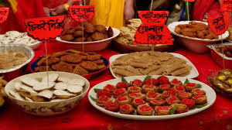
Welcome

Slide 2
Introduction
Teachers Info
Abul kucher
Assistant Teacher, ICT
Bishowanathpur Salameia
Hossaina Dhakil Madrasha
Class Info
Class : Eight
Subject: English 1st Paper
Lesson: ?
Time: 50 minutes

Slide 3
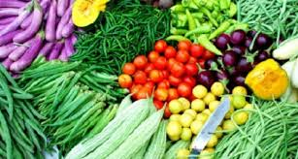
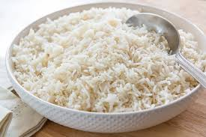
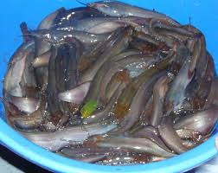
What can you see in these picture?

Slide 4
Bangladeshi cuisine

Slide 5
After this lessons students will be able to…
Identify our traditional food item,
Can write about our famous food,
Write about different winter batches pitha.

Slide 6
Boiled rice is our staple food

Slide 7
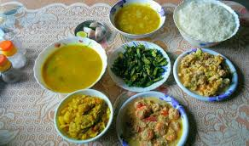
Rice served with vegetables,curry,fish,meat.

Slide 8
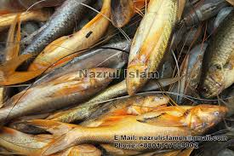
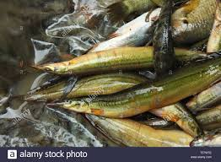
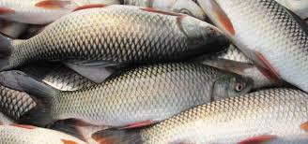
More then 40 type of fishes are common.

Slide 9
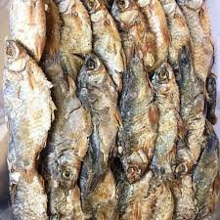
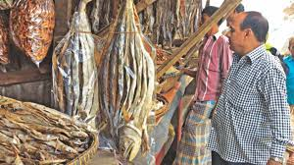
Shutki or dried fishes are popular.

Slide 10
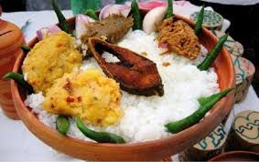
Panta bhat is popular dish on the pohela boishakh.

Slide 11
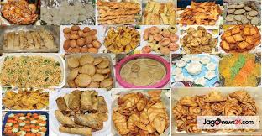
During winter pitha utsab is organized by different people.

Slide 12
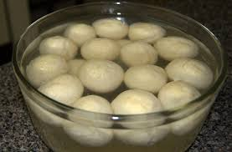
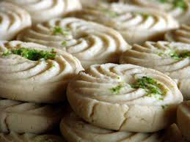
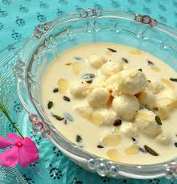
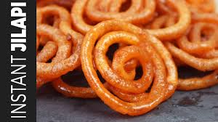
Roshgolla
Sandesh
Rasamalai
Jilapi

Slide 13
GROUP WORK
Explain what has made Bangladeshi food so special.

Slide 14
Homework
Make a list of some of the winter bakeries you know.

Slide 15
Thank You

