Slide 1
WELCOME
TO
MY ENGLISH CLASS

Slide 2
PRESENTED BY
MD.FORHAD HOSSAIN
M.A-English - National University
Assistant Teacher( English)
Louhajang Girls’ Pilot High School,
Louhajang, Munshigonj.
Class : 8
Subject : English

Slide 3
TOPIC’S NAME
EVER BEAUTIFUL SHAMIMA

Slide 4
LET’S PRACTISE
VOCABULARY
words :
outward, vow, disabled, unstitched, dignity, regret, ill-fated, product, grudge

Slide 5
Vocabulary
On or from the outside
outward
Outward beauty is not original beauty.

Slide 6
Vocabulary
vow
A solemn promise
She had a vow to go ahead.

Slide 7
Vocabulary
Without mental or physical ability
disabled
We should help disabled people.

Slide 8
Vocabulary
unstitched
determined
Shamima could prosper because she was unstitched.

Slide 9
Vocabulary
dignity
Honour/pride
Industry is the key to dignity.

Slide 10
Vocabulary
regret
Anger
I have no regret in my life.

Slide 11
Vocabulary
ill-fated
unlucky
The man is ill-fated.

Slide 12
Vocabulary
product
Thing/ crops
We sell our product in the market.

Slide 13
Vocabulary
A long-lasting of ill will/ unwilling to allow/anger/ resent
grudge
Shamima has no grudges .

Slide 14
Open your EFT book (Unit-5, Lesson-3, Page no – )
Read the passage (10mins)

Slide 15
1. Choose the correct answer from the alternatives. i) The word ‘ill-fated’ in the text means……….
a. in the clutch of bad luck b. in the light of good luck c. in the clutch of good luck d . all of the above
ii) The word ‘ ‘organisation’ in the text means……….
a. a body of persons united for different purpose b. a body of persons united for nothing c. a body of persons united for their own purpose d. a body of persons united for a special purpose
iii) The word ‘ ‘helpless’ in the text means……….
a. without help b. affluent c. well to do d. well off
iv) Shamima’s misery started…………
a.from childhood b. after marriage c. from the day of her marriage d. from infancy
v) How was her husband?
a. honest b. dishonest c. greedy d. kind
vi) He used to abused her ……
a. orally b. physically and mentally c. physically d. orally and physically
vii) When did Shamima leave her husband’s house?
a. within a few months b. within few days c. within few weeks d. within few years

Slide 16
1. Choose the correct answer from the alternatives.
i) misery
a. happiness b. comfort c. distress d. ease
ii) greedy
a. miserly b. avaricious c. selfish d. self-centered
iii) abuse
a. well-behaved b. good manner c. cultured d. maltreat
iv) verbally
a. spoken b. orally c. written d. unwritten
v) vow
a. adamant b. stubbornness c. obstinacy d. promise
i) ill-fated
a. lucky b. fortunate c. unfortunate d. opportune
ii) provide
a. offer b. confer c. stop d. supply
iii) design
a. plan b. plot c. devise d. innovate

Slide 17
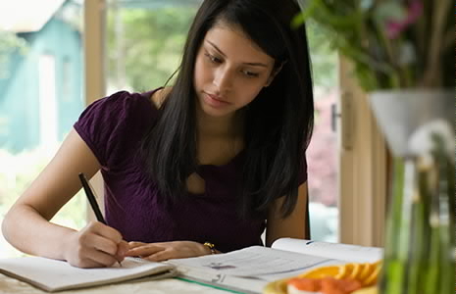
HOME WORK
Write the summery of the passage .

