Slide 1
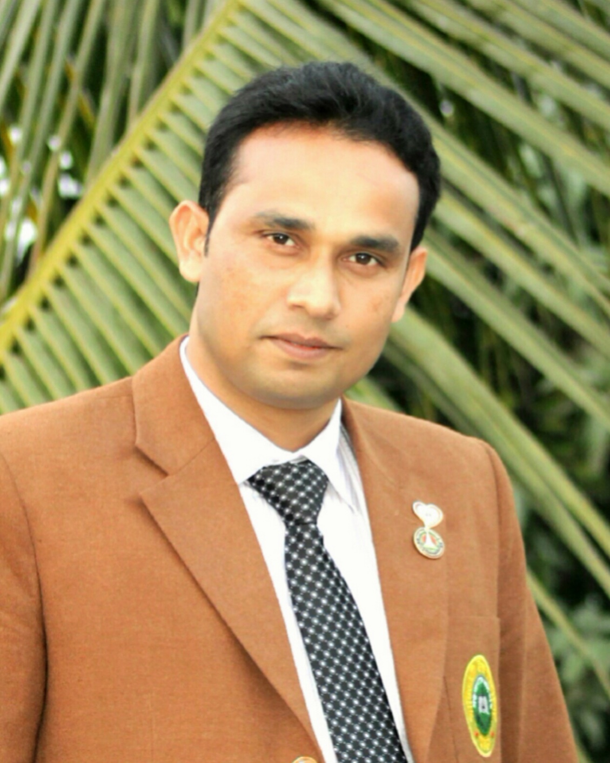
Introduction
Amzad Hossain Shovon
BA (Hons) , MA in English
B.Ed. 1st (Class)
Assistant Teacher
Matidali High School, Bogura.
English 2nd paper
Class- VIII-X

Slide 2
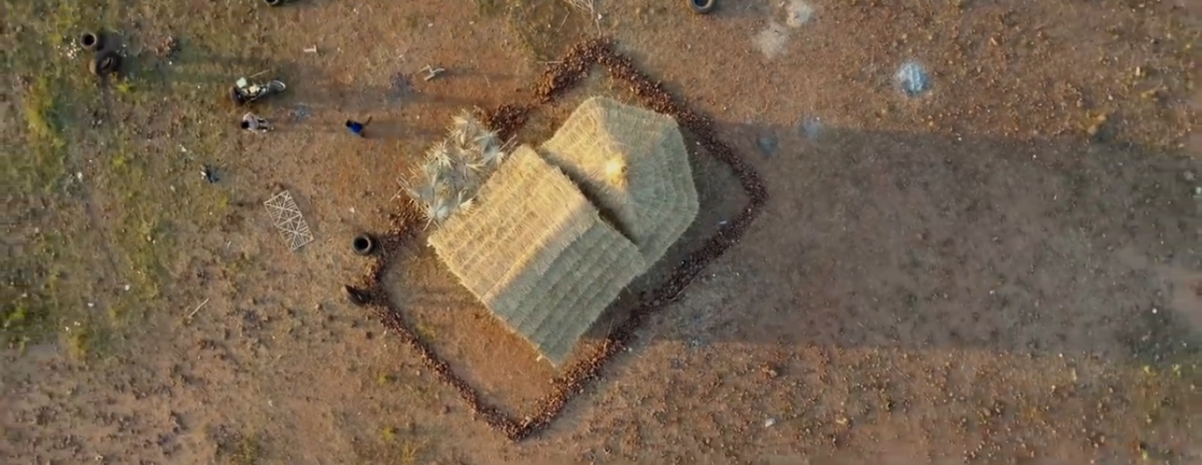
Voice Exercise

Slide 3
SN Series
Lets enjoy a Vedio
Now Exercise

Slide 4
01. Everybody loves him very much. (Passive)
He is loved very much by everybody.
02. Books introduce us to the realm of knowledge. (Passive)
We are introduced to the realm of knowledge by books.

Slide 5
03. We all should read books. (Make it passive)
Books should be read by all of us.
04. We use them for various purposes. (Make it passive)
They are used by us for various purposes.

Slide 6
05. Every student should go through many good books. (Passive)
05. Many good books should be gone through by every student.
06. So, we should never forget this thing. (Passive)
06. So, this thing should never be forgotten..

Slide 7
07. It is called the river of destruction. (Make it Active)
07. People call it the river of destruction.
08. Ruplal wanted a peaceful life. (Passive)
08. A peaceful life was wanted by Ruplal.

Slide 8
09. People of all ages enjoy this game. (Make it Passive)
09. This game is enjoyed by people of all ages.
10. I gladly accepted the invitation. (Passive)
10. The invitation was gladly accepted by me.

Slide 9
11. He is called a hero for his achievement. (Active)
11. People call him a hero for his achievement.
12. Some drastic steps have been taken against corruption (Active
12. Government /The Authority has taken some drastic steps against corruption.

Slide 10
13. The idle only curse their fate. (Passive)
13. Their fate is only cursed by the idle.
14 .Some books give us immense pleasure. (Passive)
14. We are given immense pleasure by some books.

Slide 11
15. The rose is the best of all flowers. (Positive)
15. All love the rose.
16. Some drastic steps have been taken against corruption. (Active)
16. Government/The Authority has taken some drastic steps against corruption.

Slide 12
17. Tourists from home and abroad visit its shore. (Passive)
17. Its shore is visited by tourists from home and abroad.
18. We should follow him. (Passive)
18. He should be followed (by us).

Slide 13
19. It was not invented overnight. (Active)
19. Scientists did not invent it overnight.
20. Industry brings success. (Passive)
20. Success is brought by industry.

Slide 14
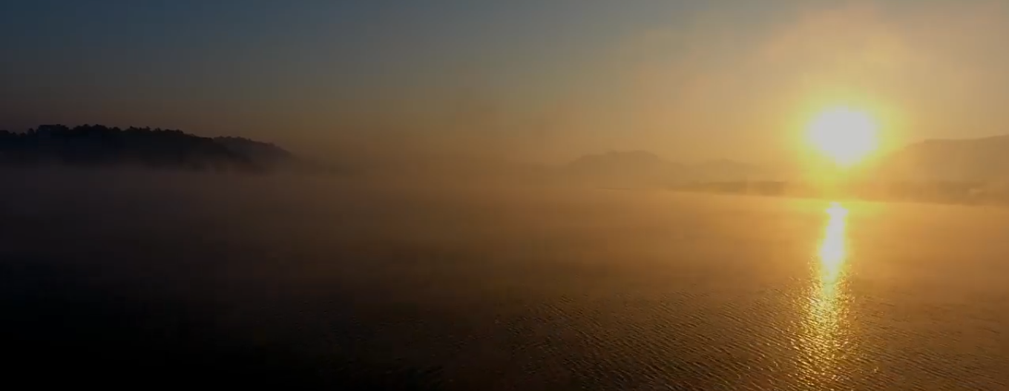
Thank You

