Slide 2
Teacher’s Identity
Mst. Lucky Akhter parveen
Assistant teacher
Bihari Govt.Primary School
Pirgachha, Rangpur

Slide 3
Subject Identity
English For Today
Class: three
Unit: 35
Lesson: 1-3
Time: 45 minutes
Date: 21/12/2019

Slide 4
Learning Outcome
Students will be able to
Listening-4.3.1 enjoy and understand simple stories.
Speaking-3.1.1 ask and answer wh question
Reading- 5.1.1 read simple paragraphs.

Slide 5
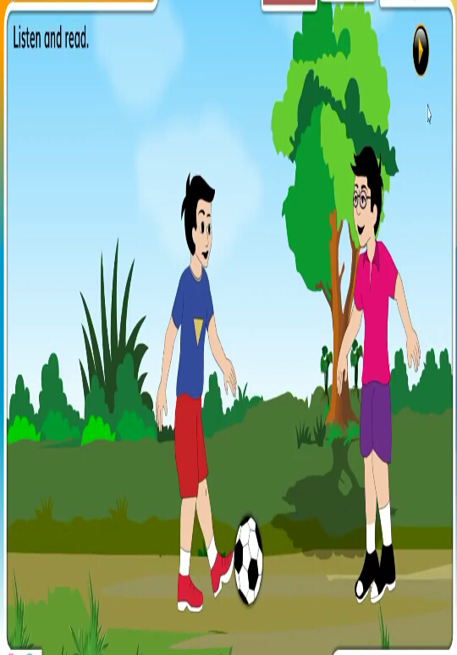
Let’s see the picture

Slide 6
My friend

Slide 7
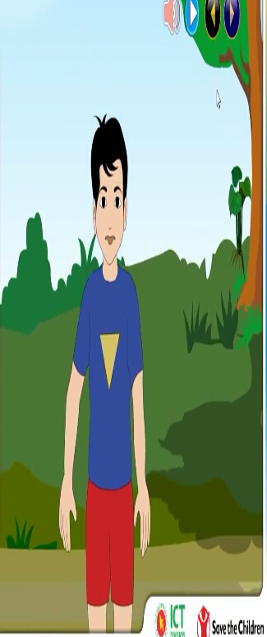
I’m Radif, I’m eight years old.

Slide 8
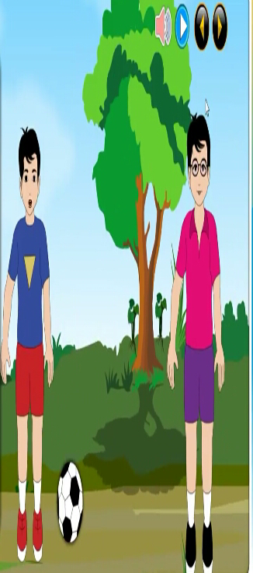
Anik is my best friend.He’s eight years old, too.

Slide 9
We go to Rajbari Primary School.

Slide 10
Anik sits next to me.

Slide 11
In the afternoon, we play football.

Slide 12
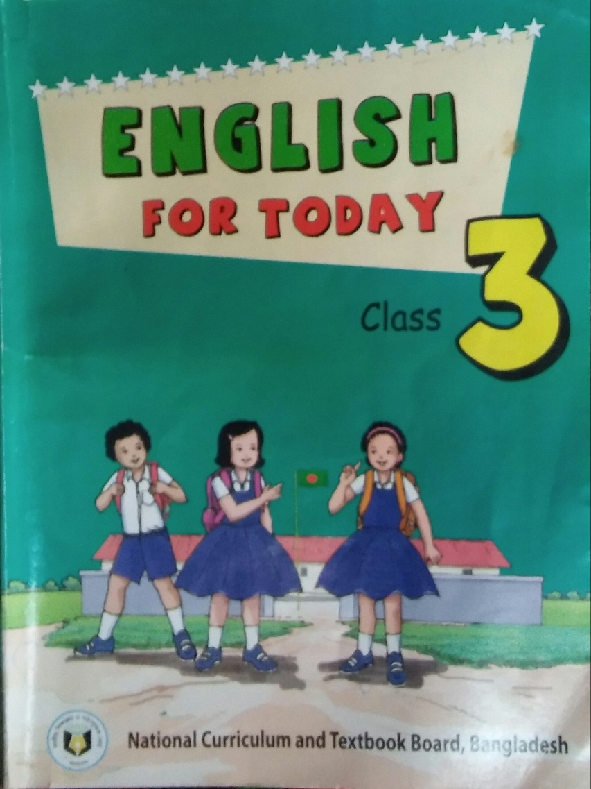
Open your English book at page 31.

Slide 13
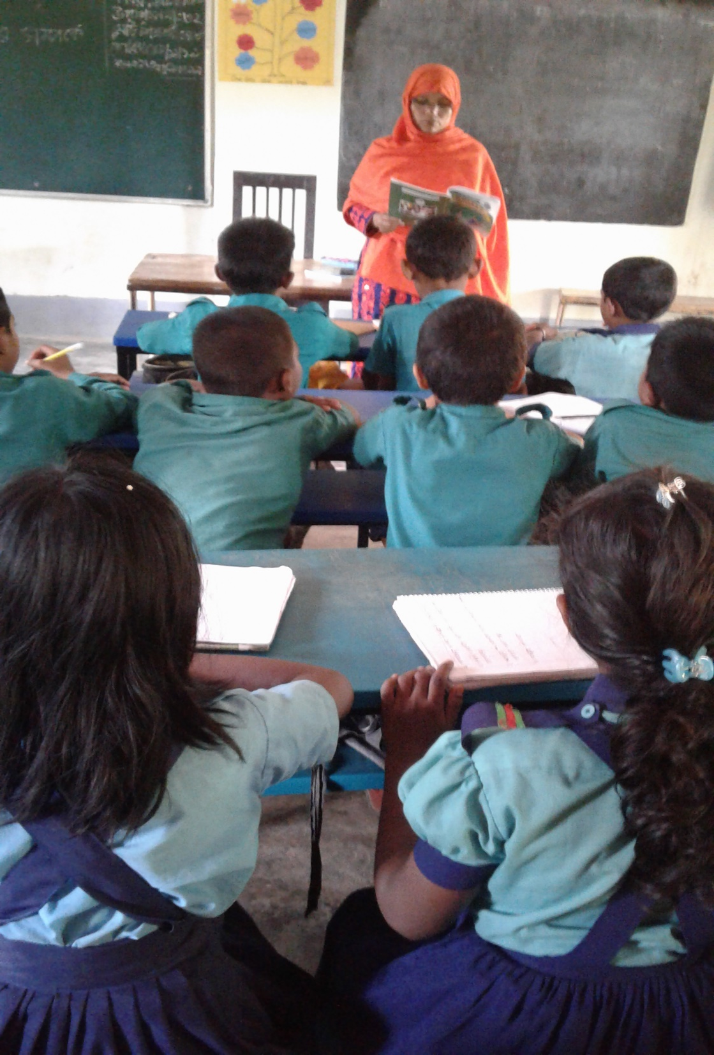
Teacher’s reading.

Slide 14
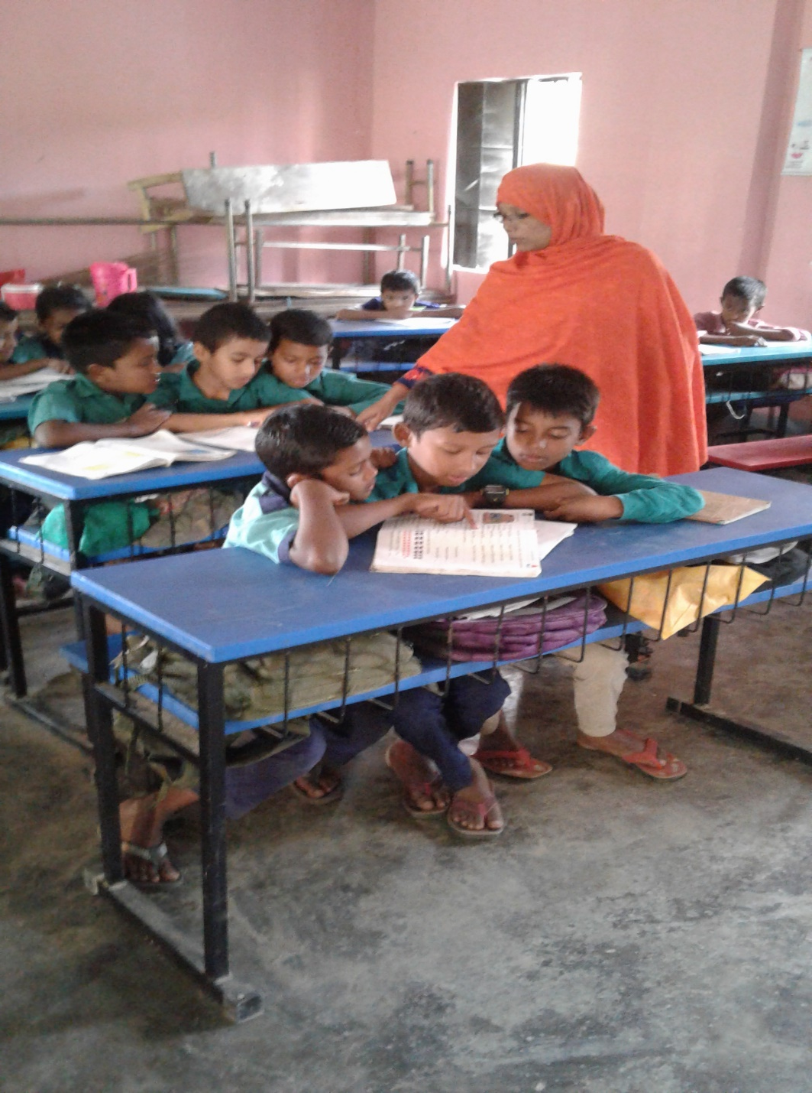
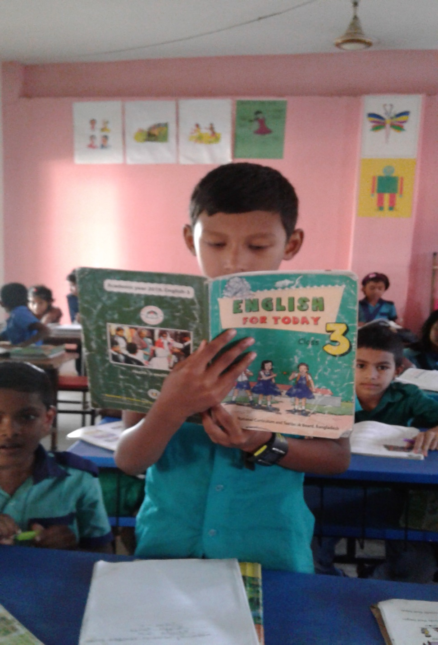
Student’s reading.

Slide 15
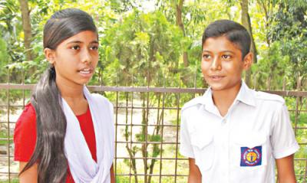
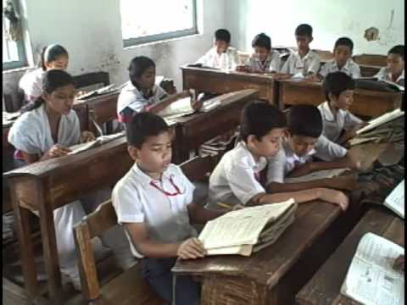
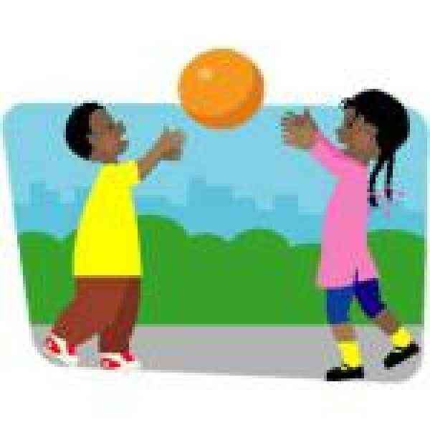
Word meaning
a person you know well and like
friend
a group of students who are taught together
class
to do thing for pleasure
play

Slide 16
Pair work. Read and choose the best answer.
1. Radif is ____ years old.
six b. seven
c. eight d. nine
2. _____ sits next to Radif.
a. Meher b. Kadir
c. Niamat d. Anik
3. Anik is ______ friend.
a. Karim’s b. Radif’s
c. Latif’s d. Jubaer’sPair

Slide 17
Pair work. Read and match the words in of the column ‘A’ with their meaning in column ‘B’.
Column ‘A’ | Column ‘B’
a. old | i. a person you know well and like
b. friend | ii. to move from one place to another
c go | iii. of a particular age
d. primary | iv. to do things for pleasure
e. play | v. developing first
 | vi. men , women and children

Slide 18
Group work. Read and answer the following question.
Who is Radif’s friend?
How old is Radif?
Write about Radif and Anik.
Where does Anik sit?
How old is Anik?

Slide 19
Pair work. Read and fill in the blanks.
1. They go to ________ Primary school.
2.Anik sits _______ to Radif.
3. They are in the _______ class.
Rajbari
next
same

Slide 20
Evaluation
Rearrange the sentences.
Radif, am, i
a, student, am, i
am, eight, i, years, old
are, we, in, the, class, same
football, play, we

Slide 21
Home work.
write a short composition about “ Your friend” at least five sentences.

