Slide 2
Nahid akhtar parvin.
Assistant Teacher
Jagodishpur Government Primary School
Upazila: taragonj.
Dist: Rangpur.
Sub: English Class: Five
Lesson: A Firefighter
Lesson unit:Raju is a firefighter....department

Slide 3
Learning outcomes:
Students will be able to-
Listening :
4.2.1understand and enjoy simple stories
3.4.1understand statements made by the teacher and students.
Speaking:
1.1.2 say sentences with proper intonation.
1.1.1 say words phrasers and sentences with proper sounds and stress.
Reading:
1.7.1 read paragraphs , dialogues stories,letters and other text.
7.1.1 recognize ounctuation marks and read accordingly.

Slide 4
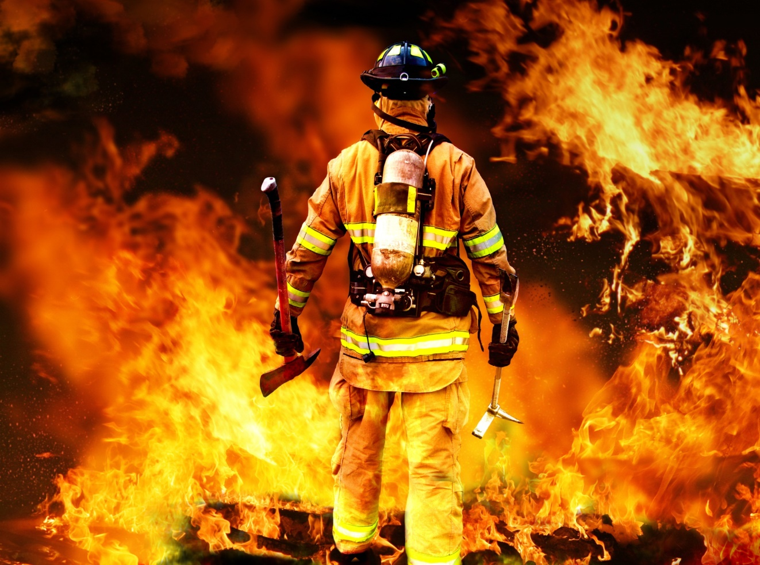
Students look at the picture

Slide 5
Todays leason
A Firefighter

Slide 6
NEW WORDS
Panicked
He got panicked
Put out
He is putting out the fires
Prevent
Prevent fires.

Slide 7
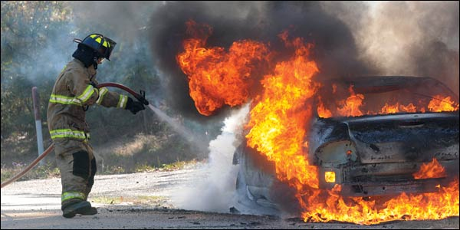
Raju is a firefighter.

Slide 8
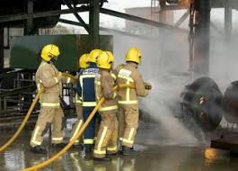
Long time ago, when Raju was in class 5, there was a fire in his school building.

Slide 9
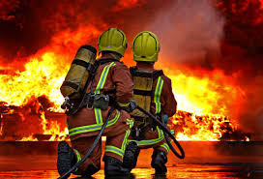
But soon a fire brigade came and put out the fire. Raju could not forget that for many years.

Slide 10
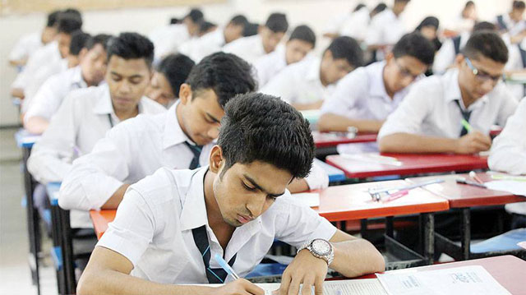
Raju
After finishing HSC, he joined a volunteer fire department.

Slide 11
Now Open your book at page 36.
Read the Text in groups.
Read the text individually one after another.

Slide 12
group -01
1. Make two sentences with the word
Fire,volunteer.
group -02
Answer the question.
Where did the fire take place?
Who put out the fire?.

Slide 13
Evaluation
What is the meaning of panicked?
Who help the students to leave the building.

Slide 14
Home work
Write 5 sentences about a fire fighter
One day one word
Afraid
ভয়
He is afraid to see.

