Slide 1
Kawsar Hyder
ID- 20
Lecturer(English)
Khagrachari Government College

Slide 2
English 1st paper
Class : XI
Time : 45 minutes

Slide 3
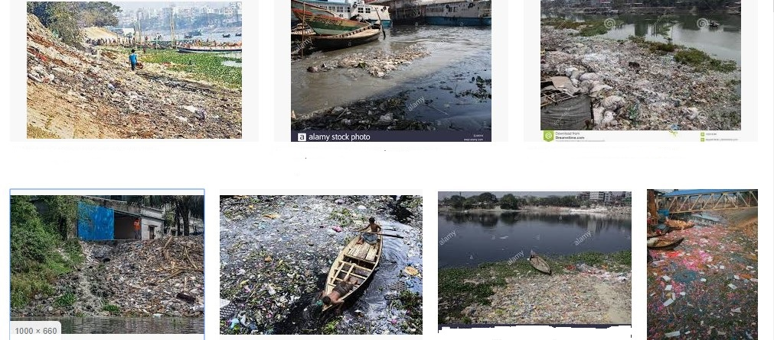
Look at the pictures
What are the pictures about?

Slide 4
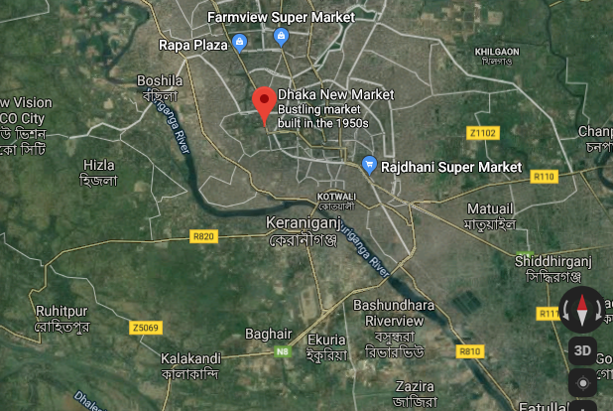
Buriganga

Slide 5
Unit Eight: Environment and Nature
Lesson 1: Water, Water Everywhere
Page: 93

Slide 6
Learning Outcomes
At the end of the lesson Students will be able to-
Define water pollution.
Identify the causes of water pollution.
Say about the transition of Buriganga River.

Slide 7
Buriganga in the past
- The Mughals marveled at the tide level
- founded their capital Jahangirnagar on its banks(1610)
- one of the sources of supplied drinking water
- supported trade and commerce.
Now watch a vedio

Slide 8
Group Work
Why did the Mughals establish their capital on the bank of buriganga?
Why is the river, Buriganga, dying?
How can we save the river?

Slide 9
Buriganga is dying because of
pollution
Huge quantities of toxic chemicals and wastes from
-mills and factories,
-hospitals and clinics
-households and other establishments
The city of Dhaka discharges
about 4500 tons of solid waste every day
- 20,000 tons of tannery waste, including some highly toxic materials every day.

Slide 10
Individual Task
Now read the text and make a flow-chart showing the transition of Buriganga river. One is given for you.
Read the passage and answer the following question
1. Marvelous tide level. |  | 2. |  | 3. |  | 4. |  | 5. |  | 6.

Slide 11
Evaluation
1. Who established capital on the bank of Buriganga?
2. What was the position of Buriganga in the past?
3. What is water pollution?
4. Tell us two causes of pollution in Buriganga.

Slide 12
Home work
Read the text again and write a summary of the text.

Slide 13
Any Question?
Moral of the day
No matter what is your size,
Saving water is wise

