Slide 2
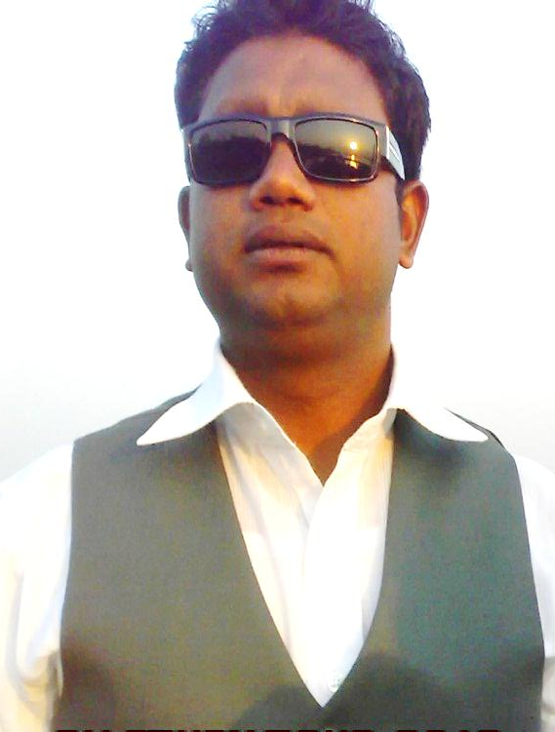
PRESENTED BY
MD.FORHAD HOSSAIN ( m. a)
Assistant Teacher( English)
Louhajang Girls’ Pilot High School,
Louhajang, Munshigonj.

Slide 3
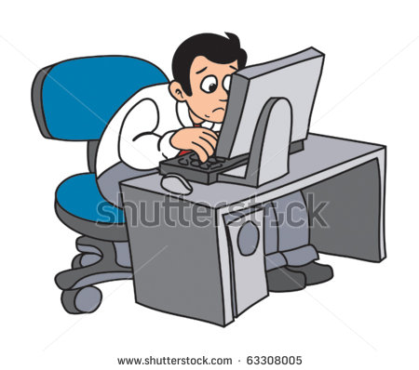

Slide 4
Knowledge, skills and attitudes
Topic’s Name………?
Unit: One Lesson:2
Time: 5o Minutes.

Slide 5
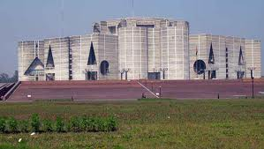
VUCBULARY
Constitution
Rules of governing
The government should maintain the constitution of the country.

Slide 6
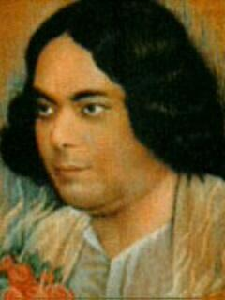
literature
Written articles ( poem, novel, story, drama, essay , etc.)
Kazi Nazrul is a shining star in the sky of Bangla literature.

Slide 7
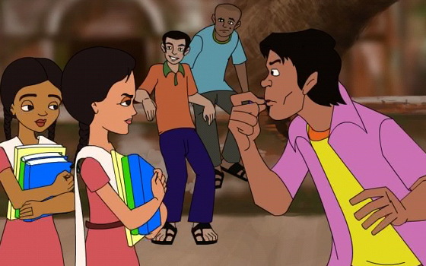
attitudes
Look/ Vision/ feelings / thinking
We should change our bad attitudes.

Slide 8
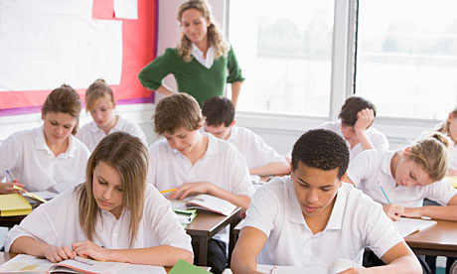
monitor
Supervise /check
A teacher monitors the activities of his students.

Slide 9
widow
Woman whose husband is dead
A widow leads a miserable life.

Slide 10
Skills
Ability to do work
We should have different Skills to be a good citizen.

Slide 11
Read
the text
silently
and
carefully
Unit-One
Lesson-2
10 mins

Slide 12
Evaluation

Slide 13
1.Choose the best answer from the alternatives. 1× 7 = 7
i) You have to prepare yourself. Here, what part of speech is prepare ?
a) Noun b) pronoun c) verb d) adverb
ii) Modern technology is closely related to the life of a ............... .
a) farmer b) fisherman c) good citizen d) thief
iii) a good citizen is an ............... to his country.
a) obstacle b) asset c) anger d) all of the above

Slide 14
iv) A student should know about …… in the class room.
a) home work b) group work c) reading d) writing
v) Through regular group work, we can get noticeable .................. in our behavior.
a) changes b) money c) gold d) wealth
VI) Group work can help to .................the class-room fruitful.
a) made b) make c) making d) makes
vii) Bangladesh needs ........................... .
a) Good citizens b) bad citizens c) dishonest men d) postmen

Slide 15
2. Answer the following questions. 2×5 = 10
(a) What should a citizen have to lead a good life ?
(b) Why is group work important for a student ?
(c) Why does a person needs skills ?
(d) What is the first thing that a good citizen should have ?
(e) What will show your attitudes towards others?

Slide 16
Home work
Write a short paragraph
on A good citizen.

