Slide 1
WELCOME

Slide 2
Farzana chowdhury
Assistant teacher
Norpati government primary school
Laksam,cumilla.
E-mail:sorna67m@gmail.com

Slide 3
Lesson declaration
Class Two
Subject ; English
Unit :26
Lesson:in the/at

Slide 4
Learning outcomes
Students will be able to -
Listening :
1.1.1 become familiar with English sounds by listening to common English words.
Speaking :
1.1.1 repeat after the teacher simple words and phrases with proper sounds and stress.
1.1.2 say simple words and phrases with proper sounds and stress.

Slide 5
Lets sing a song

Slide 6
In the
morning

Slide 7
In the
afternoon

Slide 8
In the
evening

Slide 9
at
night

Slide 10
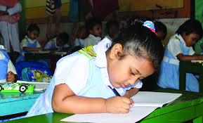
Individual work
Match the picture with the words
afternoon
night
morning
evening

Slide 11
rominng
terfnoona
nievegn
hting
Morning
Afternoon
Evening
night

Slide 12
Make sentences with the words
I have breakfast
in the morning
morning
afternoon
I play in the afternoon

Slide 13
I do my homework in the evening.
evening
I brush my teeth
at night.
night

Slide 14
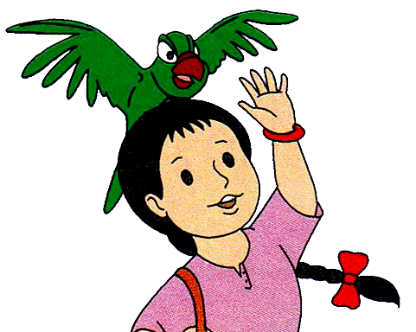
Bye bye
See you tomorrow

