Slide 1
Dear Students, welcome to my class

Slide 2
Teachers’ identity
MD Farid Uddin gazi
Headteacher
Dhaka Match Industries Secondary School,Khulna
Class-10
Unit-8
Lesson-1
Time-50 minutes

Slide 3
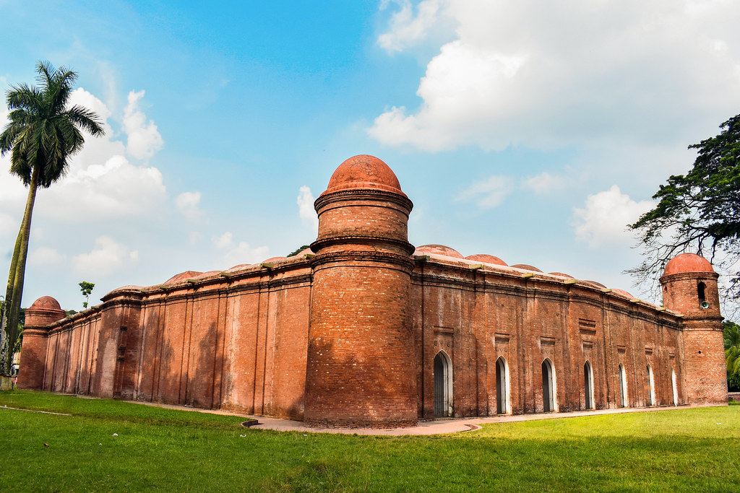
What do you see in the picture?
Shat Gambuj Mosque

Slide 4
Our today’s lesson is-
The Shat Gombuj Mosque

Slide 5
Learning outcomes
After we have studied this lesson, we will be able to-
Read and understand text
1. Ask and answer questions
2. Describe a place.

Slide 6
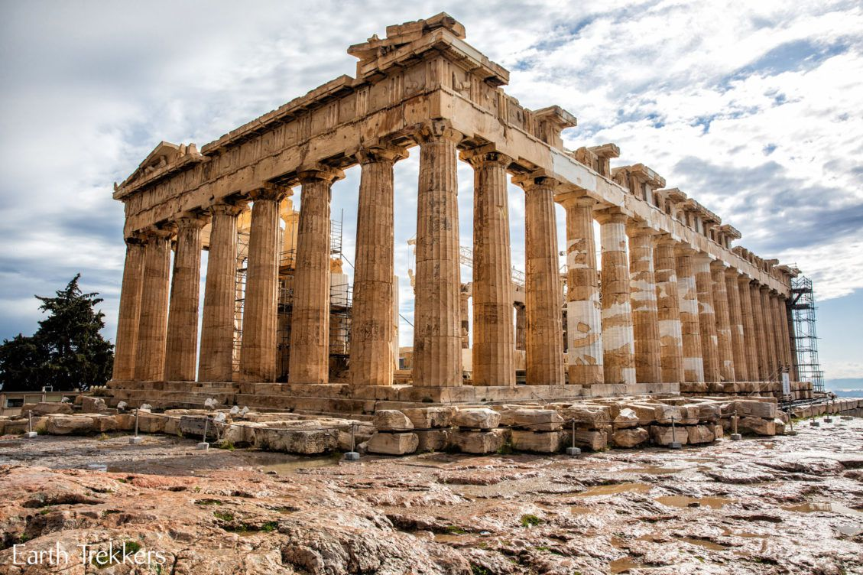
Inheritance, patrimony, legacy
Heritage
Thick, heavy, condensed
Dense

Slide 7
Dome ---গম্বুজ, দালান,ভবন,অট্টালিকা। Mihrab--- মসজিদের পশ্চিম পাশে কাবা নির্দেশকারি জায়গা। Colony--- জায়গা, অঞ্চল,আবাসস্থল।

Slide 8
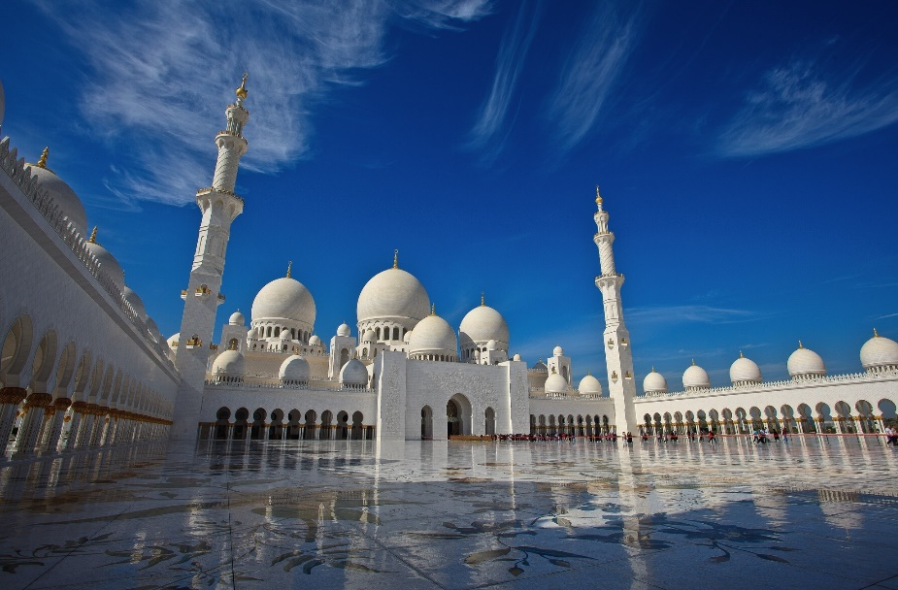
Mangrove
A tree found in tropical or sub-tropical tidal area
Islamic architecture
A piece of work done by Muslim architect.
Monuments

Slide 9
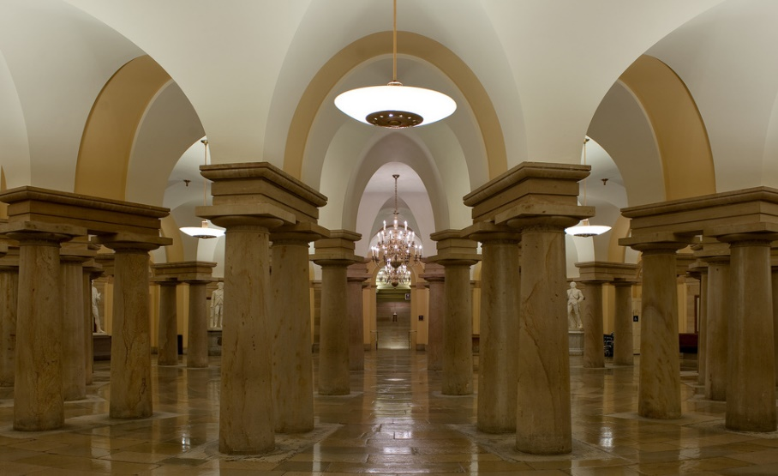
Reservoir
Pool, lake , pond
Columns
Pillar, post, poll

Slide 10
Teacher’s loud reading

Slide 11
Read the following text and answer the following questions-
Shat Gambuj Mosque is the largest of the Sultanate mosques in Bangladesh and one of the most impressive Muslim monuments in the whole of the Indian subcontinent. It is ascribed to one Khan Al-Azam Ulugh Khan Jahan, who conquered the greater part of southern Bengal and named the area khalifatabad in honour of the reigning Sultan Nasiruddin Mahmud shah (1435-59). The mosque is unique in the sense that it has 60 pillars that support the roof, with 77 low height domes. The 4 towers at 4 corners have smaller domes on the roof as well. The vast prayer hall has 11 arched doorways on the east and 7 each on the north and south for light and ventilation. It has 7 aisles running along the length of the mosque and 11 deep curves between the slender stone columns. These columns support the curving arches created by the domes. The thickness of the arches is 6 feet and have slightly narrowing hollow and round wall. The west wall in the interior has 11 ‘mihrabs’ The interior and the exterior of the mosque give a view of rather plain architecture but the interior western wall of the mosque is’ beautifully decorated with terracotta flowers and foliage. Besides being used as a prayer hall the mosque was also used as the court of Khan Jahan Ali. Now it is one of the greatest tourist attractions and best architectural beauties of Bangladesh.

Slide 12
Individualwork
Shat Gombuj Masque a)_ a world heritage site in 1985 b)_ UNESCO. The historic Mosque city c)_ as Kholifatabad. It was d)_ by the Turkish, Ulugh Khan Jahan in the 15th century. Backed bricks e)_used for the construction.
Answer- a) Has been declared b) by c) is known d) founded e) are

Slide 13
Pairwork
What is heritage?
What is world heritage?

Slide 14
Groupwork
Shat Gombuj Mosque | Information
Founded by
Situated
Number of domes
Number of pillars
Used for
Ulugh Khan Jahan Ali
Bagerhat, not very far from Mangrove forest.
77 low heights domes
60 pillars
Prayer hall as well as court

Slide 15
Evaluation
What do you mean by heritage?
When did Shat Gombuj Mosque become a world heritage site?
Where is it situated?
What did Khan Jahan Ali build in the city?
What is the most remarkable work of Khan Jahan Ali?
Answer-
a) Heritage means what we inherit from the past, live with in the present and then pass on to our children or future generation.
b) Shat Gombuj Mosque became a world heritage site in 1985.
c) It is situated at the outskirts of Bagerhat town.
d) Khan Jahan Ali Built a network of roads, bridges, public buildings and reservoirs to make the city habitable.
e) The most remarkable work of Khan Jahan Ali is Shat Gombuj Mosque?

Slide 16
Homework
Write a paragraph on the Shat Gambuj Mosque within 100 words.

Slide 17
Thank you everyone

