Slide 1
Notes for the teachers
Dear colleagues,
I like to request you to follow the instructions below the note options before going to the class so t hat the class may be effective to the students.

Slide 2
Welcome

Slide 3
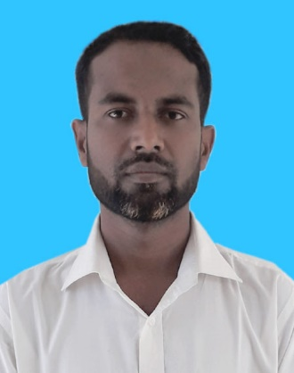
Introduction
Zakir Hossen
Lecturer in English
Bhulkara islamia alim Madrasah
Chouddagram,Cumilla
Mobile-01818-71 39 09
Email-zakirhossen78@gmail.com
English for today
Class 11-12

Slide 4
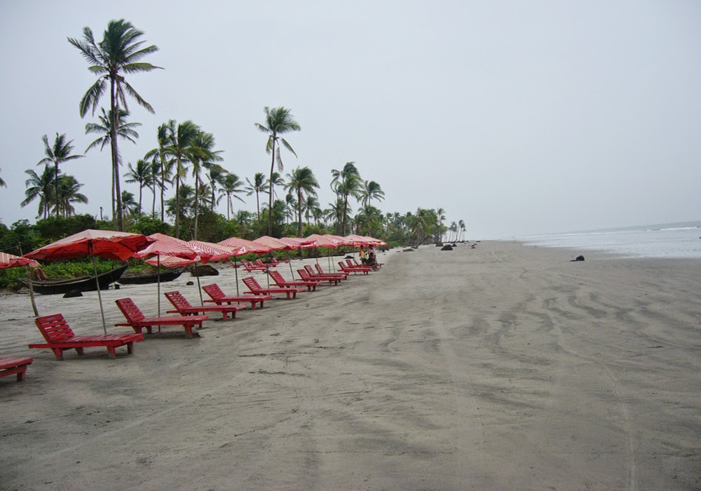
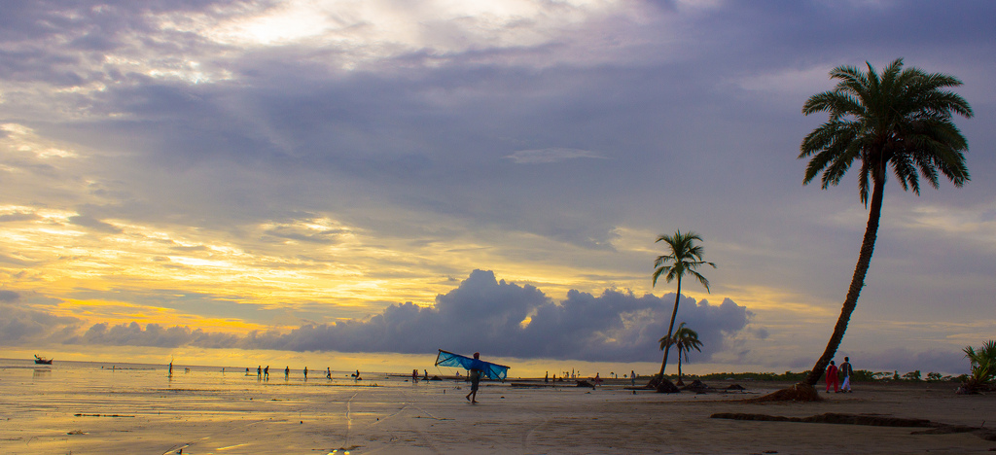
What do you see in the pictures?
Scene of sea beaches
Notes:
By this image students will be thoughtful about the picture.

Slide 5
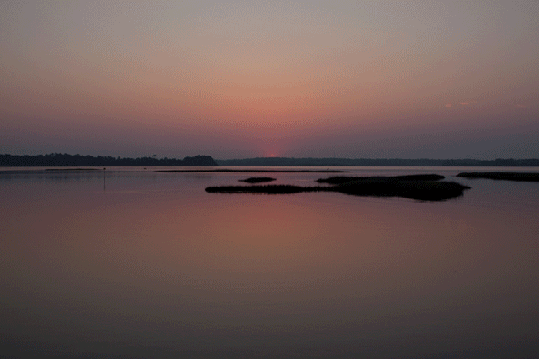
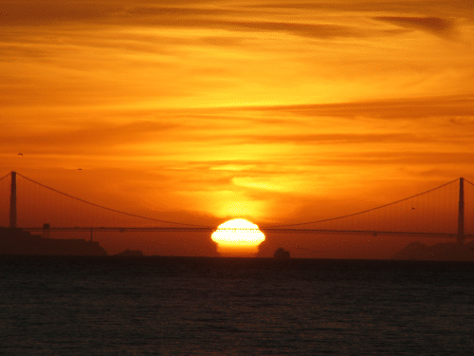
The Unique Feature of Kuakata Sea Beach…
Scene of sunrise
Scene of sunset
Kuakata sea beach offers the full view of the sunrise and sunset.
Notes:
By this image students will be thoughtful about the picture.

Slide 6
Todays topic is-
Kuakata: Daughter of the Sea
Notes:
Teacher will write down the topic on the board and also tell the student to write on their note book.

Slide 7
Learning outcomes
By the end of the lesson SS will be able to-
Read and understand the text through silent reading;
Read aloud make sounds with stress;
Read text silently for comprehension.
Notes:
Learning outcomes should be read out by the students. Teacher can hide this slide, if he wants.

Slide 8
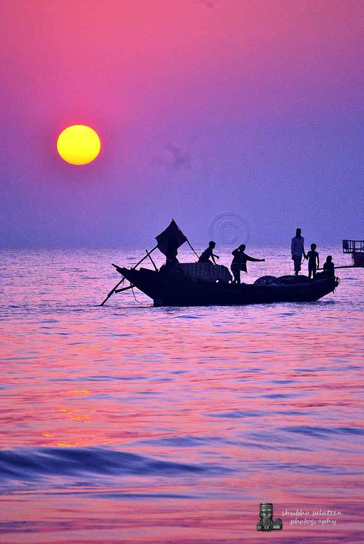
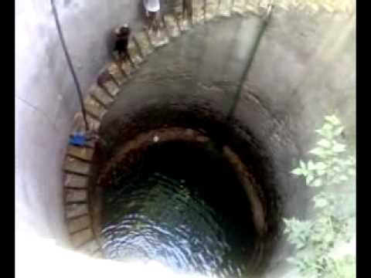
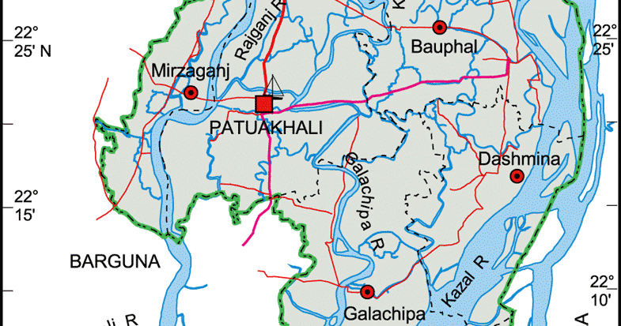
Introduction to Kuakata...
Kuakata is situated in Patuakhali district. It is 30 km long & 6 km wide. It is 70 km away from Patuakhali District headquarters & 320 km from Dhaka.
The name Kuakata comes from the story of a ‘Kua’ dug by the early Rakhains.
Notes:
Student will be able to get some information about Kuakata before reading text.

Slide 9
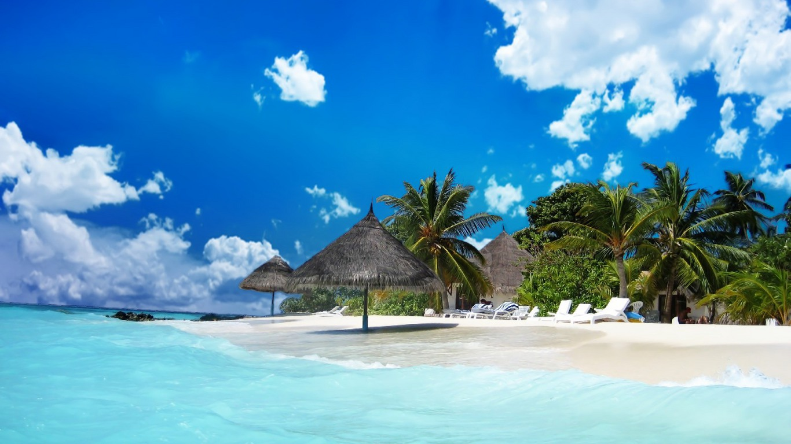
Scenic
Relating to beautiful natural scenery
Notes:
Teacher will try to get the answer from the student then give the meaning and image.

Slide 10
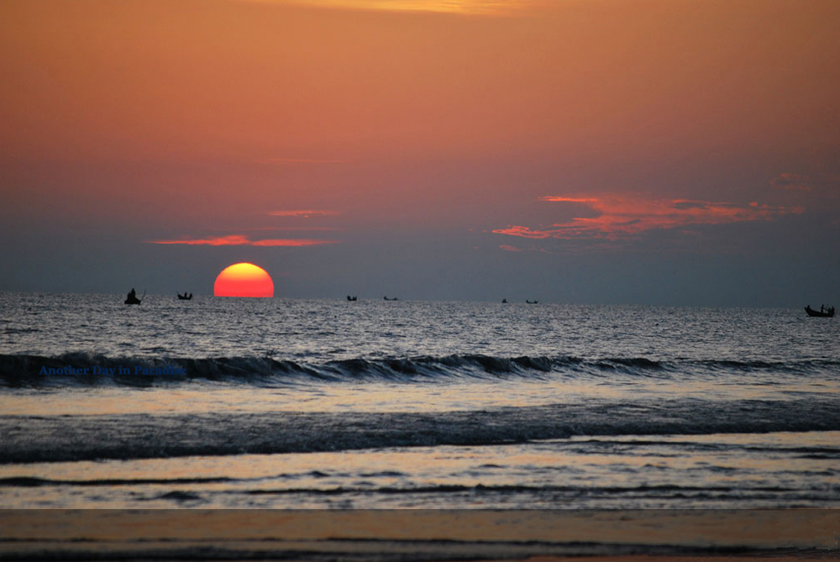
Expanse
A large, open area of water
Notes:
Teacher will try to get the answer from the student then give the meaning and image.

Slide 11
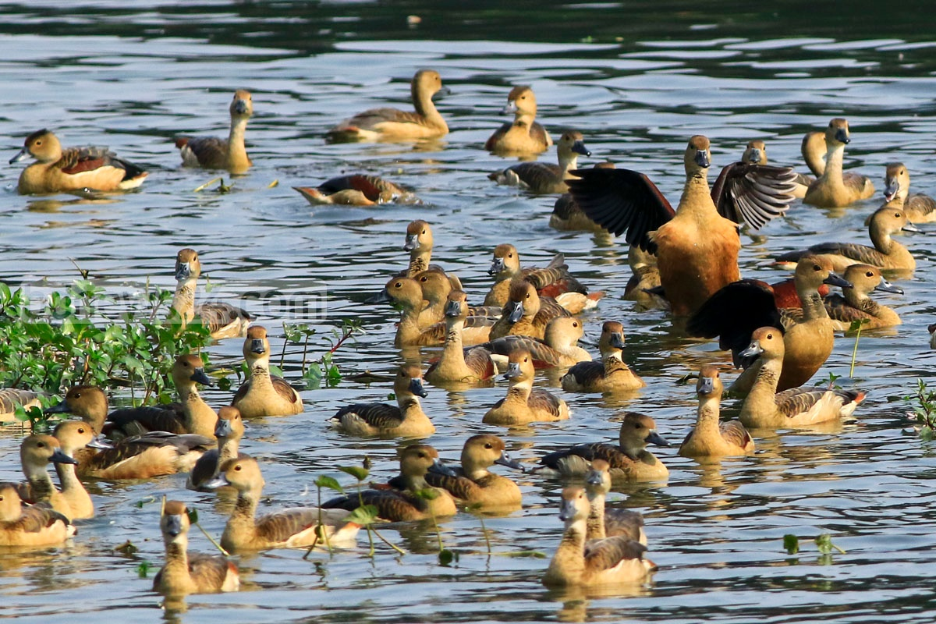
Sanctuary
A safe place or birds and animal
Notes:
Teacher will try to get the answer from the student then give the meaning and image.

Slide 12
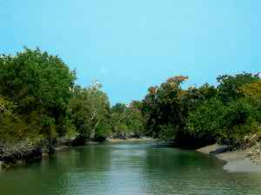
Panorama
A view of a wild area
Notes:
Teacher will try to get the answer from the student then give the meaning and image.

Slide 13
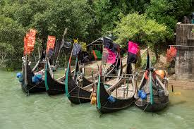
Devotee
A person who admires a person or a place or an object
Notes:
Teacher will try to get the answer from the student then give the meaning and image.

Slide 14
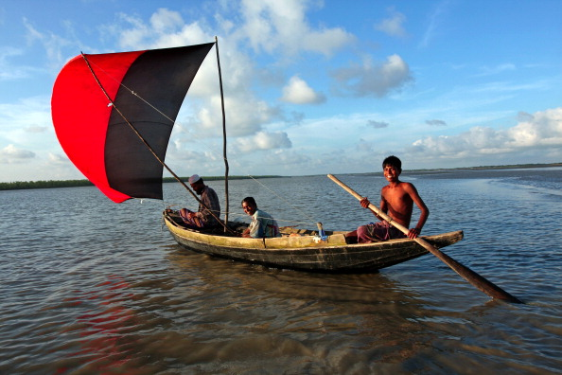
Pilgrimage
A visit to a holy or special place
Notes:
Teacher will try to get the answer from the student then give the meaning and image.

Slide 15
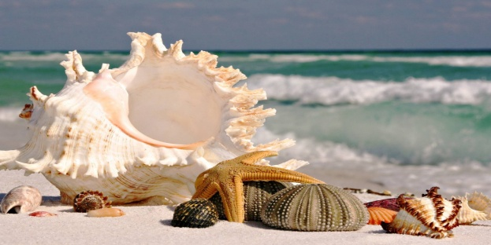
Well
A deep hole of water in the ground
Notes:
Teacher will try to get the answer from the student then give the meaning and image.

Slide 16
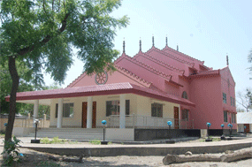
Homestead
A house or living abode
Notes:
Teacher will try to get the answer from the student then give the meaning and image.

Slide 17
Pre-reading
Dear students, you will read the first Para and
try to find out the answer of the question silently.
Where is Kuakata located?
How long is Kuakata Sea beach?
How does the beach look like?
Notes:
Students will read the passage individually and try to find this questions answer.

Slide 18
While reading
Dear students, Now read the whole passage and try to write down the answer the question given below..
Where does the name ‘Kuakata’ come from?
What is the most uniqe features of Kuakata beach?
What are some traditional events that take place in Kuakata?
Notes:
Students will do the work in pair and write down the answer in their notebook. Teacher will help them to find the answer of the questions.

Slide 19
Post reading
Read the following text again and fill in the gaps with appropiate words.
sandy | sunrise | Dhaka | natural | gentle | devotees
tip | migrating | communities | holy | seabeach | enjoy
Kuakata is a panoramic sea beach situated on the southern most (a)………. of Bangladesh. It is located in Patuakhali. It has, a wide (b)……. beach from where one can see both the (c)……. and sunset. It is about 320 kilometers south of (d)…. and about 70 kilometers from the district headquarters. The long and wide beach at kuakata has a tropical (e)……. setting. This sandy beach has (f)……. slopes into the Bay of Bengal. Kuakata is also a sanctuary for (g)…… winter birds. Kuakata is the place of pilgrimage for both Hindu and Buddhist (h)……. . Innumerable (i)…… arrive here at the festival of Rash Purnima and Maghi Purnima. On these two occasions the pilgrimage takes (j)……. bath at the bay and participate in the traditional fairs and enjoy very much.
Notes:
Students will do the work in group and try to solve the question from their understanding.
Teacher will play the role of a monitor.

Slide 20
EVALUATION
Patuakhali
1. Where is kuakata located?
2. Where does the name Kuakata come from?
Kua
3. What is the most unique features of Kuakata sea beach?
The Scene of sunrise & sunset
4. What are the traditional events that
take place in kuakata?
Rash Purnima & Maghi Purnima

Slide 21
Home Work
What do these words mean in the context they have been used in the text:
a. expanse
b. unique
c. virgin
d. indigenous
e. devotee
f. heritage

Slide 22
Thank you

