Slide 1
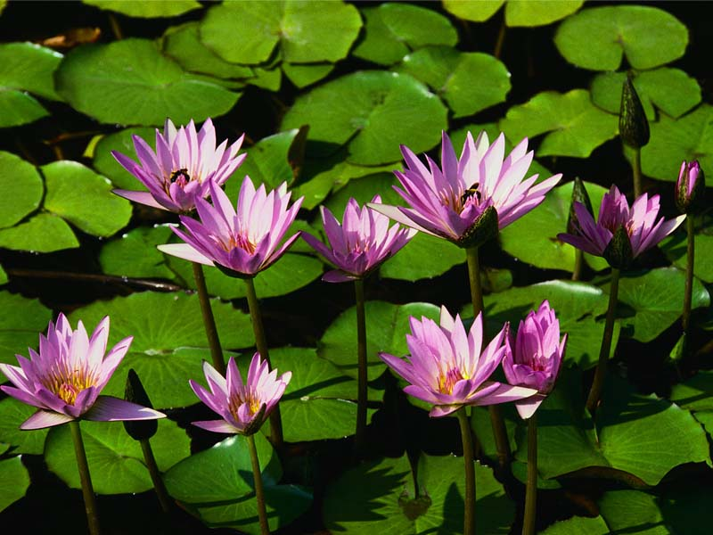
Welcome

Slide 2
Teacher’s Introduce
Lesson Introuduce
Class:Five
Subject:English
Unit: 15
Lesson: (1) Happy Birthday
Time:60 minutes
Laily Akter
Assistant Teacher
Fulgaon Govt. primary School,
Laksam, Comilla.

Slide 3
Let’s watch a video.
https://www.youtube.com/watch?v=pf0wzf2oSog
What do you see in the video?

Slide 4
Lesson Declaration
Happy Birthday
A person’s birthday………..friends and family.

Slide 5
Learning outcomes
Students will be able to:
Listening: 3.3.1 understand question about objects around them.
Speaking: 1.1.2 say sentences with proper intonation.
Reading: 1.7.1 read paragraphs, dialogues, stories, letters and others texts.
Writing: 10.1.1 write a short piece of composition by answering a set of question.

Slide 6
What do you see in the picture?
Birthday party.

Slide 7
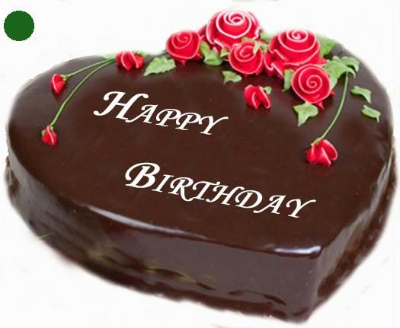
What do you see in the picture?
Birthday cake.

Slide 8
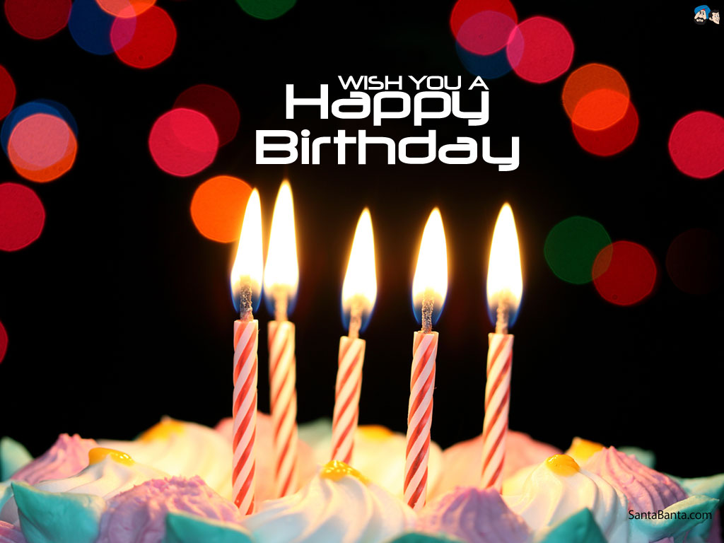
What do you see in the picture?
Candle

Slide 9
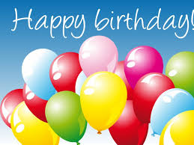
What do you see in the picture?
Belon

Slide 10
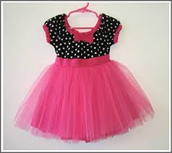
What do you see in the picture?
New cloth

Slide 11
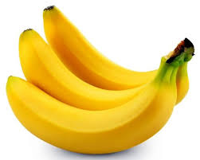
What do you see in the picture?
Special foods.

Slide 12
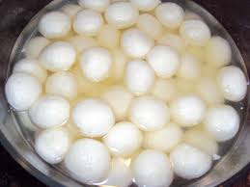
What do you see in the picture?
Sweets

Slide 13
What do you see in the picture?
Birthday Gifts.

Slide 14
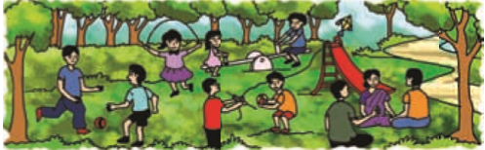
What do you see in the picture?
Play games

Slide 15
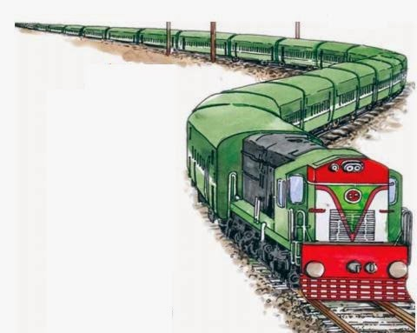
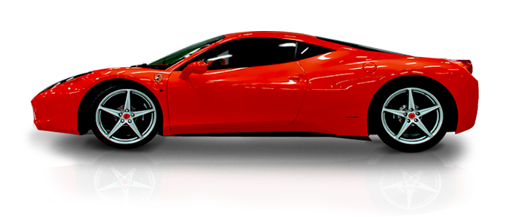
What do you see in the picture?
Different toyes

Slide 16
Birthday celebration
Birthday Cake
Candle
Birthday party
Special foods
Sweets
Birthday gifts
Toyes
New cloth
Play games

Slide 17
New words
Special
Memorable
Enjoy
Pleasure
Celebrate
Make happy
Important
Serious
Spend
Pay out

Slide 18
Now open your English book page No-58.
Listen to me carefully and put your finger under the line.
Read the text silently.

Slide 19
Group work
Cake Group
Write 5 sentences a birthday party.
Sweet Group
How make celebration a birthday party write 10 words.

Slide 20
Evaluation
Write a short composition in 5 sentences about “Your birthday” by answering the following questions.
1.What is a birthday?
2.Who arranged the party?
3.How do you celebrate this day?
4.Who attend the party?
5.What is your feeling about your birthday?

Slide 21
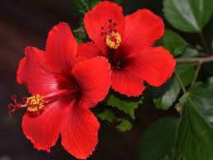
Thanks everybody
Goodbye

