Slide 1

Welcome to all
Notes:
Teacher can say it orally

Slide 2
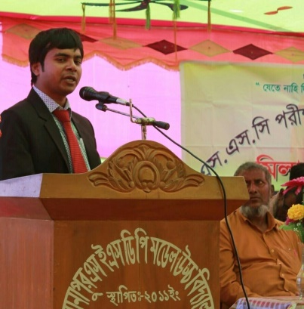
Identity
Emdadul Haque Milon
B.A hons in English M.A,B.ed
Assistant Teacher in English
Sonapur SESDP Model High School
Dowarabazar,Sunamganj
English For Today
Class : Six.
Lesson 8
Notes:
Teacher can hide this slide.

Slide 3
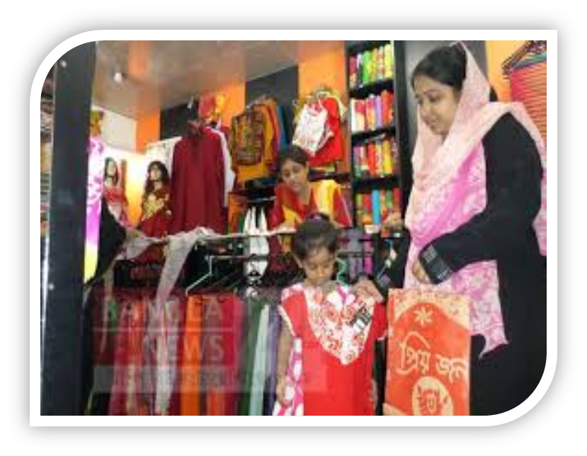
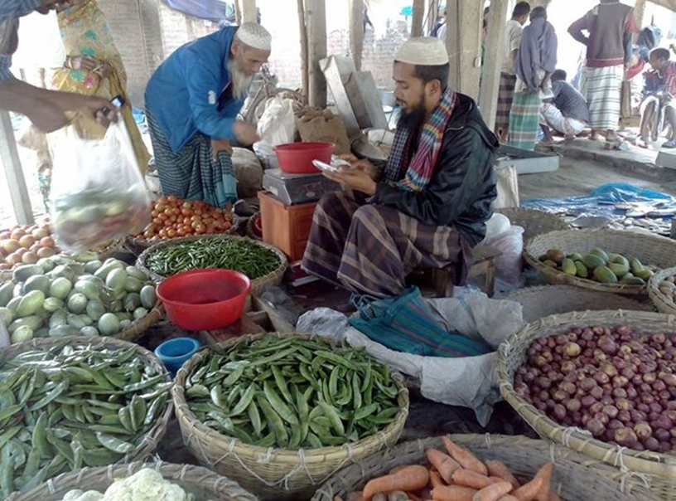
Look at the pictures
What are they doing ?
Notes:
This slide only for mind set up. Teacher can ask another questions for class arrange.

Slide 4
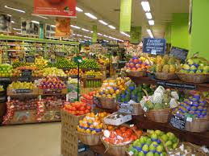
Today`s topic
Grocery Shopping
Lesson: 8(2)

Slide 5
Learning outcomes
After completing the lesson students will be able to…
Participate in short dialogues and conversations on familiar topics
use word stress on words in sentences
read and understand texts
ask and answer questions

Slide 6
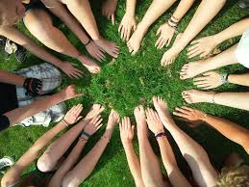
Model reading by the teacher.
How many shops did Imran go?
How many oil did Imran buy?
Why do you think Imran asked the salesman to use a paper bag?
Notes:
Teacher will give model reading. Closing book students will hear it.

Slide 7
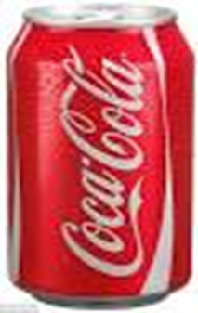

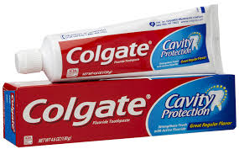
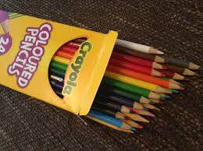
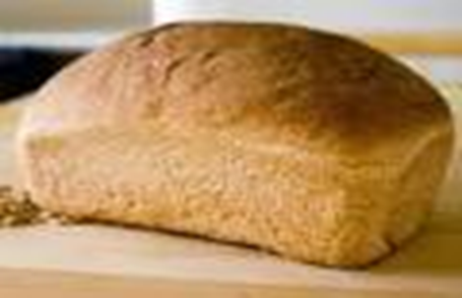
We usually say about quantities ....
A can of coke.
A sheet / roll of poster paper.
Notes:
After showing the slide teacher will go to next slide for evaluation.

Slide 8
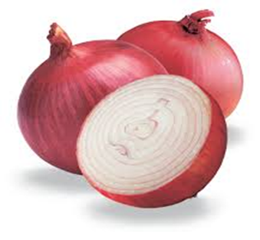
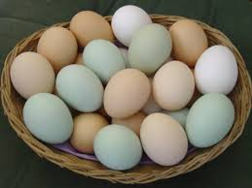
Now, look at the pictures and discuss in pairs how do you ask about quantities when you go shopping.
Example : Please, give me 1kg onion.
Notes:
After showing the pictures T will ask and try to elicit the answer from the students. If they fail then T will give feedback by clicking.

Slide 9
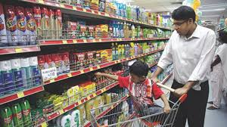
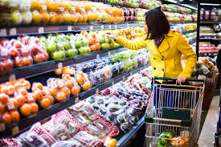
Pair Works
Make imaginary shopping list and discuss with your partner which items are available in what kinds of shops that shown below.
Grocer`s shop
Stationer`s shop
Notes:
Teacher can give one example for every shops.

Slide 10
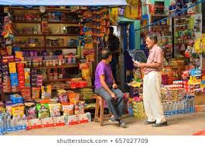
Look at the bellow pictures and make sentences using ‘some’ and ‘any’.
You can give me any one pen.
Feedback : - I have got some books.
Have you got any fruits ?
Notes:
After showing the pictures T will ask and try to elicit the answer from the students. If they fail then T will give feedback by clicking.

Slide 11
Grammar Focus
Use of `Some’ and `Any’.
We use `some’ with positive statement.
Example : I have got some suggestions.
I need some books.
We use `any’ with negative statement.
Example : I haven’t got any suggestion.
I don’t see any student there.
We also use `any’ with questions.
Example : Have you got any suggestion ?
Is there any water in the jag ?
Notes:
Teacher will discuss the points one by one.

Slide 12
Points to remember :
‘Some’ and ‘Any’ are used with countable and uncountable noun. After ‘some’ noun must be plural but after ‘any’ noun may be singular or plural.
Structure :
Sub + verb + some + plural number of noun.
Sub + helping verb + not + main verb + any + singular or plural number of noun.
Example: There are some boys and some girls.
I haven’t got any pen to write with?
Are there any eggs in the basket?
Notes:
Teacher will discuss the points one by one.

Slide 13
Pair works.
Now go to section ‘E’ and fill in the blanks with ‘some’ or ‘any’
Notes:
Student will do the task and teacher will monitoring the class. Only for feedback teacher will go to next slide.

Slide 14
Compare with your answer
Fill in the blanks with ‘some’ or ‘any’
Are there ……………….. Flowers in the garden ?
Yes, these are …………….. Roses and …………….. Lilies.
What about jasmine ? Are there ……………….. Jasmines ?
No, there aren’t ……………….. Jasmines.
Do you have ………………… idea why I ‘m asking you all these ?
any
some
some
any
any
any
Notes:
Teacher can use blackboard for evaluation

Slide 15

Home works.
Make a imaginary shopping list with quantity for grocer’s, baker’s and stationer`s.
Notes:
Teachers can give some instructions to do the home task.

Slide 16

Good Bye
Notes:
Teacher can say it orally.

