Slide 1
Wel Come
What is liberalism and what are its characteristics ?
Khandoker Mufakkher Hossain

Slide 2
What is liberalism and what are its characteristics ?

Slide 5
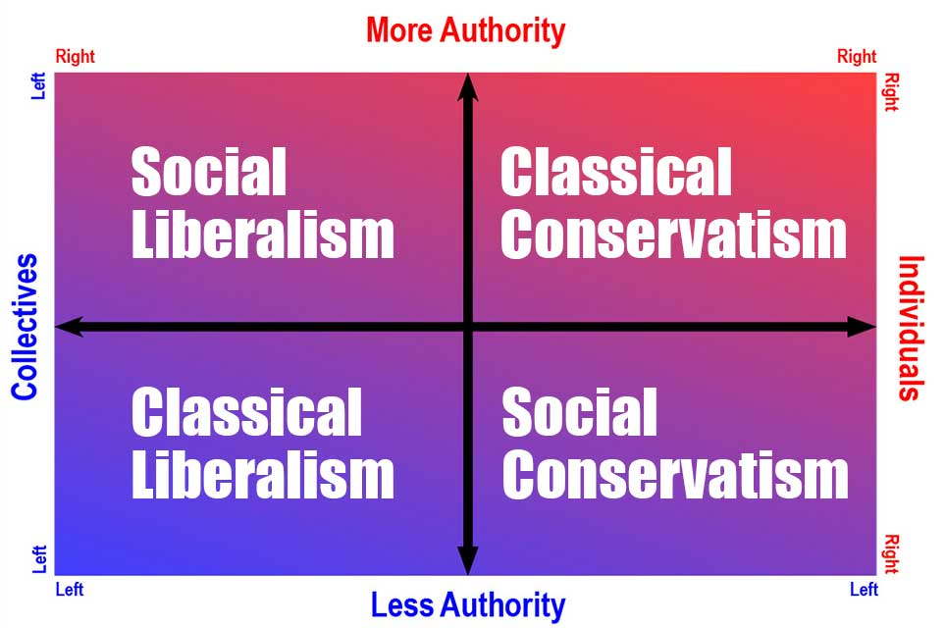

Slide 7
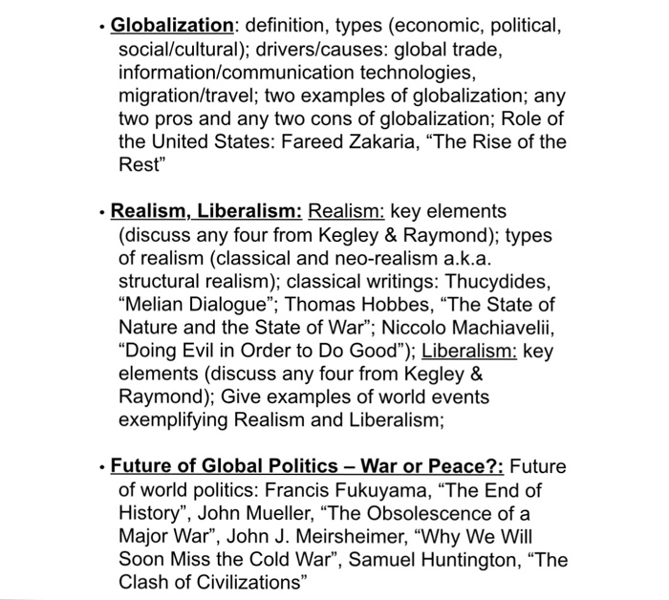

Slide 12
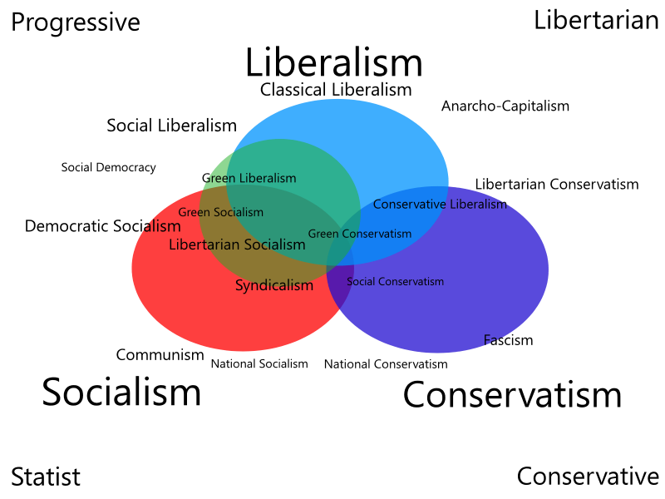

Slide 18
Liberalism is too dynamic and flexible a concept to be contained in a precise definition. Right from its inception, it has been continuously changing, adding something and discarding the other.

Slide 19
As Alblaster writes, ‘liberalism should be seen not as a fixed and absolute term, as a collection of unchanging moral and political values but as a specific historical movement of ideas in the modern era that began with Renaissance and Reformation.

Slide 20
It has undergone many changes and requires a historical rather than a static type of analysis. ’Similarly, Laski writes, ’it (Liberalism) is not easy to describe, much less to define, for it is hardly less a habit of mind than a body of doctrine’.

Slide 21
To quote Hacker, ‘Liberalism has become so common a term in the vocabulary of politics that it is a brave man who will try to give it a precise definition.

Slide 22
It is a view of the individual, of the state, and of the relations between them’. Almost the same view is expressed by Grimes, ‘liberalism is not a static creed or dogma, for dogmatism provides its own restraints.

Slide 23
It is rather a tentative attitude towards social problems which stresses the role of reason and human ingenuity…liberalism looks ahead with a flexible approach, seeking to make future better for more people, as conservatism looks back, aiming mainly to preserve the attainment of the past. ’

Slide 24
Characteristics of classical liberalism:
I) A belief in the absolute value of human personality and spiritual equality of the individual;
II) A belief in the autonomy of the individual will;
III) A belief in the essential rationality and goodness of man;

Slide 25
characteristics of classical liberalism:
IIV) A belief in certain inalienable rights of the individual, particularly, the rights of life, liberty and property;
V) That state comes into existence by mutual consent for the purpose of protection of rights;
VI) That the relationship between the state and the individual is a contractual one;

Slide 26
VII) That social control can best be secured by law rather than command;
VIII) Individual freedom in all spheres of life-political, economic, social,Intellectual and religious;
IX) The government that governs the least is the best;
X) A belief that truth is accessible to man’s natural reason.

Slide 35
Thank You

