Slide 3
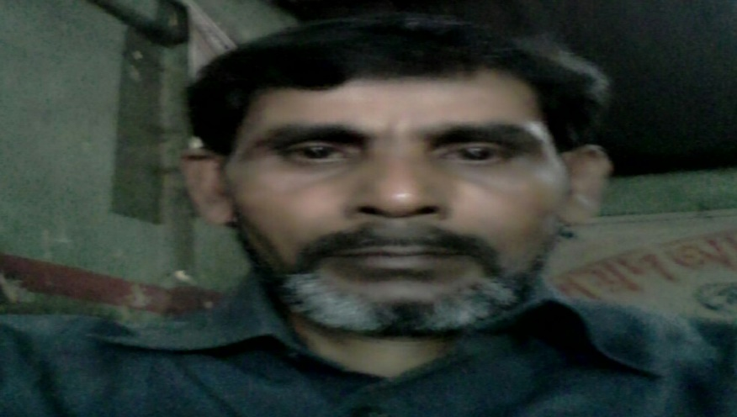
MD ABUL KASHEM
ASSISTANT TEACHER
LAKESHOR DAKHIL MADRASA
CHATAK SUNAMGONJ
O1786498922

Slide 4
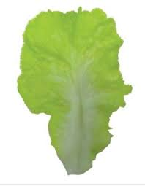
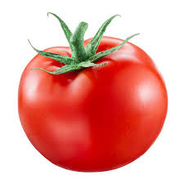
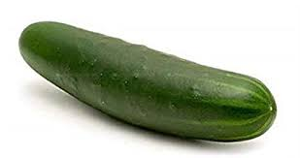
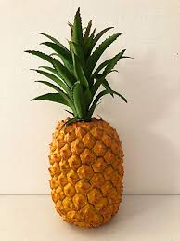
Healthy food
Lettuce
Tomato
Cucumber
Pineapple

Slide 5
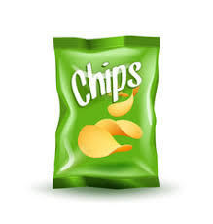
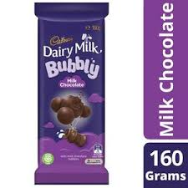
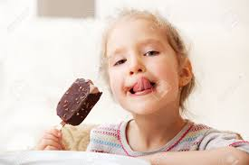
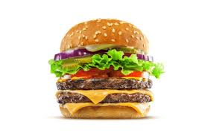
Unhealthy food
Chips
Chocolate
Barger
Ice-cream

Slide 6
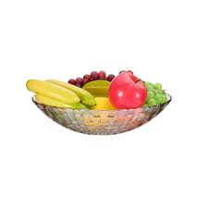
Lesson introduce
What food should we eat ?

Slide 7
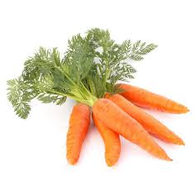
Word meaning
Tomato
টমেটো
Cucumber
শশা
Lettuce
লেটুস পাতা
Pineapple
আনারস
Carrots
গাজর

Slide 8
Let us see some pictures
থালায় ফলমুল

Slide 9
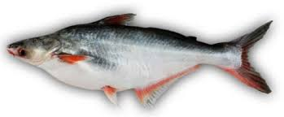
Fish

Slide 10
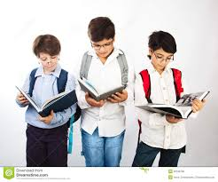
Group work
Write your note book
Chips , Pineapple , Barger , Lettuce , Chocolate , Cucumber , Ice-cream , Tomato ,

Slide 11
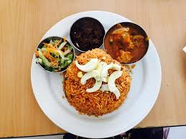
What did you see the picture ?

Slide 12
Look at the picture and say

Slide 13
Look at the picture . Do you like it ?

Slide 14
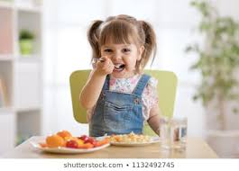
Home work
Writfoods are healthy food ?
Chips , Tomato , Chocolate , Pineapple , Barger , Lettuce , Ice-cream , Cucumber.
e your note book .Which

