Slide 1
Today’s TOPIC:
GOOD FOOD
UNIT- 2
LESSON- 1

Slide 2
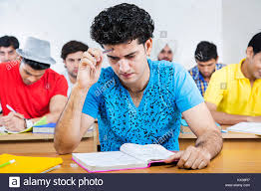
Open the page number 11 and read the passage silently for 10 minutes

Slide 3
Let’s introduce with some nutritious foods
Nutritious
Foods
Milk
Vegetable
Fruit
Grain
Meat
Fish

Slide 4
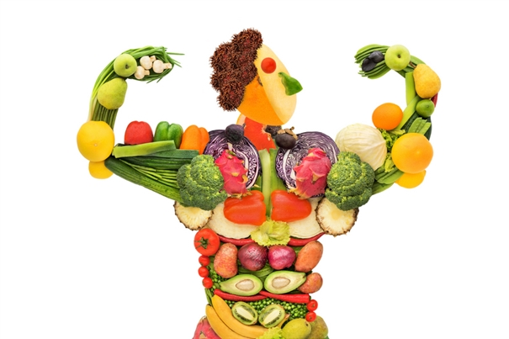
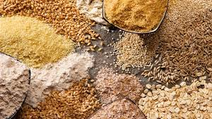
Let’s introduce with some nutritious foods
Some Nutritious foods
One kind of nutritious food named grain

Slide 5
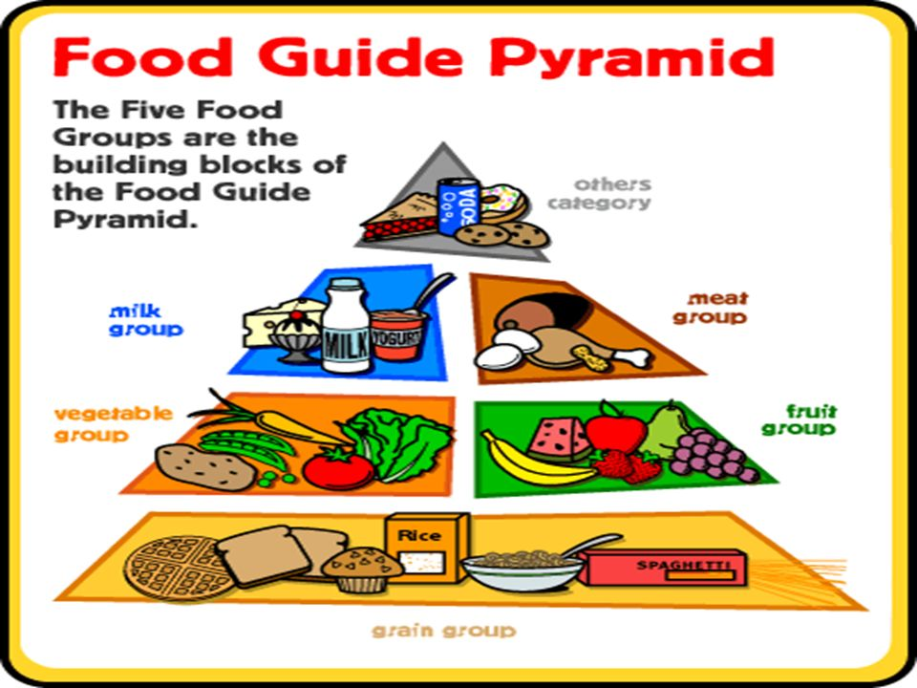
Let’s see the picture

Slide 6
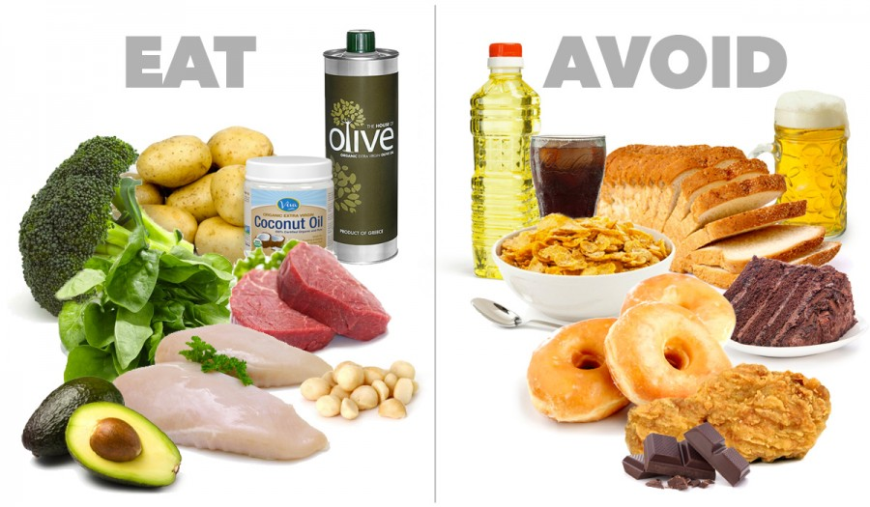
Let’s see the picture

Slide 7
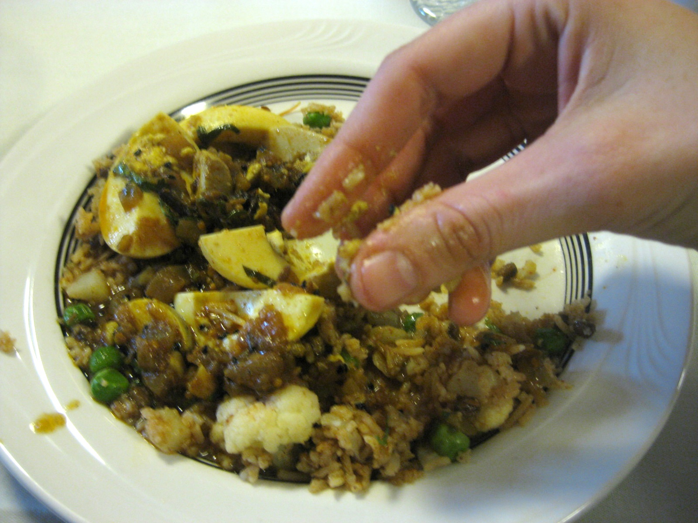
Let’s see the picture and finally decide which food we should eat.
We should eat good food to maintain good health.

