Slide 1
Learning outcomes
After we have studied this lesson, we will be able to-
Listen for specific information
Read and understand text
Ask and answer questions
Describe a place.

Slide 2
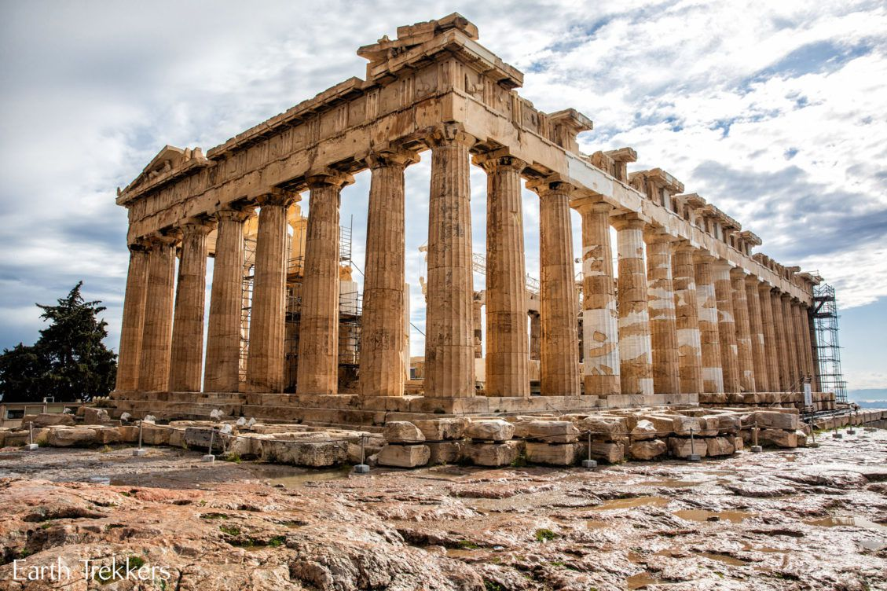
Inheritance, patrimony, legacy
Heritage
Thick, heavy, condensed
Dense

Slide 3
Individual work
Shat Gombuj Masque a)_ a world heritage site in 1985 b)_ UNESCO. The historic Mosque city c)_ as Kholifatabad. It was d)_ by the Turkish, Ulugh Khan Jahan in the 15th century. Backed bricks e)_used for the construction.
Answer- a) Has been declared b) by c) is known d) founded e) are

Slide 4
Pair work
Shat Gombuj Mosque | Information
Founded by
Situated
Number of domes
Number of pillars
Used for
Ulugh Khan Jahan Ali
Bagerhat, not very far from Mangrove forest.
77 low heights domes
60 pillars
Prayer hall as well as court

Slide 5
Homework
Look at the picture of the Star Mosque in Dhaka. Read the information and write a description of the mosque with the help of the given clue.
Location: Dhaka, Abul Khairat Road
Style: Mughul
Number of domes: 5
Decoration: Different sizes of stars on dome and outside wall
Materials used for decoration: chinaware and white cement
Interior of the mosque: mosaic floor, floral tiles on the wall
Built by: Mirza Ghulam pir, a respected Zamindar of Dhaka
Time: early 18th century

