Slide 1






Slide 2
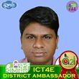
Introduce
Md. Sulyman Hossain
Asst. Teacher(ICT)
Alhaj Amena Kaatun Bidyapith
Kalukhali,Rajbari.
01303800430
Class: Six
Subject: English 2nd paper

Slide 3
Adjectives

Slide 4
Learning Outcomes
By the end of the lesson students will have…
explained what an adjective is.
identified adjectives from a text.
matched adjectives with pictures
made a list of adjectives
used adjectives to describe someone/ something

Slide 5
What is adjective?
An adjective is a word that describes/qualifies a noun or a pronoun.

Slide 6

Worried
Angry
Sad
Sleepy
Happy

Slide 7
Rina: Hello Baba. Good morning.
Father: Good morning dear. How are you?
Rina: I am fine, Baba. How is everyone there?
Father: They are okay. Tell about your exam?
Rina: Hey Baba, the hard days of exams are over. But, I did well.
Father: That’s like a brilliant girl.
Rina: Baba, I have seen an excellent purple dress in a nearby market. Can I buy that for our next festival?
Father: Festival is far ahead. But, you are already in festive mood. Okay, you can buy that one. Hope that will not be much expensive.
Rina: No Baba and thanks.
Father: You are welcome.
Rina: You are too good. Bye, Baba.
Father: Bye and take care.

Slide 8
Rina: Hello Baba. Good morning.
Father: Good morning my dear. How are you?
Rina: I am fine. How is everyone there?
Father: They are okay. Tell about your exam?
Rina: Hey Baba, the hard days of exams are over. But, I did well.
Father: That’s like a brilliant girl.
Rina: Baba, I have seen an excellent purple dress in a nearby market. Can I buy that for our next festival?
Father: Festival is far ahead. But, you are already in festive mood. Okay, you can buy that one. Hope that will not be much expensive.
Rina: No Baba and thanks.
Father: You are welcome.
Rina: You are too good. Bye, Baba.
Father: Bye and take care.

Slide 9

Act out the dialogue with your partner

Slide 10
Individual work
Find out some adjectives individually with which you can describe your classmates.

Slide 11
Adventurous Awesome Bold Brave Caring Confident Curious dependable dynamic Enthusiastic Fascinating Hardworking Helpful
honest important interesting…..

Slide 12
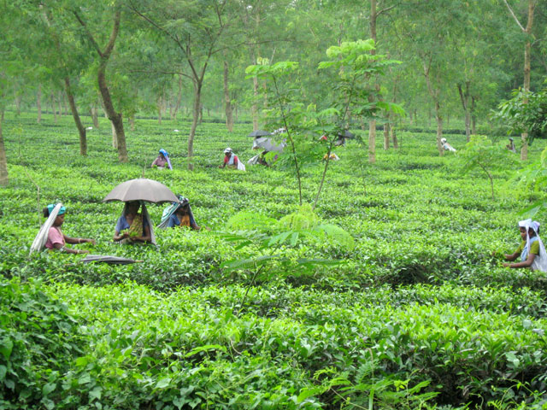
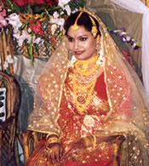
Tea garden is a shady place.
                Rita looks gorgeous.

Slide 13

This place is sunny.

Slide 14

I saw a very clear rainbow.

Slide 15
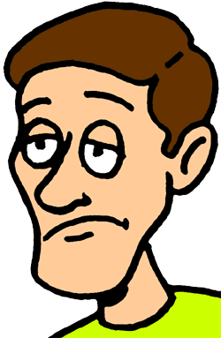
Are you tired today?

Slide 16
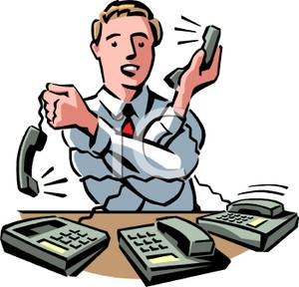
Rajib has to receive too many phone calls.

Slide 17

The gift was very surprising.

Slide 18
Work with your partner and write five sentences about your favourite person using some adjectives.

Slide 19

Describe your home within five sentences using some adjectives.

Slide 20


