Slide 2
This session is conducted by
Indrajit Chakravorty
Assistant Head Master
Gegum Gul Chemonara Academy
Chandanaish, Chittagong.
email: bheds06@gmail.com
Cell phone no: 01819949355

Slide 3
English For Today
Class – Eight
Time: 50 Minutes

Slide 4
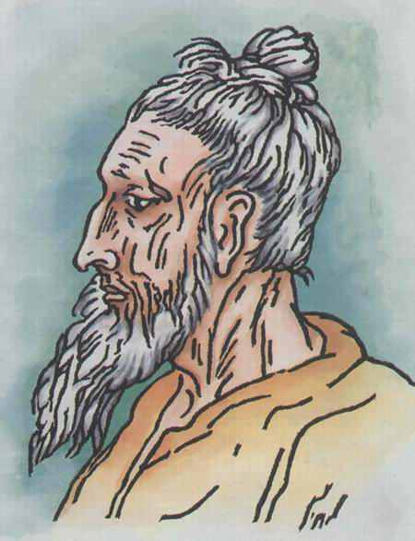
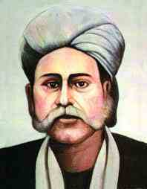
Look at the picture
Lalon Shah
Hason Raja

Slide 5
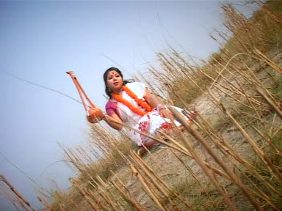

Slide 6
Our folk songs
Unit-One, Lesson-1
Page No-02

Slide 7
Objectives
After studied this unit, we will be able to
read and understand texts through silent reading
infer meaning from context
ask and answer questions
write short compositions
Notes:
This slide is only for teacher

Slide 8
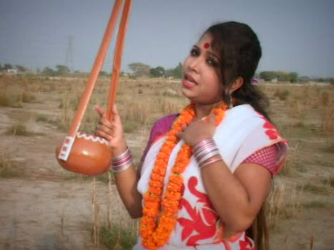
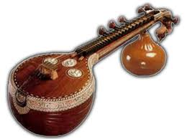
Vocabulary
One kind of song
folk
We like folk song
melodious
We use musical instruments for singing song.
musical

Slide 9
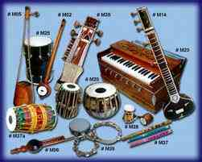
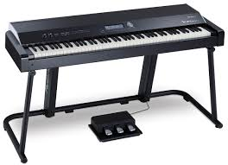
equipments
instruments
They use instruments for playing band song
One kind of musical instruments
piano
Singers use piano for singing song

Slide 10
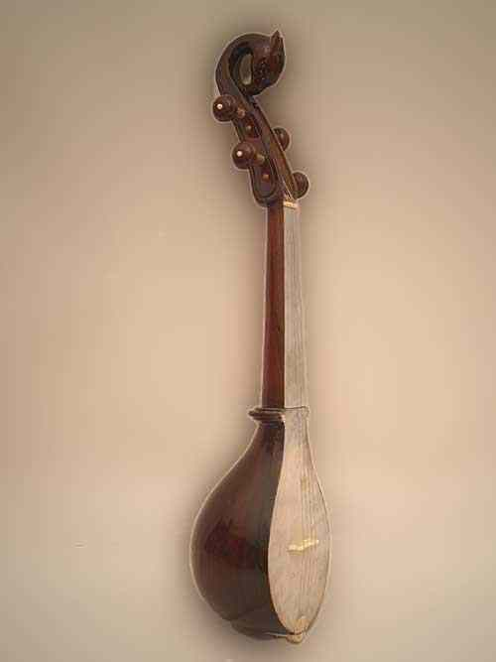
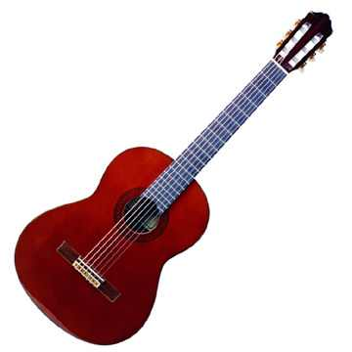
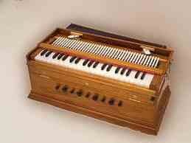
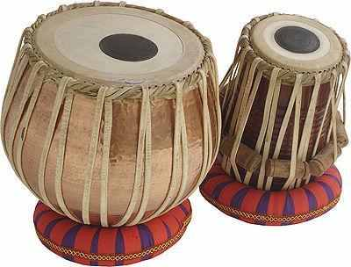
Work in pairs, Look at the picture.
and answers the following questions.
Can you sing a song?
Can you play any of this musical instruments?
Do you know any body who can play any of these instruments? Tell me what you know about her/him.
Dotara
Guitar
Harmonium
Tabla

Slide 11
B. Read the passage silently from text book
and answer the questions Given bellow.
Who usually likes our folk songs?
Can you name some well known folk singers?
Do you like folk songs? If you do, who is your favourite folk singer ?
Which song or songs do you like most?
Which instruments go well with the folk songs?

Slide 12
C. Discus in groups and write a paragraph on the following question.
Do you want more or less programmes on folk songs on our TV Channels? Why?

Slide 13
Feed Back
Write about a paragraph about Feroza based on learning.
If you have any
question ask me.

Slide 14
Who can Give the answer?
a) What do you know about folk song?
b) Who can tell the name of two folk
singers of Bangladesh?
C) What are the main element of folk
songs of Bangladesh? ?

Slide 15
Home work
Write about a paragraph about Feroza based on learning.
Write a paragraph about folk songs of Bangladesh.

