Slide 1
W
E
L
C
O
M
E

Slide 2
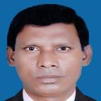
Identity
Md. Billal Miah
Head Teacher
Bhairab Model Govt. Primary School
Bhairab, Kishoreganj.
E-mail: bhairabmodel@gmail.com
Unit:9
Lesson:1-2
Parts of the Lesson:
A long time.…didn’t mind.
Time: 45 minutes.
Date: 01-03-2019

Slide 3
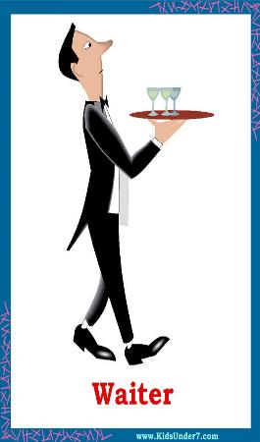
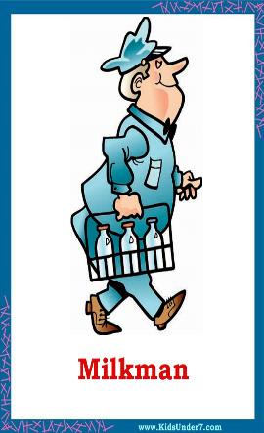
Look at the Following pictures and try to say about them

Slide 4
Watch The Video

Slide 5
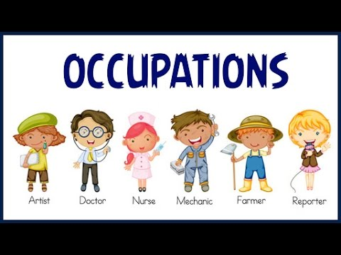

Slide 6
Learning Outcomes
Listening:
3.3.1 understand question about objects around them.
Speaking :
1.1.1 say words ,phrases and sentences with proper sound.
Reading:
1.5.1 read words ,phrases and sentences in the text with proper pronunciation, stress and intonation.
1.6.1. recognize and read statement, command greetings question and answers.

Slide 7
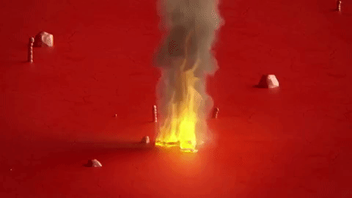
fire
New words
fire
burning
There was a fire in Raju`s school.

Slide 8
fire
afraid
frightened
Everyone was very afraid.

Slide 9
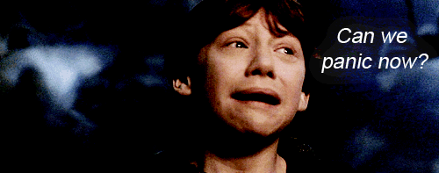
fire
Panicked
Alarmed
No one panicked.

Slide 10
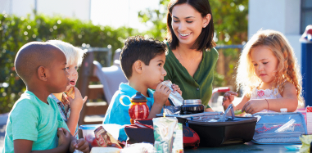
fire
Volunteer
A job without payment
After college, Raju joined a volunteer fire department.

Slide 11
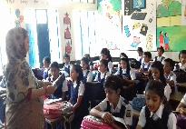
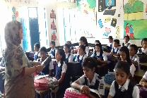
fire
Teacher’s Model Reading
A long time ago, when Raju was in class 5, there was a fire in his school. Everyone was very afraid, but no one panicked.
The teachers helped the students to leave the building quietly and safely.

Slide 12
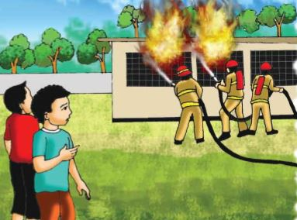
Soon the firefighter came and put out the fire. Raju watched the firefighters from the school yard. He thought about the fire and the firefighters for a long time. After college, Raju joined a volunteer fire department. As a volunteer, he didn`t get any money for his work. But Raju didn`t mind.

Slide 13
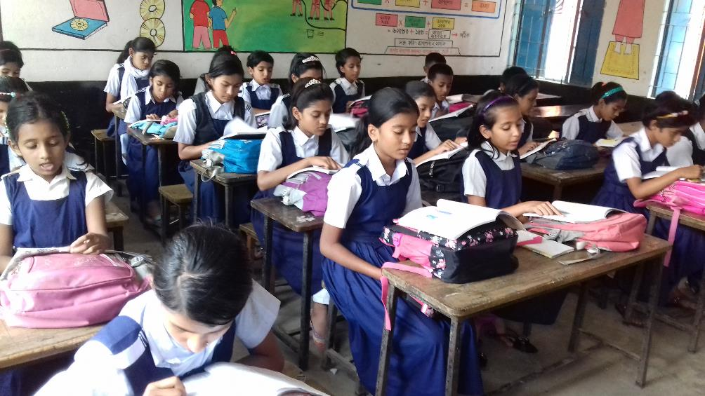
Student’s Reading

Slide 14
Group work
Group A:
Make sentences:
fire, afraid, firefighter, put out.
Group B:
Say T for true F for false:
1)There was a fire at Raju’s school when he was in class 5. ………..
2)The teacher’s left the students in the building during the fire. …………..

Slide 15
Evaluation
Answer the questions:
1.Where did the fire take place?
2.Who helped the student to leave the building?
3.Who put out the fire?

Slide 16
One day one word
Firefighter
Home work:
One page hand writing for the next class.

Slide 17
Goodbye

