Slide 1
Welcome

Slide 2
Teacher’s Identity
Mst. Nasrin Akhter
Assistant Teacher
Jummapara Govt. Primary School.
Rangpur Sadar.

Slide 3
Subject Identity
Subject: English
Class: Three
Unit:6
Topic: A

Slide 4
Learning outcomes
Student will be able to…..
1. recognize the person and say his occupation.
2.match picture with person.

Slide 5
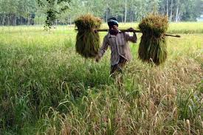
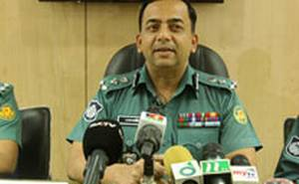
Farmer
policeman

Slide 6
Todays Lesson
People and occupation

Slide 7
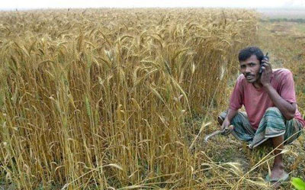
Farmer

Slide 8
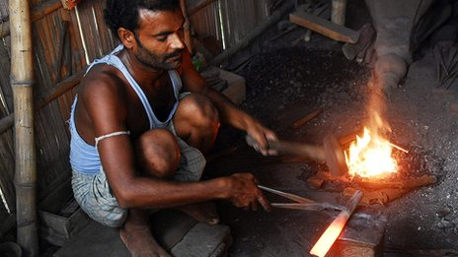
Blacksmith

Slide 9
Doctor

Slide 10
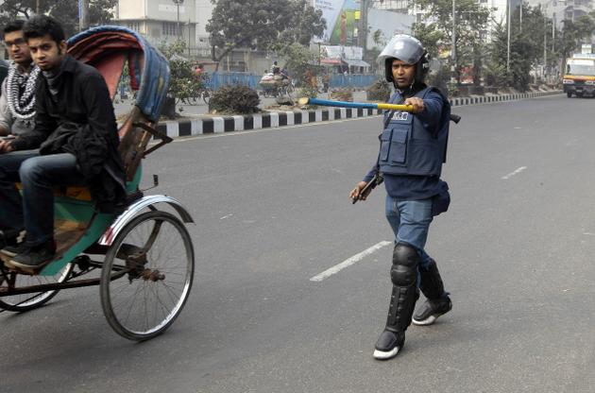
Police

Slide 11
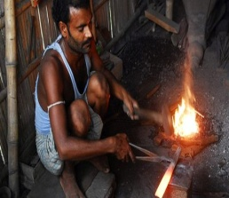
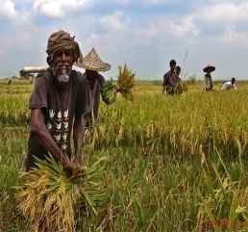
Group work
Match the word with picture
Police
Doctor
Farmer
Blacksmith

Slide 12
Open your Book
At page no.41

Slide 13
Evaluation
1.Where does farmer work?
2.Where does doctor work?
3.What does blacksmith do ?

Slide 14
Task
Tell me some profession in your locality.

Slide 15
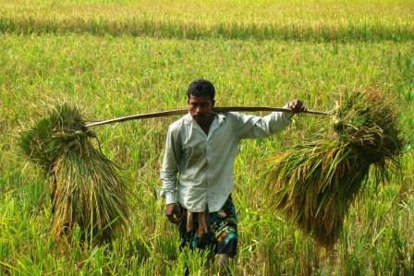
Thank you

