Slide 1
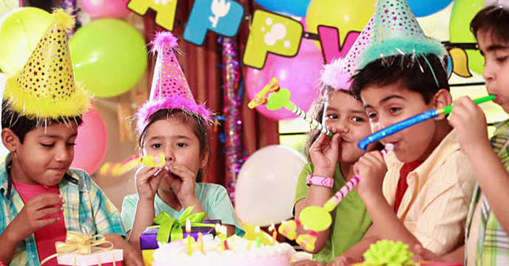
Welcome

Slide 2
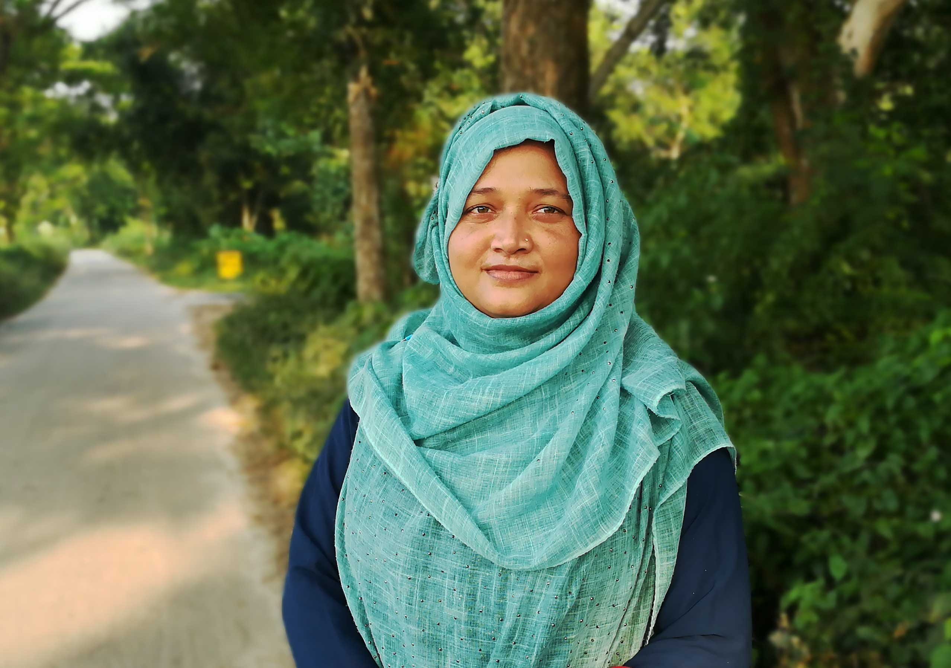
IDENTITY
Mst. Nurun Nahar
Assistant Teacher
Kathalpota Govt. primary School,
Meherpur Sadar , Meherpur.
Class : Five
Subject : English for today
Unit: 15
Lesson: 1(Happy Birthday)
Time: 50 minutes

Slide 3
GREETING
Teacher
Good morning, students
Good morning, teacher
Student’s
How are you today ?
Fine. And you ?
Fine, thank you.

Slide 4
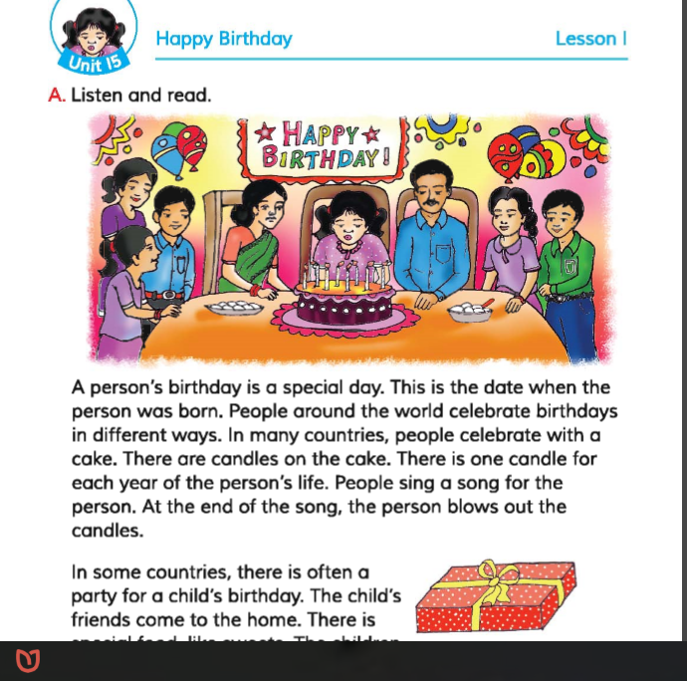
Let’s watch a picture……
What do you see in the picture?
What do you do that day?
Do all of you know when your birthday is?
DO you know when your friends’ birthday are?
Do you know your family members’birthday are?
What do you do on your friend’s birthday?

Slide 5
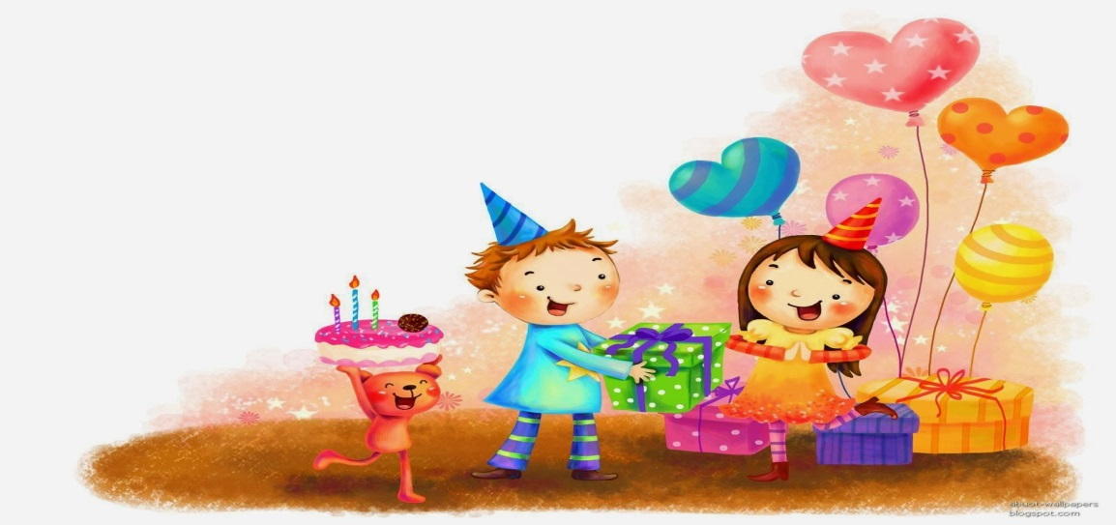
Ok! Dear student’s Today’s lesson is….
‘Happy Birthday’
( A persion’s birthday…..friend’s and family.)

Slide 6
Learning outcomes
Students will be able to…..
Listening: 3.3.1 understand question about objects around them
Speaking: 1.1.2 say sentences with proper intonation.
Reading: 1.7.1 read paragraphs, dialogues, stories, letters and others texts.
Writing: 10.1.1 write a short piece of composition by answering a set of question.

Slide 7
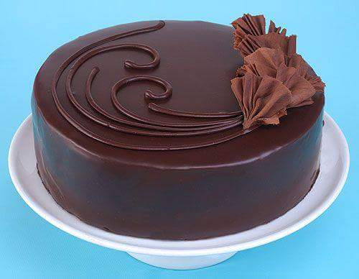
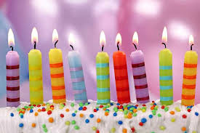
পিঠা
New words
Cake
Patty
Candle
Taper
মোমবাতি

Slide 8
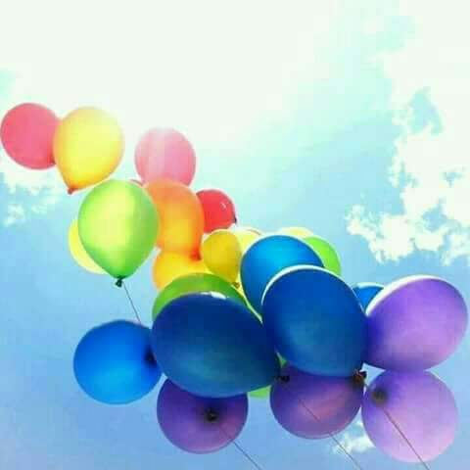
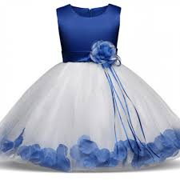
New words
বেলুন
Balloon
Airship
Cloth
Dress
কাপড়

Slide 9
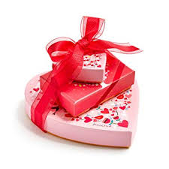
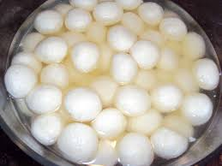
New words
উপহার
Gift
Offering
Sweet
Mellow
মিষ্টি

Slide 10
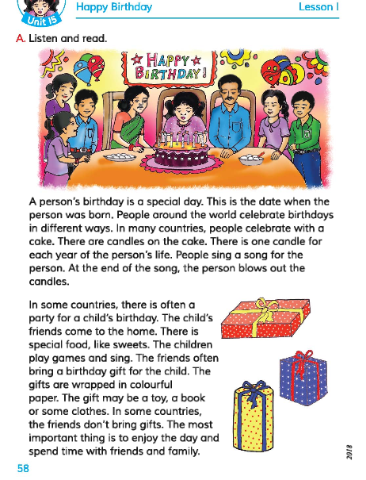
Teacher’s Reading
Dear student’s..
Listen to the text attentively....

Slide 11
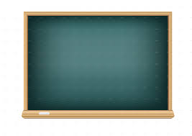
Student’s look at the board and read the question’s silently.
Teacher’s Reading
1. What type of day is birthday?
2.What is the most important thing of a birthday ?

Slide 12
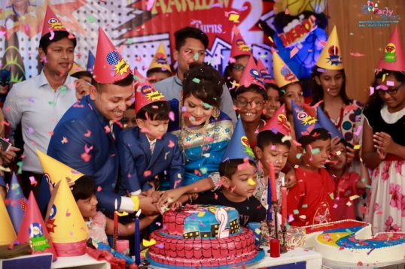
Teacher’s Reading
A person’s birthday is a special day. This is the date when the person was born . People around the world celebrate birthdays in different ways . In many countries, people celebrate with a cake.

Slide 13
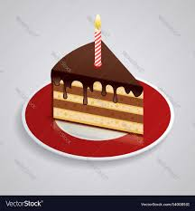

Teacher’s Reading
There are candles on a cake. There is one candle for each year of the person’s life. People sing a song for the person. At the end of the song , the person blows out the candles .

Slide 14
Individual Work
Dear student, Read the text silently and try to find out the answer of the following question.
?
What are the necessary thinks to celebrate birthday party ? Write two names.

Slide 15
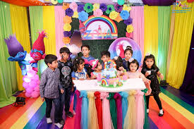
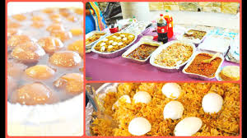
Teacher’s Reading
In some countries, there is often a party for a child’s birthday . The child’s friends come to the home . There is special food , like sweets .

Slide 16
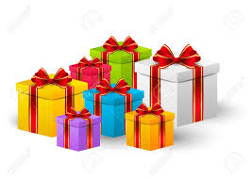
Teacher’s Reading
The children play games and sing . The friends often bring a birthday gift for the child . The gifts are wrapped in colourful paper . The gift may be a toy , a book , or some clothes .

Slide 17
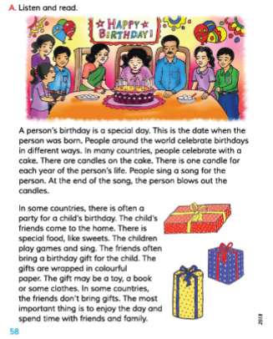
Pair Work
Dear Students, make Pair and Read the text with pair.

Slide 18
Evaluation
Dear Students Answer the following question’s…..
01.What type of day is a birthday?
02.Write the names of three thinks as birthday gift.
03.Why do the child’s friends come to birthday party ?

Slide 19

HOME WORK
Dear Student’s
You will write at least five sentences about your birthday party.

Slide 20
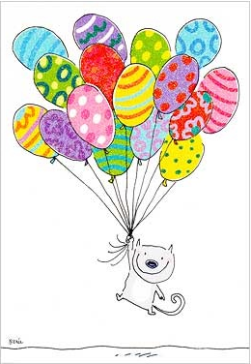
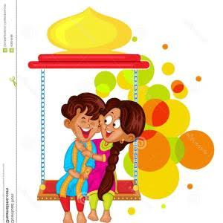
Thanks all of my students

