Slide 1
Welcome

Slide 2
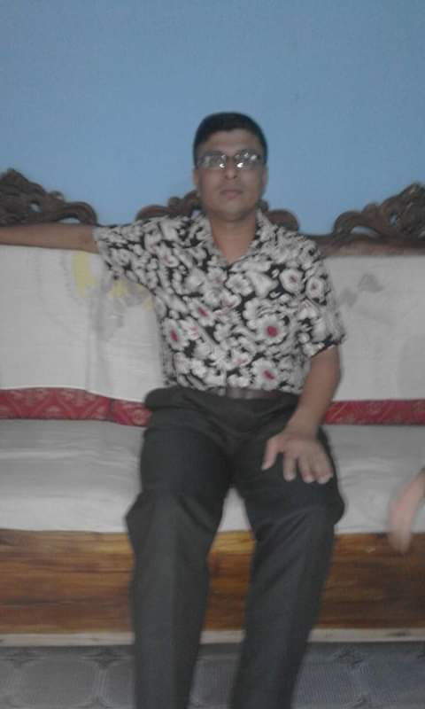
INTRODUCTION
Sultan Ahmed Miazi
ASSISTANT TEACHER ( ENGLISH)
Balia Kajir Bazar D.N. Dakhil Madrasah, Chandpur Sadar, Chandpur. 01817106106
CLASS: SEVEN
SUBJECT: ENGLISH FIRST PAPER

Slide 3
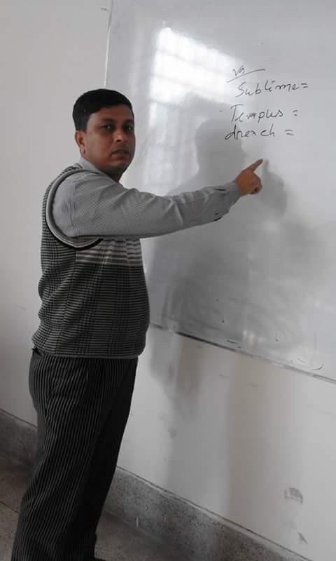
Can you guess what her profession is?
He is a teacher.
Doctor
Nurse
Engineer
Can you tell what he does in madrasah and in his home?
Teacher
Business
Fashion
designer
Discuss with your friend what he does in the madrasah and in his house.

Slide 4
Today our topic
A Teacher(2)
UNIT: Four
LESSON: 2

Slide 5
LEARNING OUTCOMES OF THE LESSON
By the end of the lesson the students will be able to--
Ask and answer questions;
Read and understand text;
Talk about people;
Fill in the gaps;
Tell the meaning of some key words from inference;

Slide 6
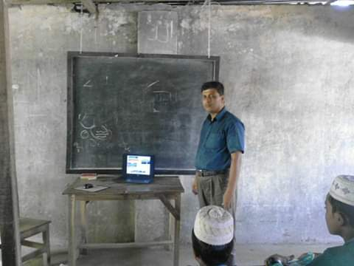
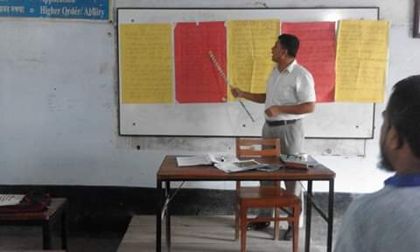
Ask your friend the following question.
What is he doing?
He is teaching.

Slide 7
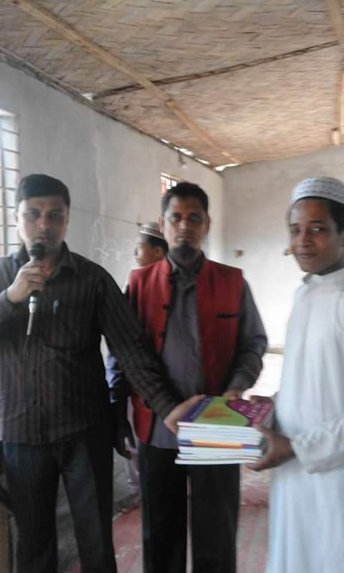
Ask your friend the following question.
What is he doing?
He is talking to the students.

Slide 8
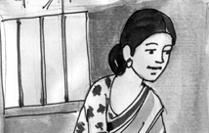
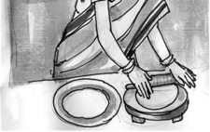
Ask your friend the following question.
What is she doing?
She is doing her household work/She is making bread.

Slide 9
Ask your friend the following question
What are people doing to her?
People are giving her salaam.

Slide 10
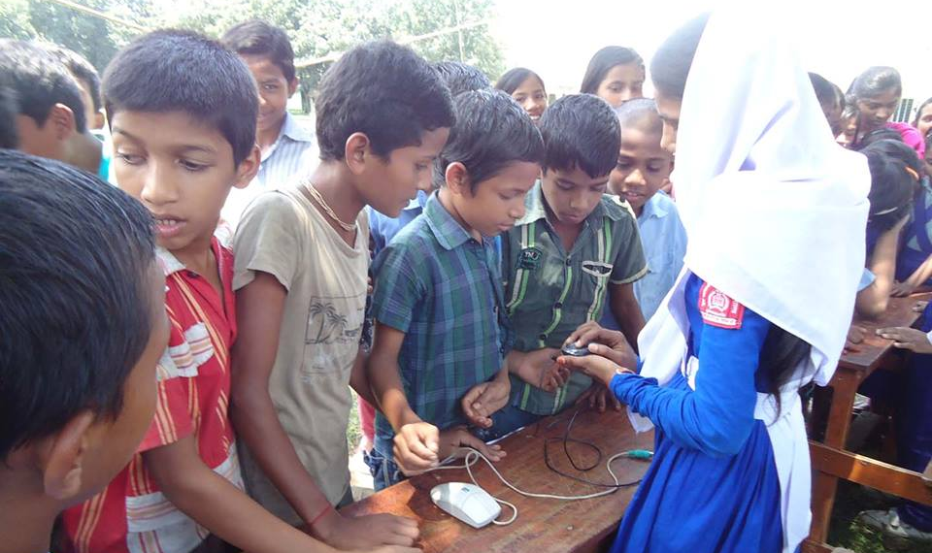
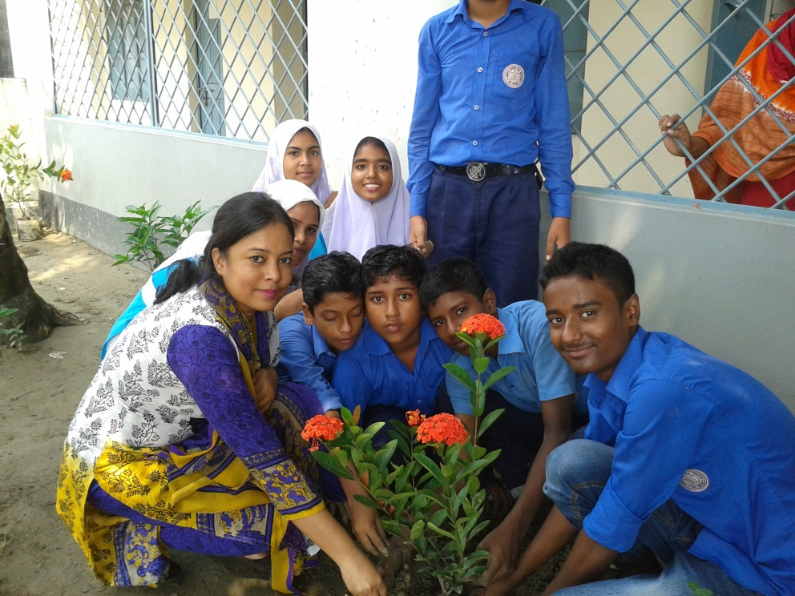
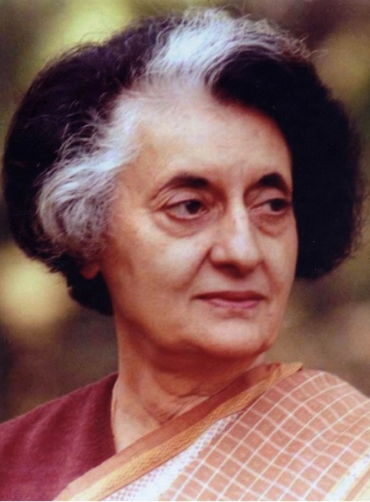
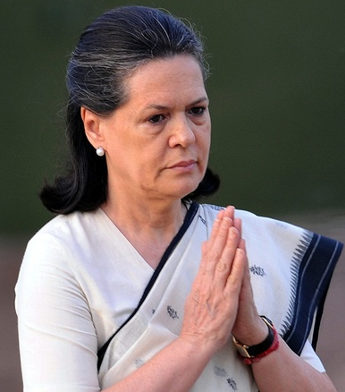
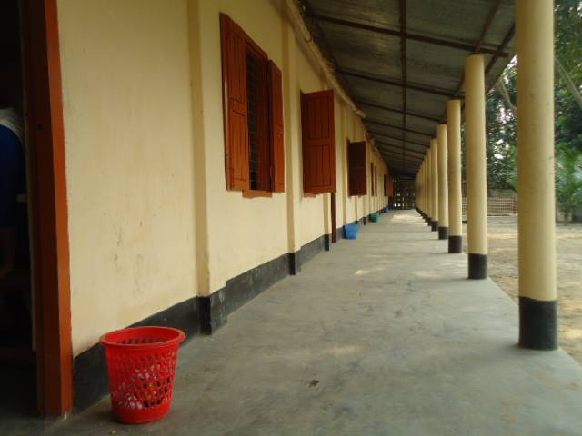
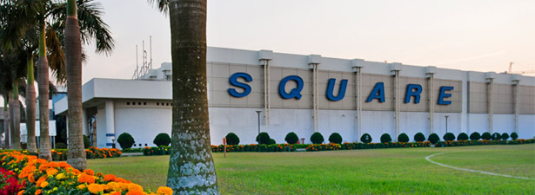
Vacant
Vocabulary
Company
Corridor
Demonstrate
Inspire
In-laws
fill (someone) with the ability to do or feel something good; encourage
a long passage in a building from which doors lead into rooms
having no fixtures, furniture, or inhabitants; empty
show (something) clearly by giving evidence.
relatives by marriage.
Meaning
a commercial business.
Meaning
Meaning
Meaning
Meaning
Meaning
There is nothing in the box. It is vacant.
The Square is a renowned pharmaceutical company in Bangladesh.
The classes are going on. There is nobody in the corridor.
The teacher is helping students to make garden. Thus she inspires students to do good work.
The girl is demonstrating how a mouse works.
Indira Gandhi is mother- in-law of Sonia Gandhi .

Slide 11
Individual/Pair Work
Go to the section B in the text book then match the words with their meanings.

Slide 12
Individual Work
Read the text from the textbook , section A and make a list of things that Shahana does as a teacher.

Slide 13
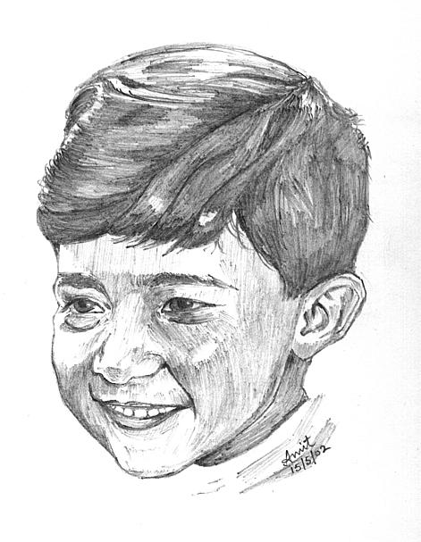
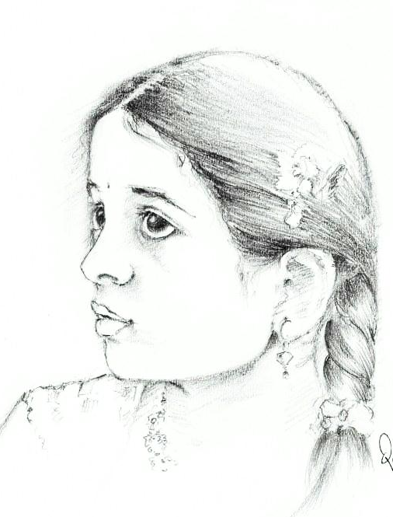
Help them to complete the dialogue filling the gaps. Take the words from the box.
do
want
What do you …….. to be?
Why …….. you want to be a Lawyer?
Because I ………. it. . I want to ……… the people get ……….. .
like
Lawyer
help
I want to be a ……….
.
justice
do
want
like
Lawyer
help
justice

Slide 14
Pair Work
Now in the same way you ask and answer with your friend about what you want to be.
1. What do you want to be?
2. Why do you want to be a ………..?

Slide 15
Individual/Pair Work
Read the passage from section E and complete the passage with words from the box. A word can be used more than one time.

Slide 16
Home Work
Recently you have meet your cousin Shamin/Shamima. Now write a dialogue between you your cousin about what you want to be.

Slide 17
I want to be a Fashion designer.
I want to be a Lawyer.
Fix it. It will help you to become a successful person.
What about all of you?

Slide 18
Thank you all

