Slide 1

Good morning students

Slide 2
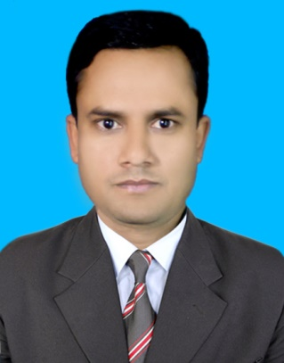

I
DENTITY
Class – five
Subject – English
Lesson Unit -9; Occupation.
Lesson : A time ago……. didn’t mind.
Time : 40 min
Date : 11/09/2019
Mhd. Kamal Hossain,
Assistant Teacher,
Hariharnagar Govt. Primary School.
Jibannagar, Chuadanga.

Slide 3
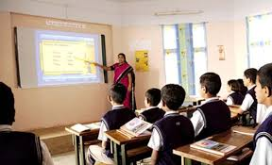
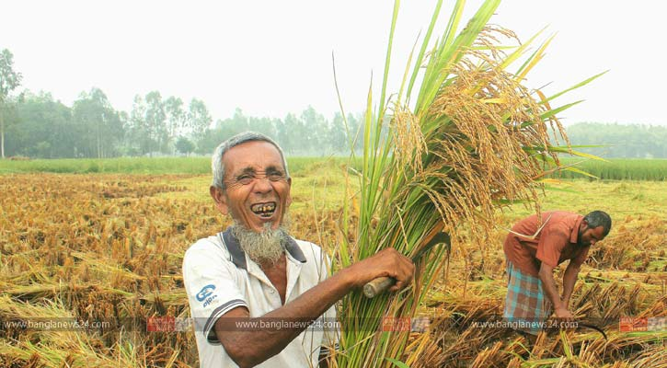
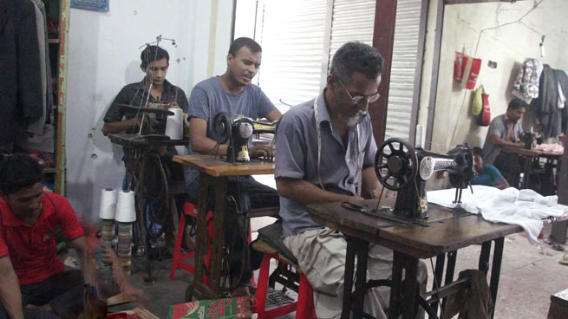
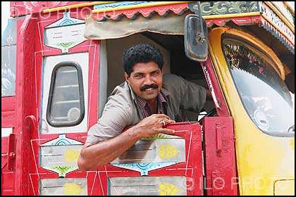
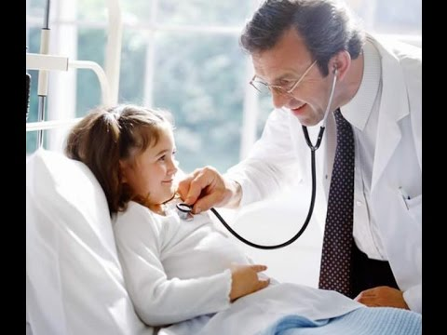
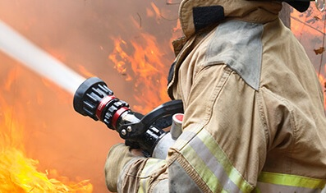
Look at picture and say about it.
Teacher
Farmer
Tailor
Driver
Doctor
Firefighter

Slide 4
Occupation
Work
Doctor
services to the patients
Tailor
make dresses
Teacher
teaches to the students.
Firefighter
puts out the fire.

Slide 5
Earn money
By working
Occupation
A person who earn money by working is called occupation

Slide 6
Learning outcomes: Students will be able to - -
Listening:
1.3.1 recognize which words in a sentence are stressed.
3.3.1 understand questions about object around them.
3.4.1 understand statements made by the teacher and students.
4.2.1 understand and enjoy simple stories.
Speaking:
1.1.1 Say words, phrases and sentences with proper sounds and stress.
6.1.2 say what others doing.
Reading:
1.5.1 Read words, phrases and sentences in the text with proper
pronunciation, stress and intonation.
1.7.1 read paragraph, dialogues stories, letters and other texts.

Slide 7
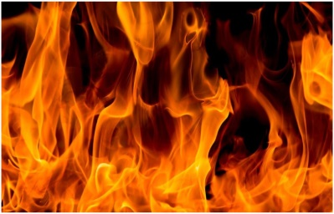
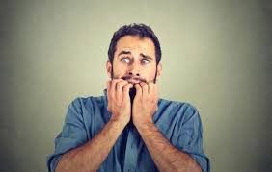
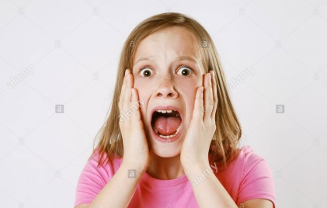
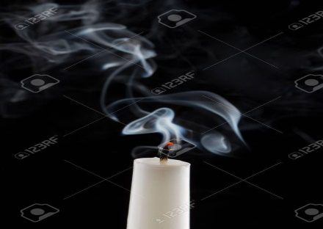
Key words and Bangla meaning:
Fire
আগুন
Afraid
ভীত
Panicked
আতঙ্কিত
Put out
নিভিয়ে ফেলা

Slide 8
Key words, Bangla meaning and make Sentences
Firefighter
দমকল কর্মী
I want to be a firefighter.
Quietly
শান্তভাবে
Leave the building quietly.
Volunteer
সেচ্ছাসেবক
Roton is a volunteer in an NGO.
Join
যোগদান করা
He joined in a high school.
Watch
লক্ষ্য করা
Tina is watching the rain.

Slide 9
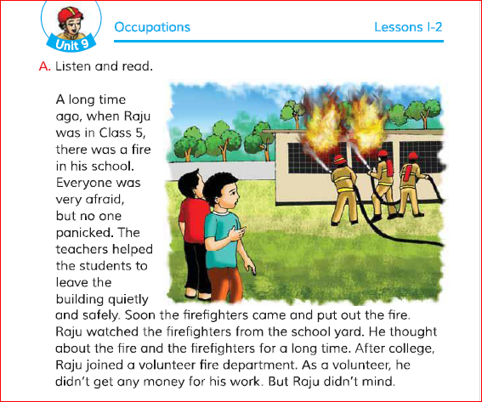

Teacher’s model reading
Please open at page 34. Now listen the audio of text by following the text book.
WCW

Slide 10
Now, all of you make pairs and read the text with correct pronunciation
PW

Slide 11
Now, all of you read the text with correct pronunciation
IW

Slide 12
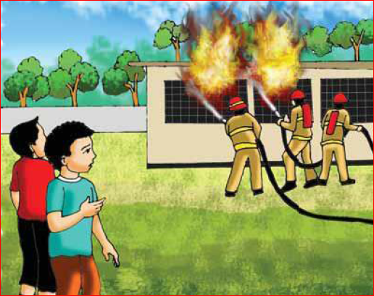
Look at the picture and say about it.
Which people can you see in the picture ?
There are two boys and three firefighters in picture

Slide 13
Pair work:
Write the answer of the following question :
a)What happened in Raju’s school?
b)What class was Raju in during the fire accident in his school?

Slide 14
Look at the picture and say about it.
Where did the fire take place?
The fire was at the school building.

Slide 15
Individual work:
Write the answer of the following question :
a) How many student was afraid?
b) Who help them to leave the school building?

Slide 16
Look at the picture and say about it.
What are firefighter doing ?
They are trying to put out the fire.

Slide 17
Group work: Please make 4 groups A B C and D. Discuss in groups and answer the following question -
Group A: What happened in Raju’s school ?
Group B: How students leave the building ?
Group C: Who put out the fire?
Group D: When Raju joined in fire department?
Group A: There was fire in Raju’s school.
Group B: The students leave the school quietly and safely.
Group C: The firefighters put out fire
Group D: After college Raju joined a volunteer fire department.

Slide 18
Evaluation:
Match the words of column A with their
meaning that is mentioned in the text in the column B.
Column A | Column B
Quietly | i) a section of a large organisation.
b) Yard | ii) premise.
c) Department | iii) the state of being safe.
d) Put out | iv) making very little or no noise.
e) Safety | v) without creating disturbance
 | vi) to stop something from burning.
 | vii) an area outside house or building

Slide 19
Home work:
You have to write 5 sentences about ‘Firefighter’.

Slide 20

Here is the end of our lesson.
Thank you very much

