Slide 1
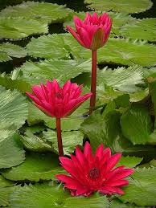
Good morning my dear students.

Slide 2
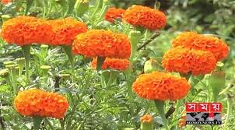
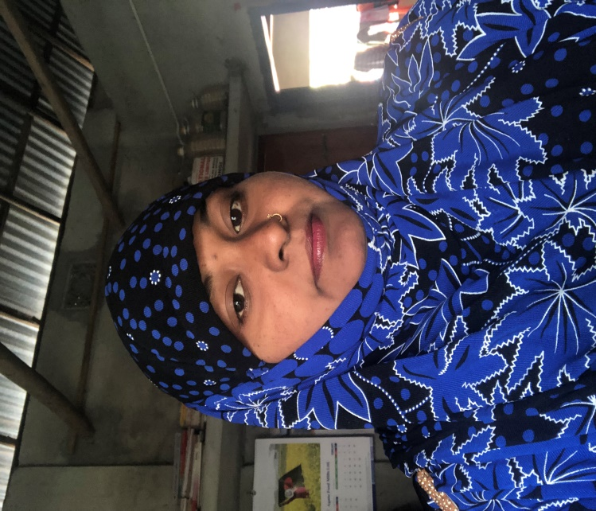
Teachers information
Mazada Akter
Lecturer (English)
Barabor alim Madrasha
Class : 1x
Subject : English 1st paper

Slide 3
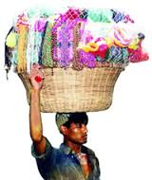
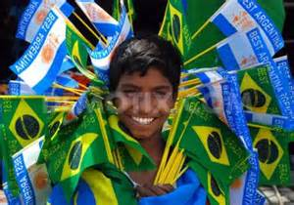
Try to imagine these pictures.
A Street Hawker
A Street Hawker

Slide 4
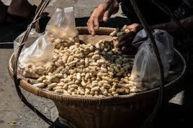
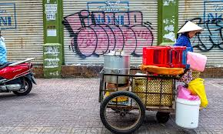
Who are they?
A Street Hawker
A Street Hawker

Slide 5
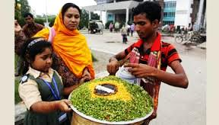
Our Today’s Topic
A Street Hawker

Slide 6
Learning outcomes
After completing this lesson, we will be able to-
identify a street hawker.
tell the life of a street hawker.
write a paragraph.

Slide 7
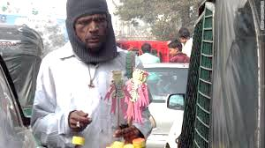
Who is a street hawker ?
A person who sells various things walking from street to street is called a street hawker.

Slide 8
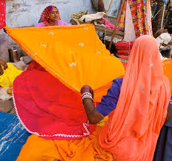
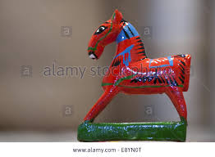
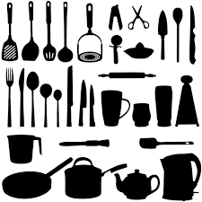
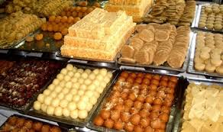
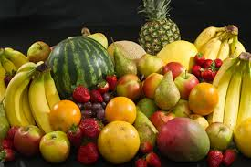
What does he sell in the streets?
Cloths
Ribbons
Toys
Utensils
Sweets
Fruits

Slide 9
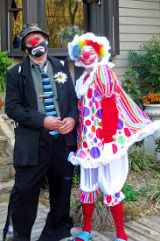
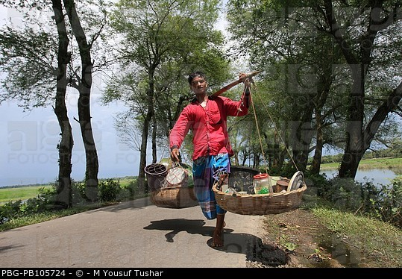
What does he do to attract the buyers ?
Sometimes he tricks
He makes funs
He uses various tricks to attract the attention of the buyers. Sometimes he starts singing or even starts acting. Sometimes he is funny and sometimes irritating
Sometimes he tricks

Slide 10
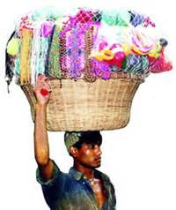
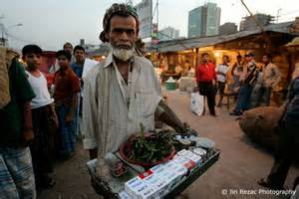
How does he carry his goods ?
Goods in hands
Good on head
Goods in hands
He carries his goods either in hands or on the head and sometimes in handcart

Slide 11
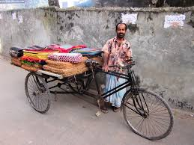
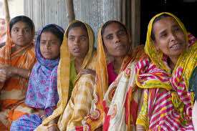
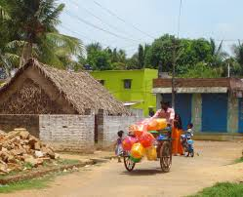
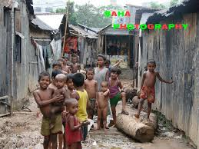
Who are the target of a street hawker ?
Street hawker
women
Street hawker
children
He is interested to sell his goods to the women and the children whom he can cheat easily

Slide 12
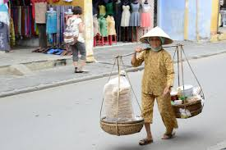
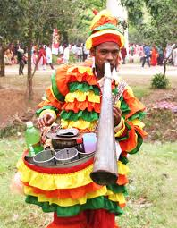
What does he wear specially ?
Peculiar dress
Peculiar dress
Sometimes he wears peculiar dress of different colors which is attracting.

Slide 13
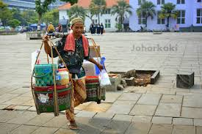
Pair work
Why does the street hawker wear a peculiar dress?

Slide 14
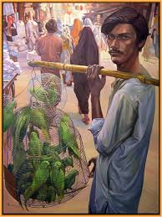
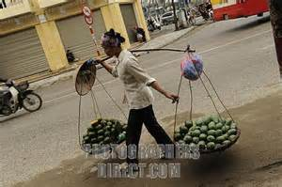
.
by the sweat of his physical labors.
by the sweat of his physical labors.
A street hawker earns his livelihood by the sweat of his physical labours.

Slide 15
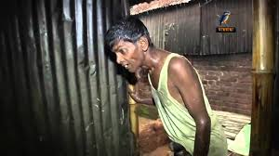
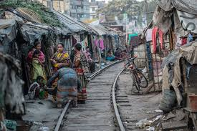
How does he lead his life?
miserable life
miserable life
He leads a miserable life with his family.

Slide 16
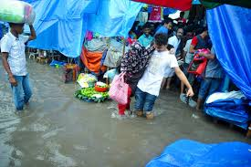
When does he face a great problems?
s.
During rainy day
During rainy days he faces great problem to sell his products.

Slide 17
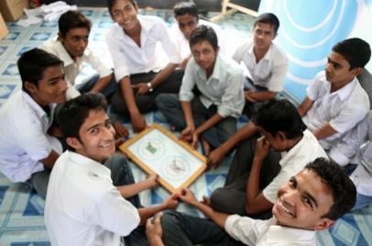
Group Work
Write three sentences about a street hawker whom you have seen before.

Slide 18
Evaluation
Who is a street hawker ?
What sort of man is he ?
Where is a street hawker seen?
What does he wear ?
How does he attract the attention of the customers?

Slide 19
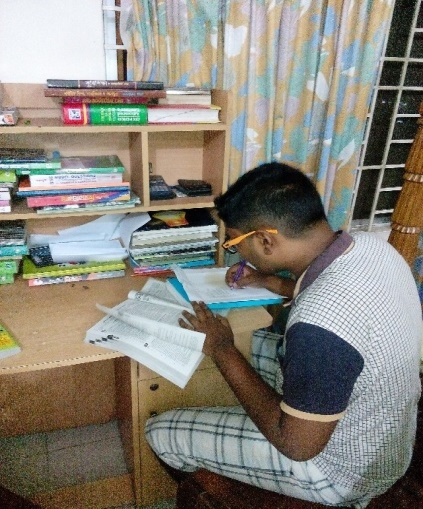
Home Task
Write a paragraph on
“A Street Hawker”.

Slide 20
Thank
You all

