Slide 1

Learning outcomes
Teachers & Lesson
Introduction
1.3.1 recognize which words in a sentence are stressed.
3.3.1 understand questions about objects around them.
3.4.1 understand statements made by the teacher and students.
4.2.1 understand and enjoy simple stories
1.1.1 say words, phrases and sentences with propersounds and stress.
1.1.2 say sentences with proper intonation
1.5.1 read words, phrases and sentences in the text with proper pronunciation, stress and intonation.
1.6.1 recognize and read statements, commands, greetings, questions and answers.
1.7.1 read paragraphs, dialogues stories, letters and other texts.
Rajesh Majumder
Ass. Teacher
Enayetnagot Govt. Pry.School
Daganbhuiyam
Feni
Class-Two
Unit-9
Lesson-1
(Life every day)
Lesson-A,B,C
Page-56

Slide 2
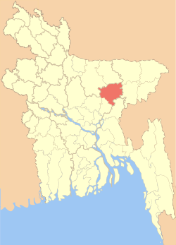
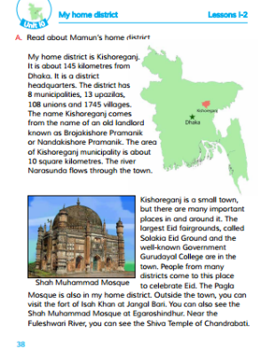
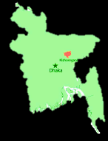
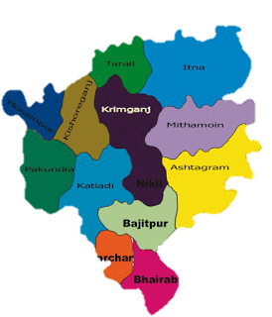
Please, open the page 38 of
Where do we use question
When do we use capital
Where do we use full
Yesterday we learned about capital
Please, look at the first picture.
your text book.
letters, full stop and question mark .
mark in a sentence?
letters in a sentence?
stop in a sentence?
What other place map are showing inside
Which place are star marked?
My home district is Kishoreganj.
the Bangladesh map?

Slide 3
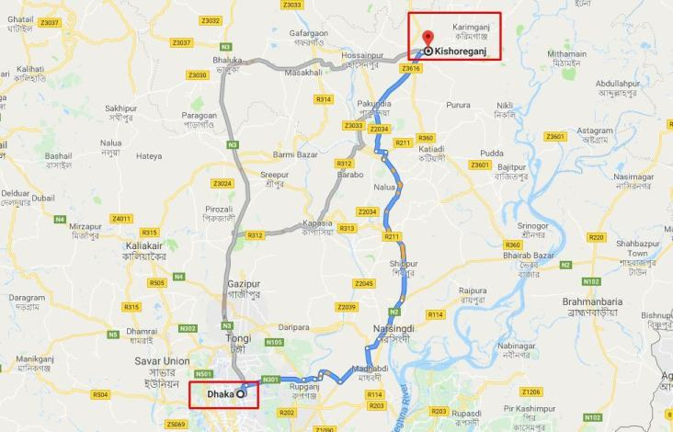
0
0
0
1
1
2
3
4
5
6
7
8
9
1
2
0
0
1
1
1
1
1
1
1
1
1
1
1
1
1
1
2
3
4
5
6
7
8
9
1
2
0
0
2
2
2
2
2
2
2
2
2
2
2
2
2
It is about 145 kilometres from Dhaka.
1
2
3
4
5
6
7
8
9
1
2
0
0
3
3
3
3
3
3
3
3
3
3
3
3
3
1
2
3
4
5
6
7
8
9
1
2
0
0
4
4
4
4
4
4
4
4
4
4
4
4
4
1
2
3
4
5
6
7
8
9
1
2
0
0
5
5
5
5
5
5
5
5
5
5
5
5
5
1
2
3
4
5
6
7
8
9
1
2
0
0
6
6
6
6
6
6
6
6
6
6
6
6
4
6
1
1
2
3
4
5
6
7
8
9
1
2
0
0
7
7
7
7
7
7
7
7
7
7
7
7
4
7
2
1
2
3
4
5
6
7
8
9
1
2
0
0
8
8
8
8
8
8
8
8
8
8
8
8
4
8
3
1
2
3
4
5
6
7
8
9
1
2
0
0
9
9
9
9
9
9
9
9
9
9
9
9
4
9
4
2
3
3
5
6
7
8
9
0
2
3
4
1
1
0
0
0
0
0
0
0
0
0
0
0
5
0
0

Slide 4
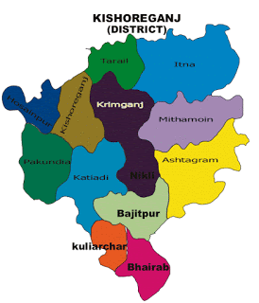
0
0
0
1
0
2
0
3
0
4
Kishoreganj has 8 municipalities.
0
5
0
6
0
7
0
8

Slide 5
0
0
0
1
0
2
0
3
Kishoreganj has 13 upazilas.
0
4
0
5
0
6
0
7
0
8
0
9
1
0
1
1
1
2
1
3

Slide 6
Kishoreganj has 108 unions and 1745 villages.

Slide 7
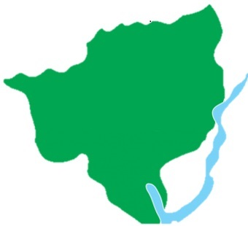
Brojakishore Pramanik
or
kishore
Nandakishore Pramanik
kishore
ganj
The name Kishoreganj comes from the name
of an old landlord known as Brojakishore
Pramanik or Nandakishore Pramanik.

Slide 8
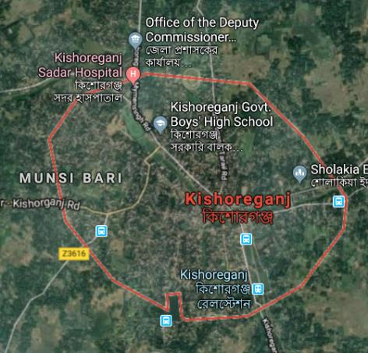
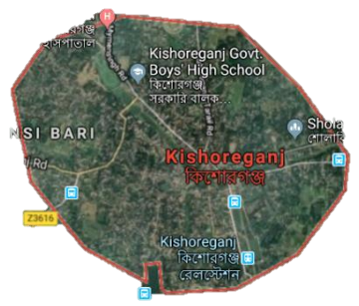
0
0
0
1
0
2
The area of Kishoreganj municipality is
0
3
about 10 square kilometres.
0
4
0
5
0
6
0
7
0
8
0
9
1
0

Slide 9
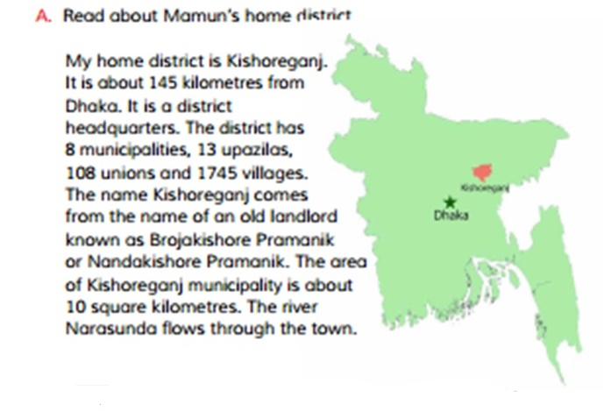
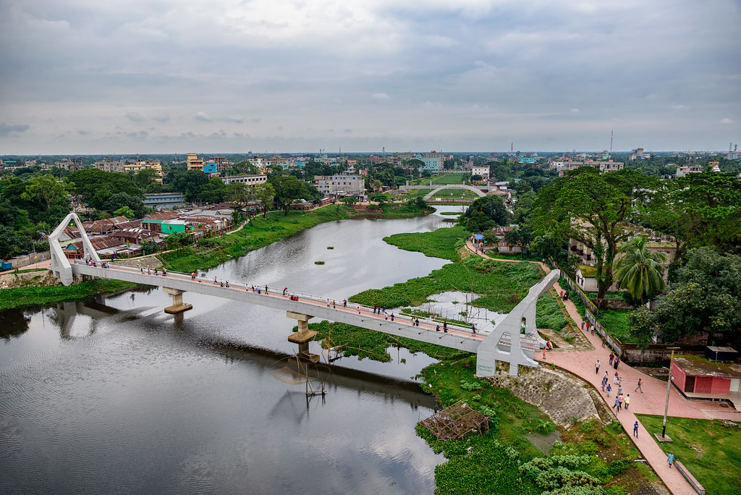
My home district is Kishoreganj. It is about 145 kilometres from Khula. It is a district headquarters. The district have 8 municipalities,13 upazilas,108 unions and 1745 villages.The name Kishoreganj comes from the name of an old landlord known as Brojakishore Pramanik or Kishoreganj Pramanik. The area of Kishoreganj municipality is about 10 square kilometres. The river Narasunda ﬂows through the town.
My home district is Kishoreganj. It is about 145 kilometres from Khula. It is a district headquarters. The district have 8 municipalities,13 upazilas,108 unions and 1745 villages.The name Kishoreganj comes from the name of an old landlord known as Brojakishore Pramanik or Kishoreganj Pramanik. The area of Kishoreganj municipality is about 10 square kilometres. The river Narasunda ﬂows through the town.
Look at the screen and read the words.
word
meaning
Similar word
Do you know the meaning of the words?
Headquarter
কেন্দ্রস্থল
Main office
Now I repeat the text. Please listen
Headquarter
attentively .If you get any mistake will
I’ll read the text. Listen attentively and
Municipality
পৌরসভা
Corporation
Municipalitie
say stop then I’ll ‘stop’ after that you
follow me .
Upazila
উপজেলা
will say the correct word.
Upazila
Union
সমাজ
Society
Union
Village
গ্রাম
Hamlet
The river Narasunda ﬂows through the town.
Village

Slide 10
Impotant imformation about the lessan are...
It is a district headquarters.
Kishoreganj is about 145 kilometres from Dhaka.
The district has 8 municipalities.
The district has 13 upazilas.
The district has 108 unions.
The district has 1745 villages.
The river Narasunda ﬂows through the town.

Slide 11
Dear students, please read the text
Tell me what you understood
silently and try to understand.
about this lesson.

Slide 12
Discuss in the group and write
on the leader's note book.
What do the numbers mean in this lesson?
8
10
145
13
108
1745

Slide 13
Let’s check
8
10
145
13
108
1745
The district has 8 municipalities.
The area of Kishoreganj municipality is about 10 square kilometres.
Kishoreganj is about 145 kilometres from Dhaka.
The district has 13 upazilas.
The district has 108 unions.
The district has 1745 villages.

Slide 14
Discuss in pair
Write true or false .
Kishoreganj is about 140 kilometres from Dhaka.
The name Kishoreganj comes from the name of an old landlord
Kishoreganj has 8 municipalities.
The river Narasunda ﬂows through the town.
Kishoreganj isn’t a district headquarters.
Kishoreganj has 108 villages.

Slide 15
Let check
Kishoreganj is about 140 kilometres from Dhaka.
False
The name Kishoreganj comes from the name of an old landlord.
True
Kishoreganj has 8 municipalities.
True
The river Narasunda ﬂows through the town.
True
Kishoreganj isn’t a district headquarters.
False
Kishoreganj has 108 villages.
False

Slide 16
Fill in the gaps with the given words from the box.
10
108
13
145
Kishoreganj It is about ______ kilometres from Dhaka.
Kishoreganj has 13 upazilas, ___ unions.
The area of Kishoreganj municipality is about ____
square kilometres.

Slide 17
Let’s check
10
10
108
108
13
13
145
145
Kishoreganj It is about ______ kilometres from Dhaka.
Kishoreganj has 13 upazilas, _________ unions.
The area of Kishoreganj municipality is about ______ square kilometres.

Slide 18
Let’s check
Re-arrange the sentence.
My home district is Kishoreganj.
Kishoreganj/ district/ is / home / my.
The river Narasunda ﬂows through the town.
river/ ﬂows/ the/ the / Narasunda / through/
town

Slide 19
Read the questions carefully.
Raise your hand if you know the answer.
Whose home district are we reading about?
How many upazilas are there in Kishoreganj?
How many municipalities are there in Kishoreganj?
Which river ﬂows through the town?

Slide 20
Home work
Write five sentences about “Kishoreganj”.

Slide 21




