Slide 1
WELCOME

Slide 2
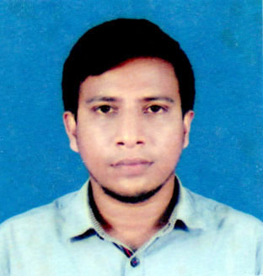
MD. Abu Sayed
Lecturer (English)
Indrakul Akbaria Senior Madrsah,
Bauphal, Patuakhali.
BTT ID: 111020043 (Batch-2), TTC, Barisal
Email: abusayed8625@gmail.com

Slide 3
Date: 14th March, 2019
Class: 9-10
Subject: English 1st Paper
Unit: 08
Duration: 45 min.

Slide 4
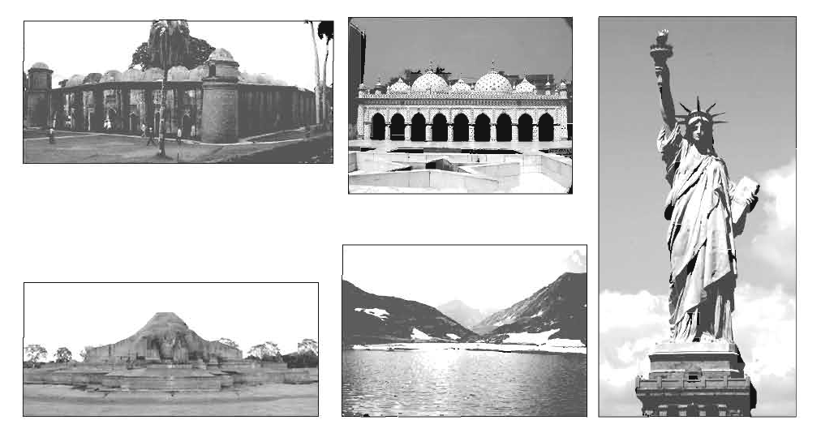
Shat Gambuj Mousqe, Bagherhat
Star Mousque, Dhaka
Shompur Bihar, Paharpur
Lake Baikal, Eastern Syberia
Statue of Liberty, USA

Slide 5
World Heritage

Slide 6
Learning outcomes
After we have studied this unit, we will be able to…
talk about world heritage.
identify some new vocabularies.
gather information about heritage sites.
describe a place.

Slide 7
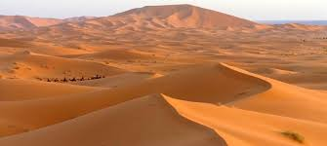
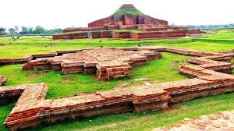
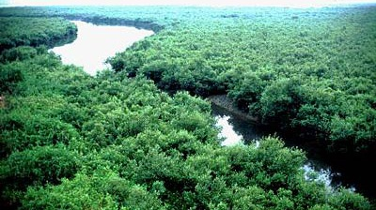

Slide 8
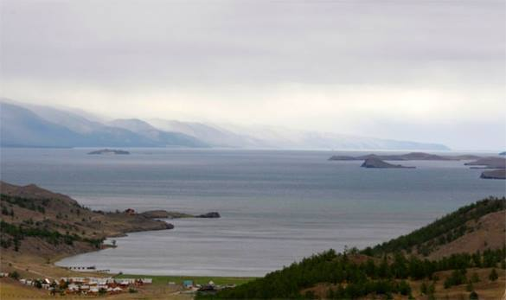
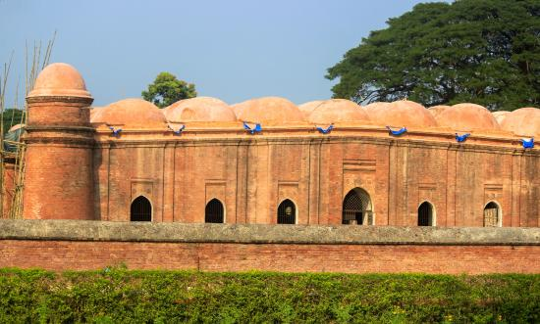
1 What are these picture about?
2 What do we call these?
3 What are these for?

Slide 9
Let’s read the text attentively
‘Heritage’ is what we inherit from the past, live with them in the present and then pass on to our children or future generation. Our unique source of life and inspiration is our cultural and natural heritage. When we speak of ‘World Heritage’, it indicates places and sites that we got from the past and pass on to the future generation of the entire world.

Slide 10
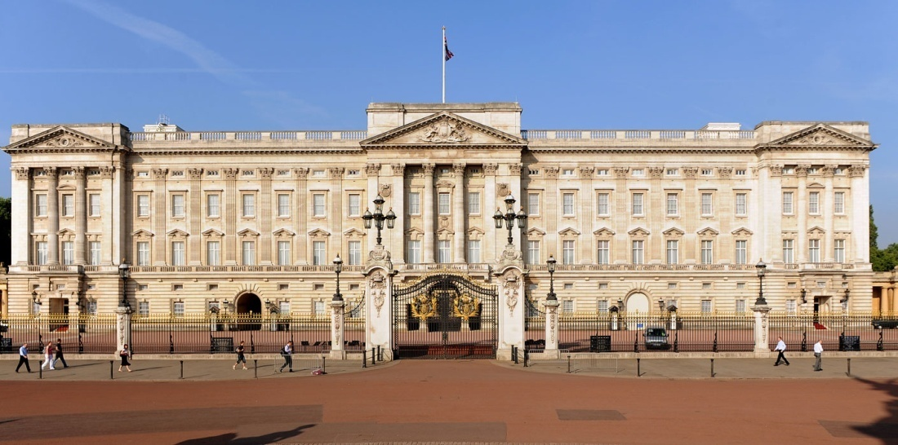
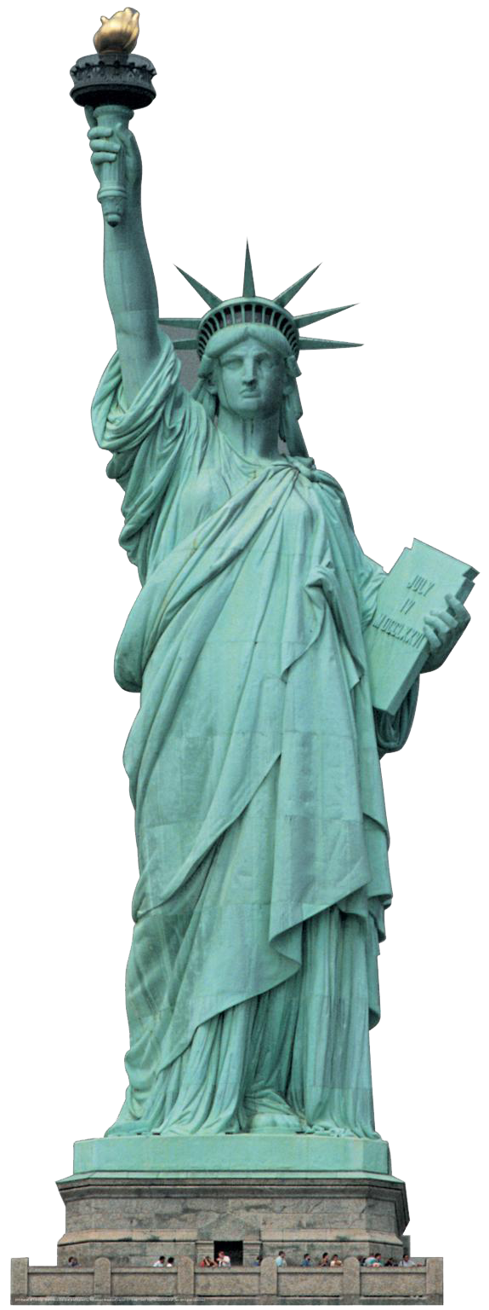
What is called heritage?
Do you have a building or places like these pictures in your town/village?
What do you know about these pictures?

Slide 11
Let’s have a look on this video …
Video

Slide 12
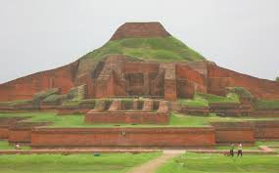
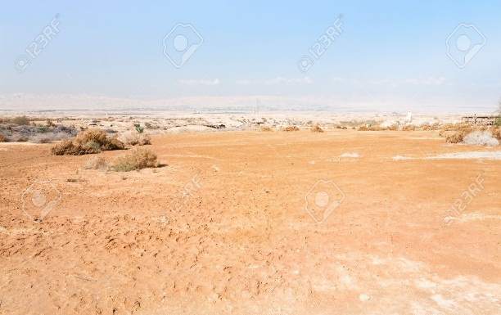
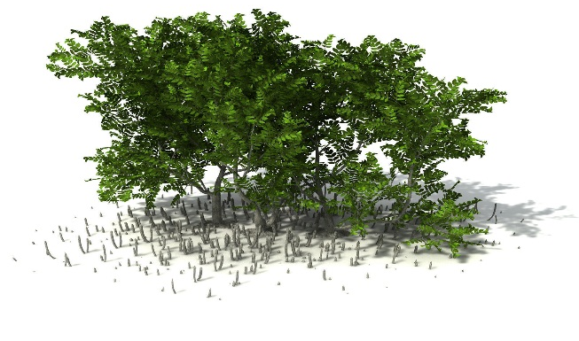
Match the words with the pictures
Archaeological
Mangrove
Infrastructure
Plain land

Slide 13
Let’s do the quiz here….

Slide 14
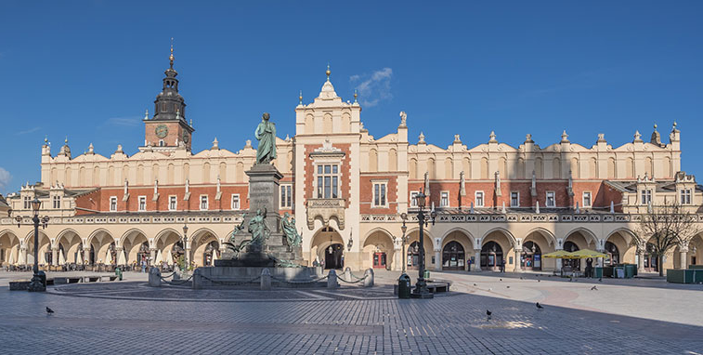
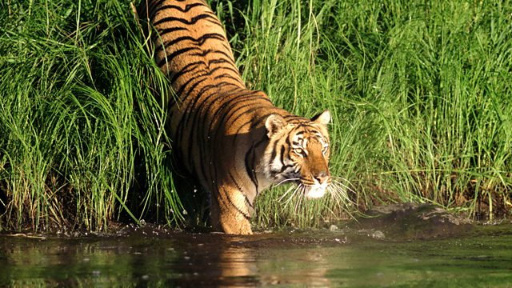
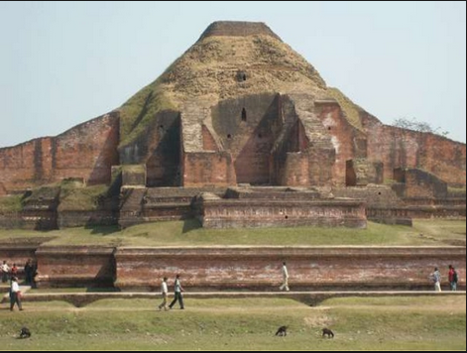
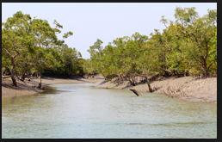
Write down the name of some places of world heritage sites in Bangladesh.

Slide 15
Evaluation
***Write down the meaning and make sentences with these words:
Heritage, mangrove forest, monuments, infrastructure, archaeological, plain land.

Slide 16
Home work
Write a short paragraph about World heritage.

Slide 17
Thank you …

