Slide 1
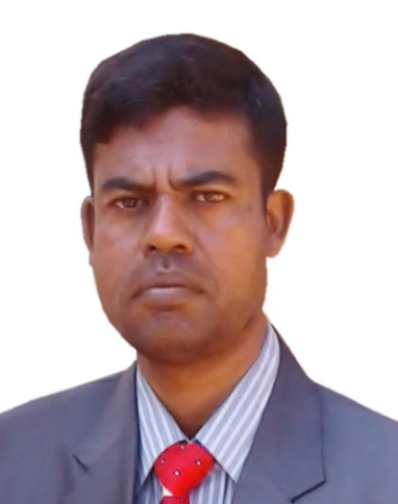
MD. ABDUR RAZZAK
HEAD TEACHER
DHALAHARA WESTPARA
SECONDARY GIRLS’ SCHOOL
E-mail: abdurrazzakmt@gmail.com
Phone number: 01721588402

Slide 2
TOPIC
LEARNING GRAMMAR
TITLE : CONNECTORS
CLASS : ix & x
Time : 50 minutes

Slide 3
LEARNING OUTCOMES
After the end of the lesson the Ss will be able to –
Talk about the pictures.
Explain what connectors are and their use .
Make sentences using sentence connectors .
Write good writings in their real life situations.

Slide 4
Acknowledgement
MoE, DSHE, NCTB , A2I respective officials & Prof. S. Yoffie
Note for the teachers:
Implementation of such model content depends on the class room situation and skills of the teachers. If the situation demands please edit it according to Ss’ demands.

Slide 5

Dhalahara Westpara Secondary Girls’ School
WELCOME TO MULTIMEDIA CLASS
ENGLISH

Slide 6
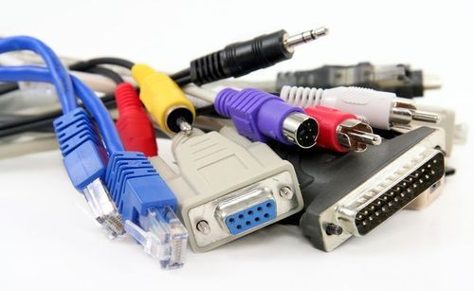
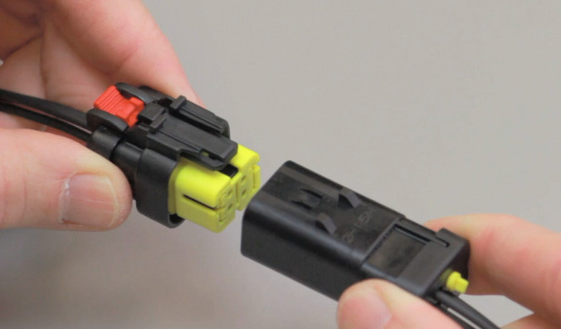
Look at the picture.

Slide 7
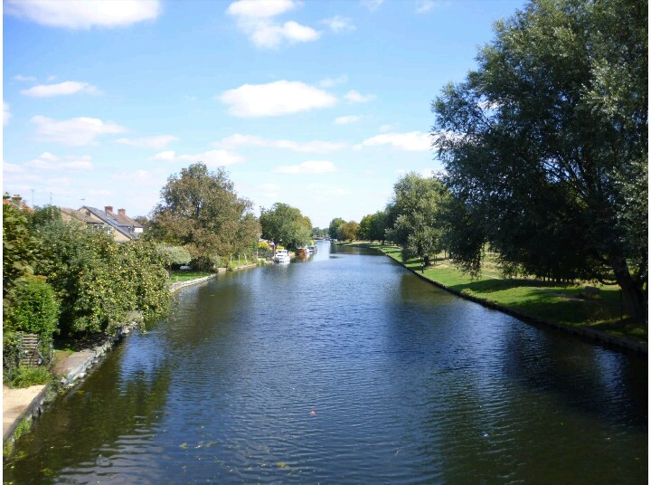
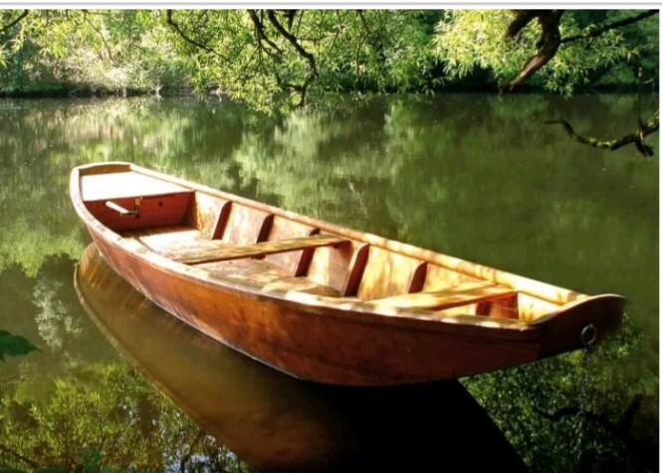
If you want to cross the river
you need a boat.
If you want to cross the river , you need a boat.

Slide 8

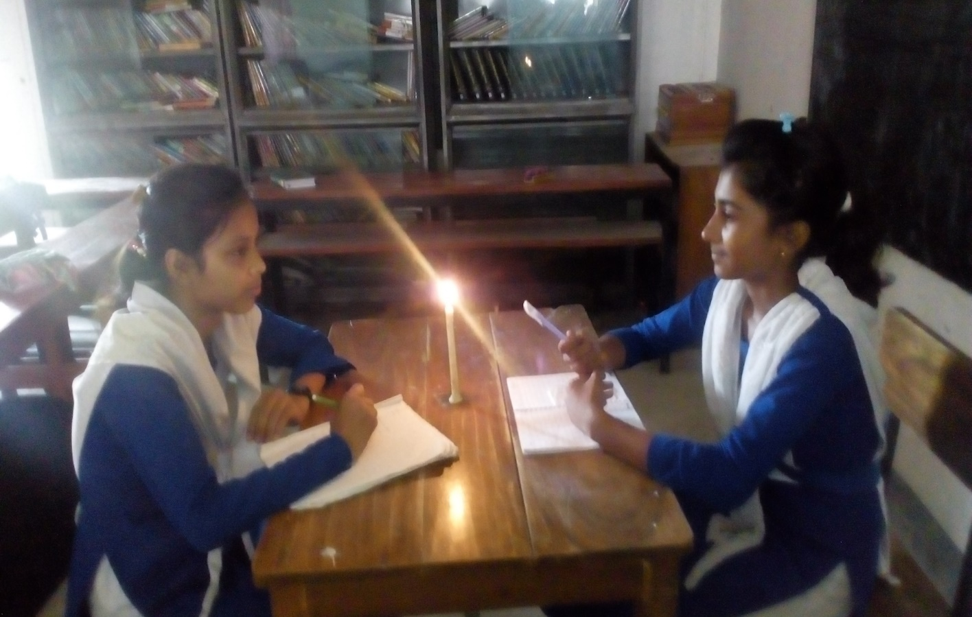
When load shedding goes on
we have to lit the lamp to study.
.
When load shedding goes on , we have to lit the lamp to study.

Slide 9
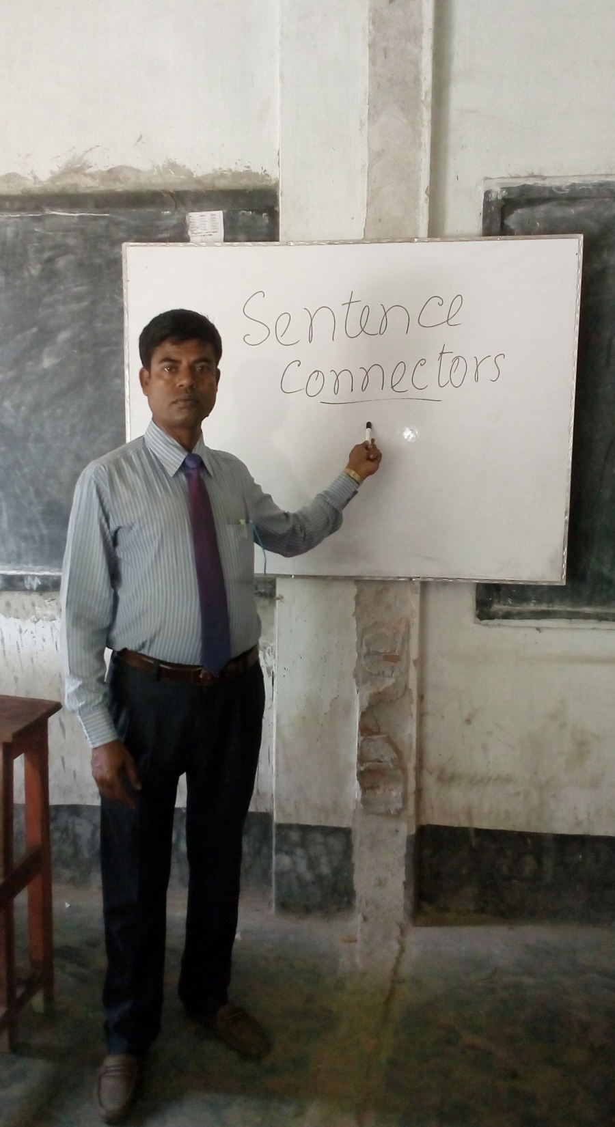
Could you tell me what we are going to learn today?
CONNECTORS/
LINKERS
CONNECTORS/
LINKERS

Slide 10
Do you think that learning CONNECTORS/LINKERS
is important in English language? If so, why and what is connectors?
Obviously: Because CONNECTORS/LINKERS are used to link a large group of words, phrases and sentences.
Without them we cannot maintain coherence in good writings.
Let’s discus about it.

Slide 11
Though/although he is poor, he is honest.
As/ since he was ill, he couldn’t go to school.
While/when his mother is sick, he takes care of her.
Sumona is not only a good student but also a good singer.

Slide 12
Either he or his brotherhas broken the glass.
She is small in size but (she is) active .
As your teacher, I will teach you to write better. Moreover,
I will increase your vocabulary.

Slide 13
Individual work
Complete the following text.
but also
Rupa is not only a good student…………a good player.
… she is comparatively weak in English. ……… she cannot cut good figure in English, she does well in other subjects. ---------she doesn’t understand any grammatical point, she takes help from her teachers. She wants -----to be a doctor or to be a teacher.
But
Though
If/when
either

Slide 14
Let’s discus more about it.
Some language teachers believe in memorizing dialogues. However, others think that memorization is not as good as engaging in natural conversations with native speakers.
I need to finish my writings. For this purpose, I am trying hard to do them.
Children need nutritious food. Furthermore, they need vaccinations.
Shima won the gymnastics competition. She graduated with honors as well.

Slide 15
My sister works full-time at the school Besides, she is active in English spoken course.
Malaysia has a very rainy climate. In fact, it rains there 65% of the time
You can have the rest of this chocolate cake. As a matter of fact, I hope you do it. Because I need to lose weight.
Arifa has never liked swimming. Actually, she's afraid of water and won't go near it.
I may go to my friend’s house. On the other hand,
I may stay there to finish my pending work

Slide 16
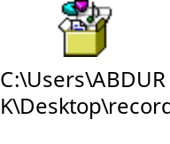
Pair work
Welcome to listening skills
and after listening the audio clip every pair will have to fill in the blanks with suitable transitional words.
like
The government has taken steps to make our country Digital one. a)…. every other sectors, education sector is going forward using ICT. In the institutions we are taking classes in the multimedia classrooms. b)…………………we the teachers have to make digital contents. c)………… most of the teachers have been given training on making digital contents. ….. all of them can not develop contents due to various types of barriers. d)……………considering the increasing demand of digital contents, a group of model content developers has been selected by A2i. e)………. A2i is doing this job very successfully.
For this purpose,
For this
But
However,
And

Slide 17
Let’s discus more about it to write good compositions.
To indicate similarity
Similarly
People cannot survive under water. Similarly, a fish will die if it is taken out of water.
Likewise
If you work hard, you will shine in life. Likewise, if you waste time, you will fail.
in the same way
Speaking a foreign language fluently needs oral practice. In the same way, playing the piano cannot be learned without regular practice.

Slide 18
To indicate contrast or giving in
However
Some language teachers believe in memorizing dialogues. However, others think that memorization is not as good as engaging in natural conversations with native speakers.
Nonetheless
I realize that skydiving is dangerous and expensive. Nonetheless, I want to try it.
despite (this)
I am going to have to get up at 4:00 in the morning to catch my train. Despite this, I probably won't go to bed until midnight.
in spite of (this)
Mita has the worst headache. In spite of this, she is going to sit for exam.

Slide 19
To indicate cause and effect
as a result
Grammar rules sometimes overwhelm and confuse students of English. As a result, many people avoid studying grammar.
consequently
Soma's car broke down on the highway. Consequently, she couldn't arrive on time for her class.
therefore
You will not be informed of the test result until next month. Therefore, it is a waste of time to keep calling the office.
thus
We are in the middle of a severe draught. Thus, the city government has asked us to conserve water whenever possible.
hence
Cats have flexible spines. Hence, they can do many physical maneuvers that people cannot do.

Slide 20
To indicate purpose
in order to
We need to find out what is causing your pain. In order to understand this, we need to do a series of tests.
with this in mind
Toufa realized that her job was at a dead end. With this in mind, she went back to college to learn more skills.
in addition
I have to study this evening. In addition, I have to cook dinner.
also
You can pay your bills in cash. You can also write a check.

Slide 21
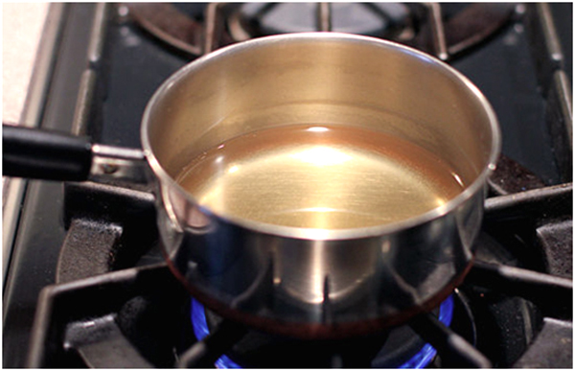
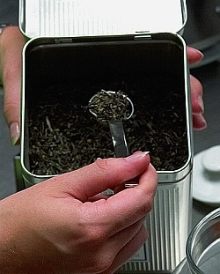
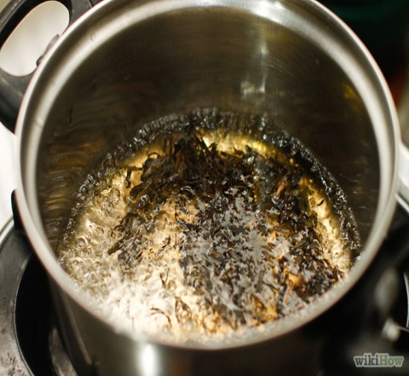
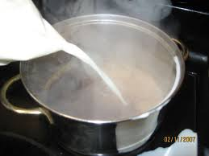
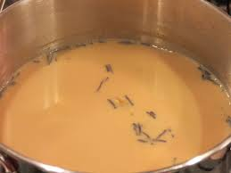
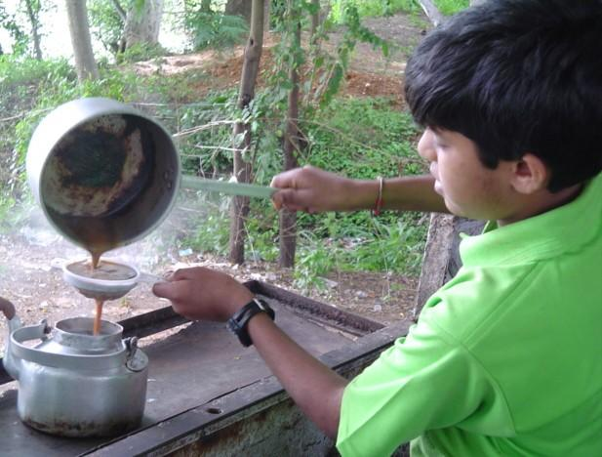
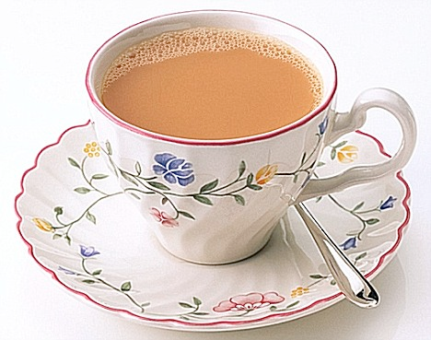
Discuss the pictures with your group members. Then develop a paragraph using the given clues.
Clues: At first, Then, After that, Next, Afterward, later ,Finally, Thus, But
GROUP WORK

Slide 22
How to Make a Cup of Tea
Tea is a good drink. no doubt. It removes our fatigue. Generally we entertain our guests with a cup of tea. But many of us do not know how to make a cup of tea. To make a cup of tea is not a hard task. At first he has to take one and a half cup of water into a kettle. Then he has to put the kettle over a stove. Next he has to heat it until the water is boiled. Later he has to put tea dust into the hot water. After that he has to take aside kettle from the stove when the water has turned into red colour. Afterward he has to pour the liquor into the cup through a filter. Finally he has to mix some sugar and milk with the liquor and shake it until the sugar is dissolved. Thus a cup of tea is prepared. But in case of lemon tea he to add some lemon juice instead of milk.

Slide 23
Feedback
because
She goes to the tennis club …………she likes to play tennis.
either
or
We can ……….. go to the cinema …..to the café.
in spite of
He looks very fit ……………his old age.
Since
…………he has lost his money, he couldn't go to the restaurant.
whether
I'm going home …………..you like it or not.

Slide 24
HOME WORK
Write a paragraph on Early rising using connects.

Slide 25
ADVICE
Connectors play an important role for good writings. So, be attentive to connectors.

Slide 26

THANKS ALL

