Slide 1
WELCOME
Business Studies
Class: ix
Subject: Introduction to Business
Chapter: Business Environment

Slide 2
Aveyj Kvjvg AvRv` iæ‡ej,
সহকারী শিক্ষক
knx` AvjvDwÏb D”P we`¨vjq, wgR©vcyi, cvKzw›`qv, wK‡kviMÄ|

Slide 3
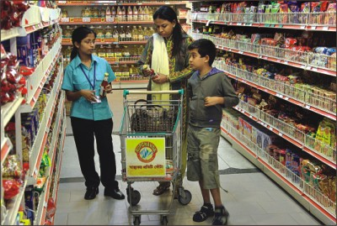
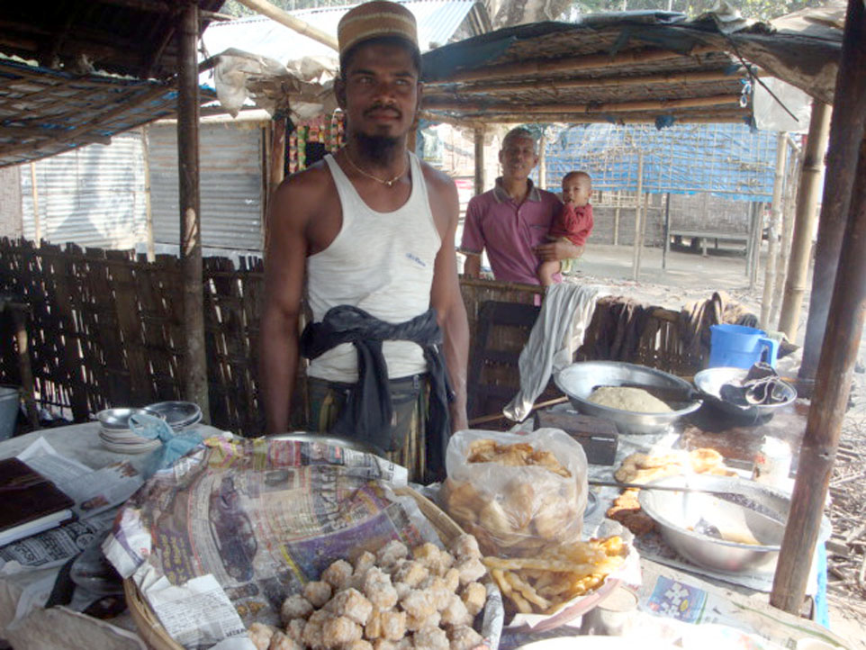
Learning Outcomes
By the end of this lesson students will be able to---
1. say what business environment is.
2. describe the elements of business environment.
3. explain the influence of environment on business.
4. compare and analyze among different types of
business.
Business
Environment
Shop in a village
Shop in a town

Slide 4
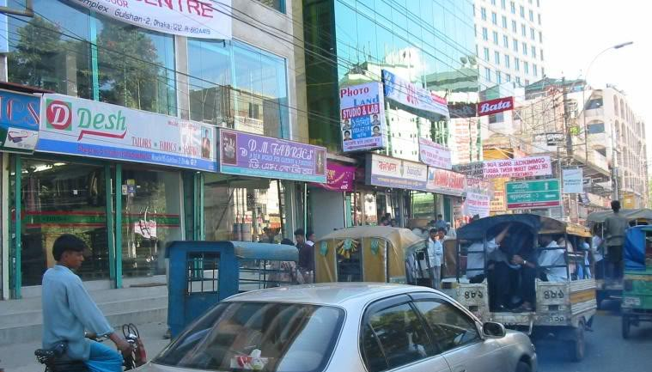
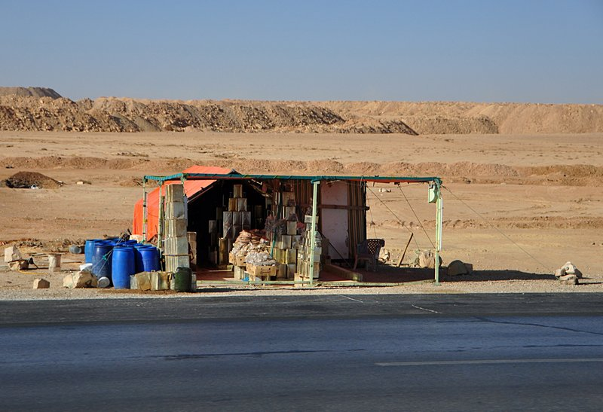
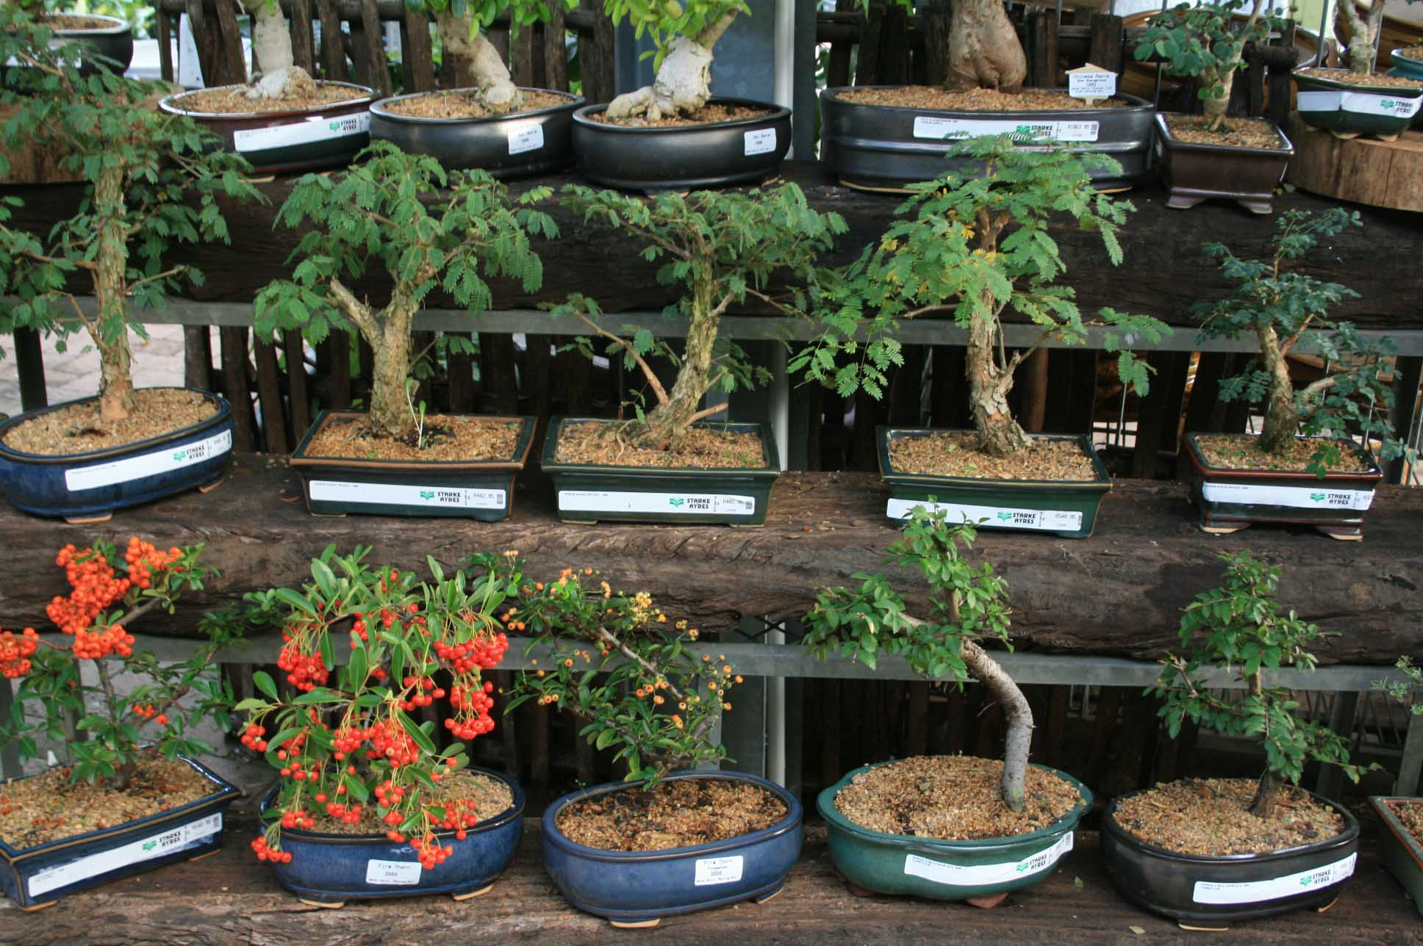
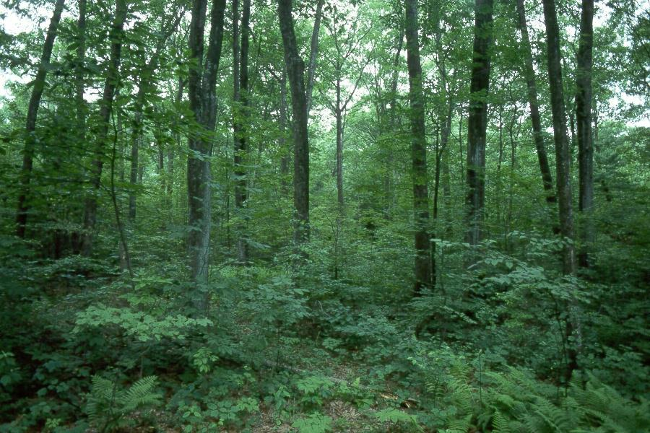
Business in desert
Business in populous area

Slide 5
Climate
Land and Natural Resources
Primary industries
&
Secondary
industries
Factors
influencing
Business
Environment
Finance and credit system

Slide 6
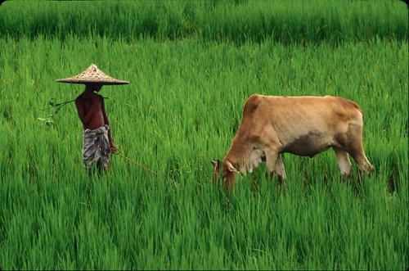
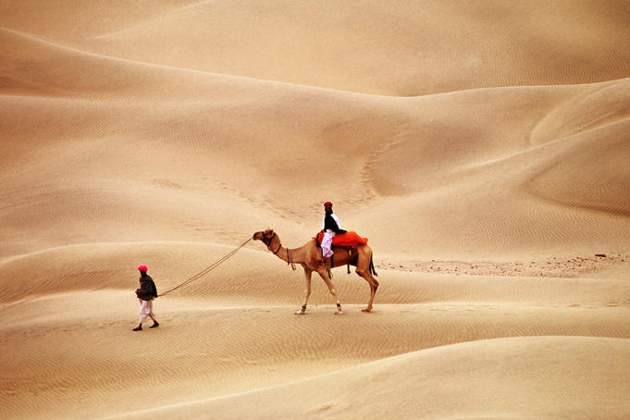
Climate
Natural
Environment
Tropical Area
Temperate Area
Cold Area

Slide 7
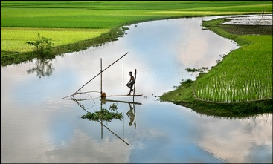
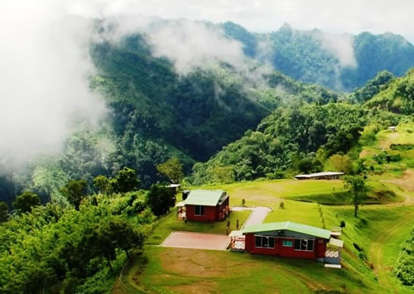
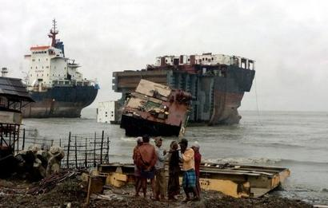
Land and Natural Resources
Natural
Environment
Plain land
Hilly area
Sea beach

Slide 8
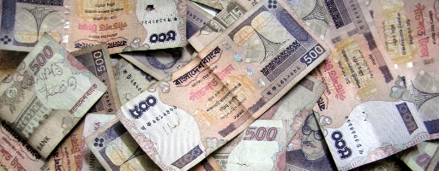
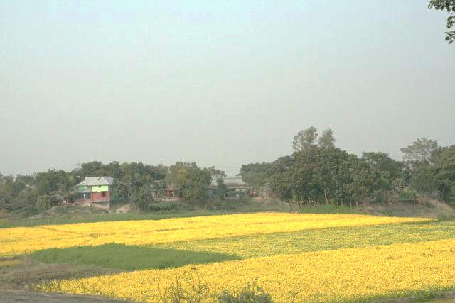
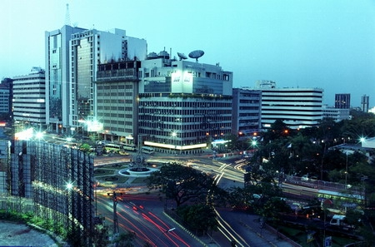
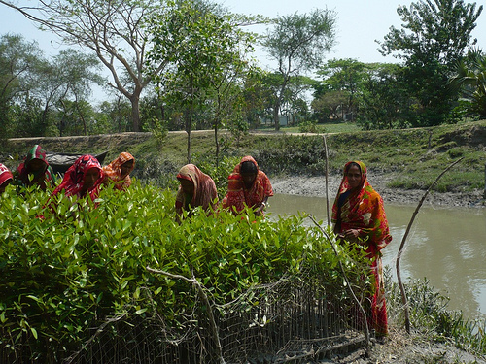
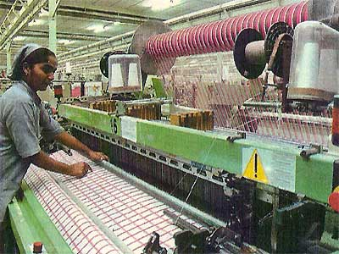
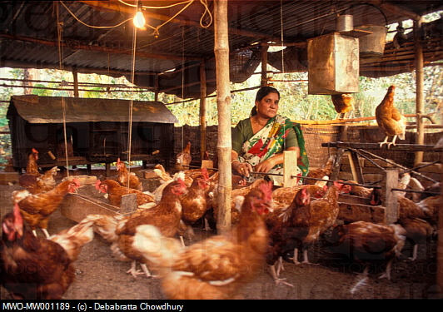
Money & Credit System
Primary
Industry
Economic
Environment
Secondary
Industry

Slide 9
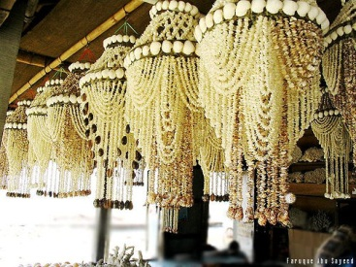
Group Work
Form groups of five. Then discuss and write the answers of the following questions.
1.Where is this shop situeted ?
2.Which environmental elements influence to set up and run this type of business?

Slide 10
EVALUATION
1. Which types of business do not require machines?
2. What are the difficulties to cultivate apple in
Bangladesh?
3. Why is it difficult to establish big industries in
villages?
4. Why Japan is enriched in industries?

Slide 11
Homework
Abir wants to establish a jute industry in Saudi Arab. Do you support his decision? Give reasons for your opinion.

Slide 12
THANKS

