Slide 1



WELCOME

Slide 2
Objectives:
Presented by:
Lesson Identity:
Students will be able to…
Zobeda Israt
Azhar Uddin Government Primary School.
Hatiya, Noakhali.
1.1.1 become familiar with English sounds by listening to common English words
Class-Two
Subject: English
1.1.2 say simple words and phrases with proper sounds and stress
2.1.1 recognize and read cardinal numbers up to 5-7
4.1.2 write numbers up to 5-7 in figures and in words.

Slide 3

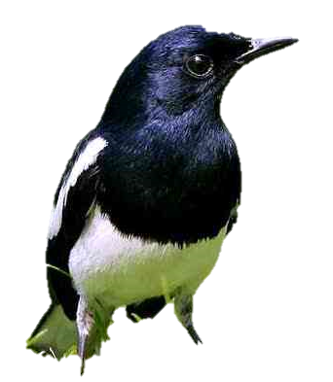

What can you see in the picture?
How many apples?
How many birds ?
How many flowers?

Slide 4
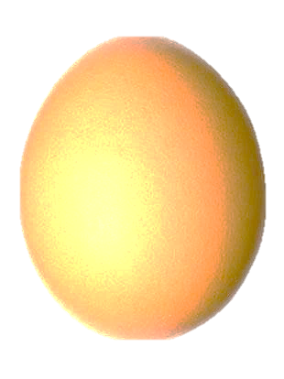

Look and say
5
6
7

Slide 5
Today our lesson is
Numbers
Lesson- 1 -3
Page- 8

Slide 6
Look and say
5
6
7
five
six
seven

Slide 7

Look, listen and say:
5
five

Slide 8

Look, listen and say:
6
six

Slide 9

Look, listen and say:
7
seven

Slide 10
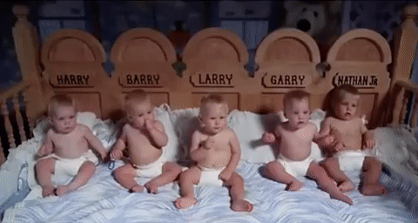
How many babies?
6
5
7
five

Slide 11
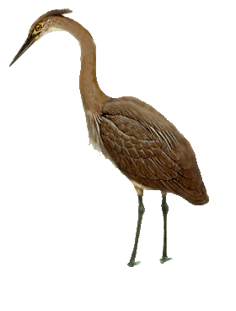
How many birds?
5
6
7
six

Slide 12
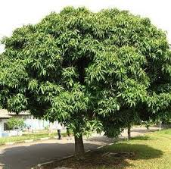
How many mangos?
6
7
5
seven

Slide 13

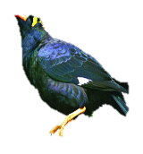
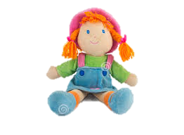

Look, listen and say:
Picture
Figure
Word
5
five
6
six
7
seven

Slide 14
six
Say, trace and write.
5
6
7
seven
five

Slide 15
Match the numbers with words:
P.W
Time: 5 minutes
Number
Word
6
seven
5
six
7
five

Slide 16
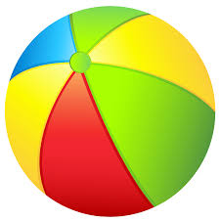
Write the missing numbers by using pictures:
I.W
Time: 5 minutes
5
6
7
five
six
seven

Slide 17
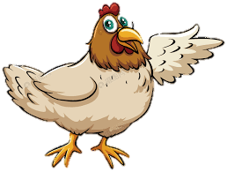
Checking learning
W.C.W
Count and write the numbers:
7
6
5

Slide 18

Thank you

