Slide 1
WEL COME

Slide 2
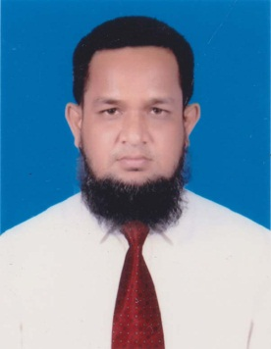
IDENTITY
MD. ABDUR ROUF
Lecturer(English)
Khalna Islamia Fazil(Degree) Madrasah
Patnitala,Naogaon.
CLASS-Eight
ENGLISH 2ND PAPER
DATE: 20/09/2019

Slide 3
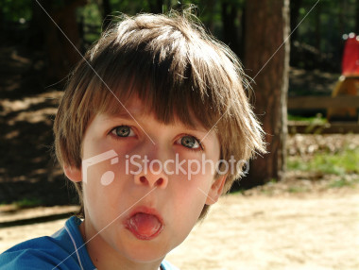
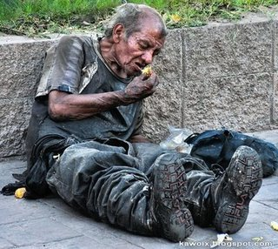
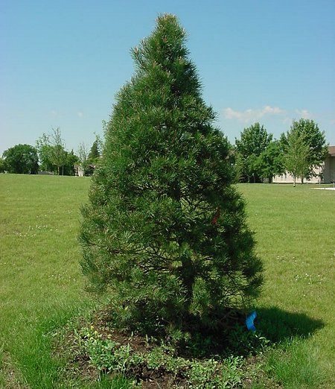
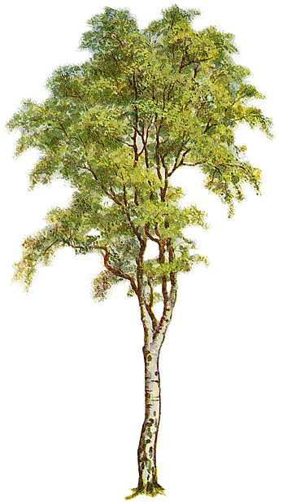
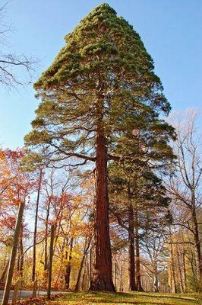
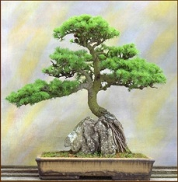
naughty boy
Poor man
Ten taka
tall
taller
tallest

Slide 4
Adjective Of Degree’

Slide 5
Learning Outcomes
After learning the lesson Ss can know about the formation of Degree.
Kind of Degree
Ss can also use them properly.
Make sentence.

Slide 6
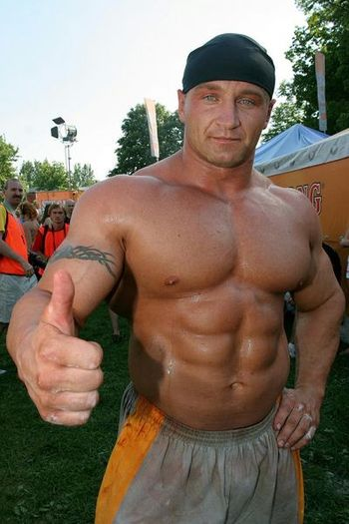
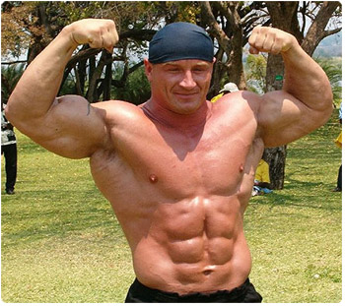
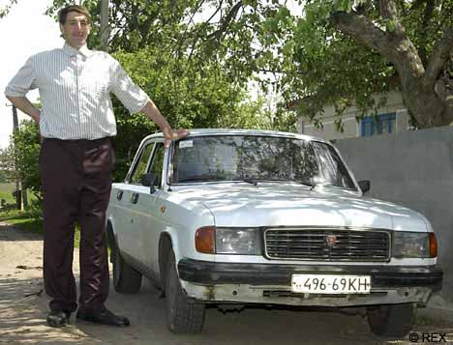
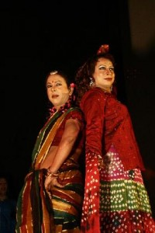
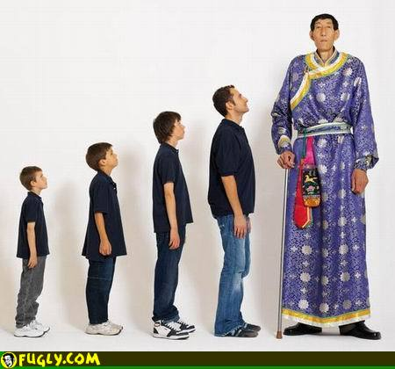
Strong
Stronger
Strongest
Taller
Tallest
Tall
-Usually ‘er’& ‘est’ are used to make comparative & superlative.

Slide 7
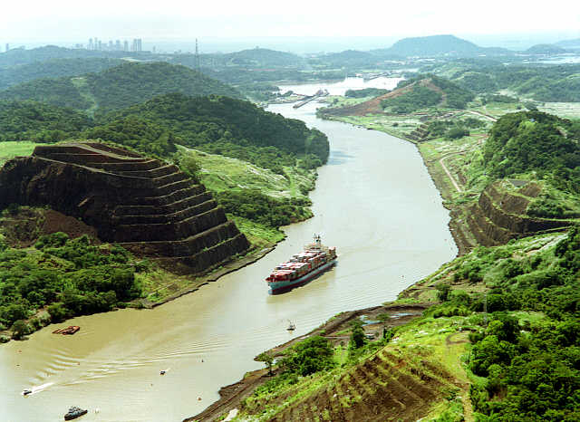
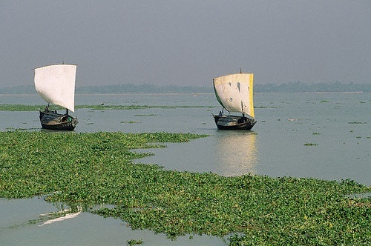
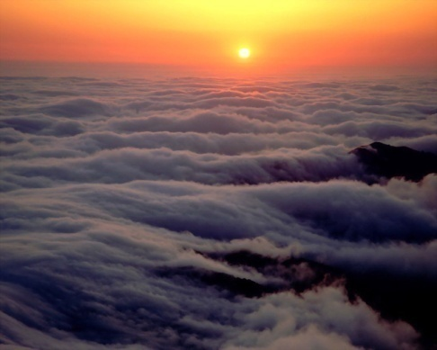
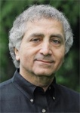
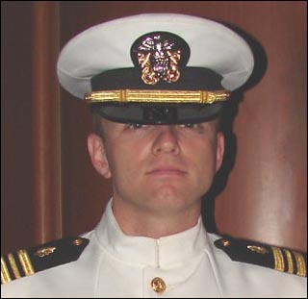
large
larger
largest
brave
braver
bravest
- Here ‘er’ & ‘est’ are used to make comparative & superlative

Slide 8
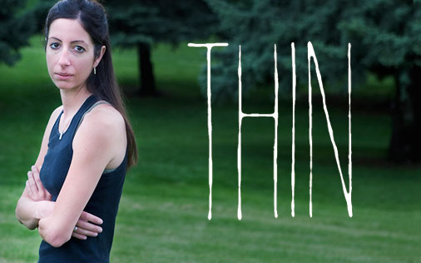
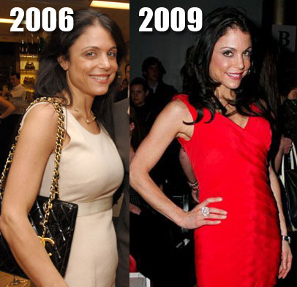
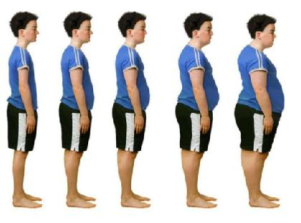
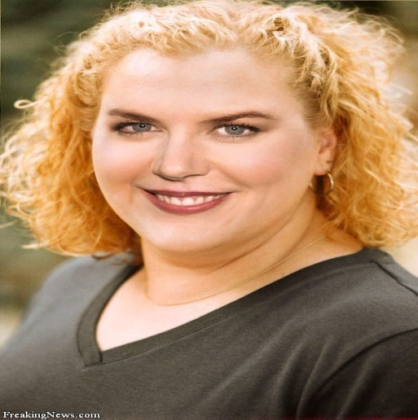
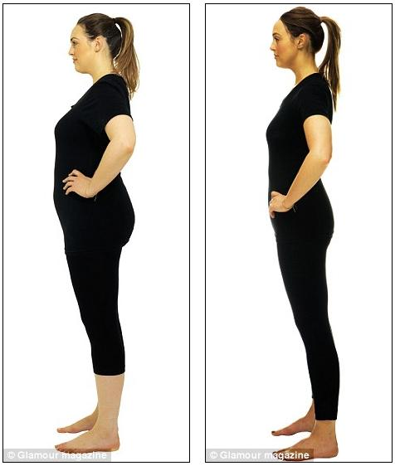
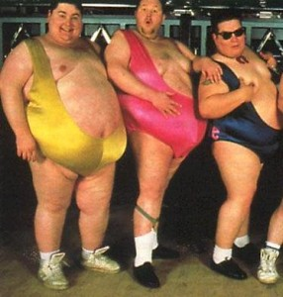
Thin
Thinner
Thinnest
Fat
Fatter
Fattest
-Words finishes with a consonant & before one vowel use double consonant to make comparative & superlative .

Slide 9
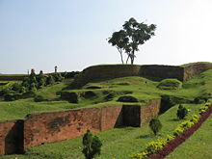
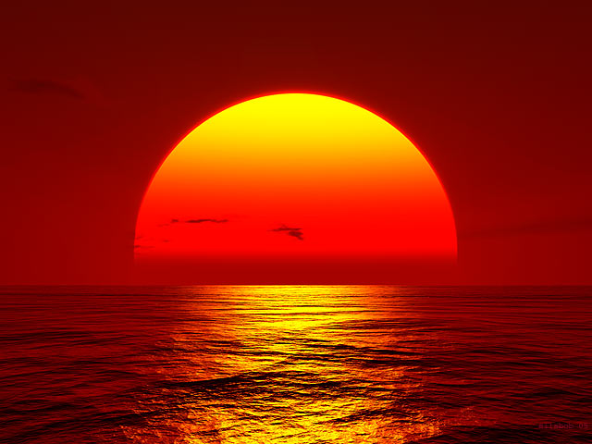
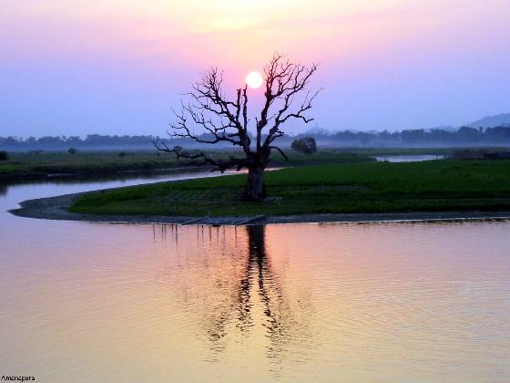
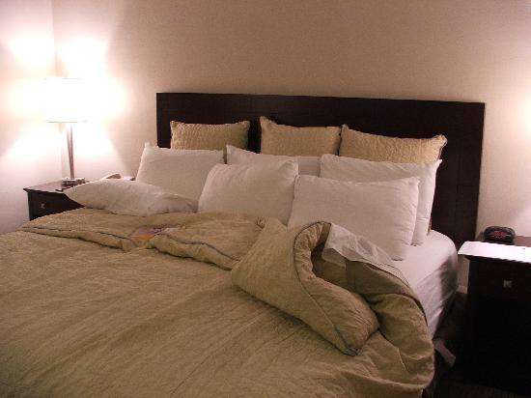
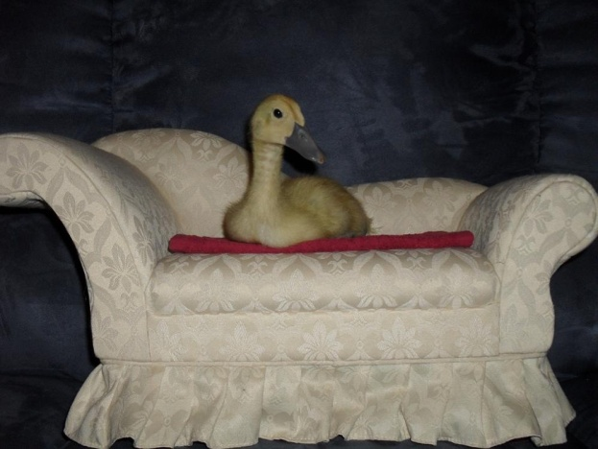
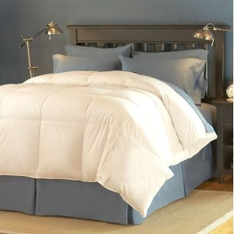
Beautiful
More beautiful
Most beautiful
Comfortable
More comfortable
Most comfortable
-For more than one syllable we use ‘more’ & ‘most’ to make comparative and superlative.ssssss

Slide 10
Group Work :
Make Comparative and Superlative of the following words :-
Thin, useful, clever, smaller, hot, big, intelligent, cold, brave, warm.

Slide 11
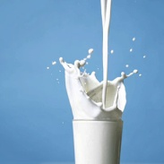
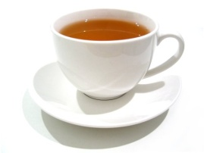
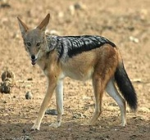
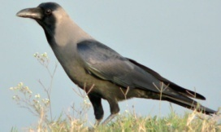
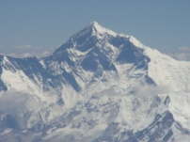
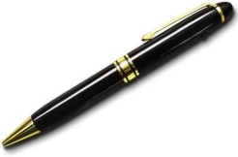
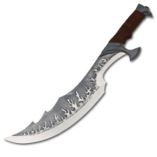
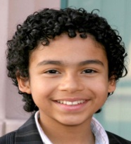
Evaluation:
Fill in the blank with the following adjectives :
a) A is---------------than a .
b) A is-------------------- than a .
c) The is the -------------- mountain in the world.
d) A is -------------------than a .
e) is a ----------- boy .
more conning
highest
smart
mightier
better

Slide 12
Home Work
Frame 5 sentences by using Positive , comparative & superlative degree.

Slide 13
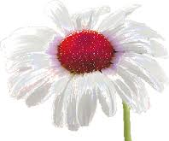
THANKS

