Slide 1
WEEL COME

Slide 2
TEACHER IDENTITY
MD.ABDUR ROUF
LECTURER (ENGLISH)
KHALNA ISLAMIA FAZIL(DEGREE) MADRASAH
PATNITALA,NAOGAON.

Slide 3
Lesson Introduction
Class : Nine
Subject : English 2nd paper
Unite : one
Lesson : one
Time : 45 Min.
Date : 09/10/2019

Slide 4
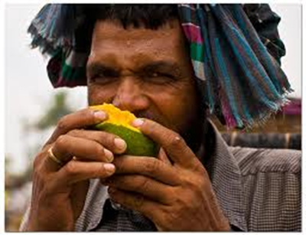
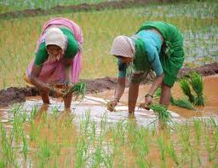
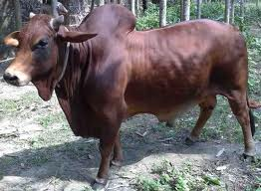
Look at the pictures below
He eats mango
They are working in the field.
I have a cow

Slide 5
Today’s Topic
Parts of speech

Slide 6
Objectives
By the end of the lesson, Student will able to-
give definition of parts of speech.
tell how many kinds of parts of speech.
make a various kinds of parts of speech

Slide 7
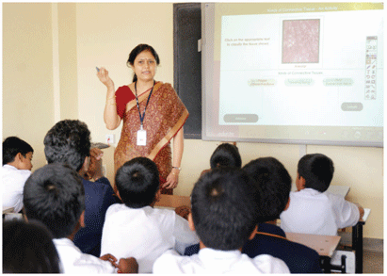
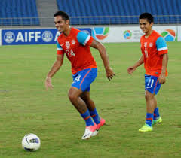
Look at the picture, and say…..
Mrs. Rehena is a school teacher.
Are they playing football?

Slide 8
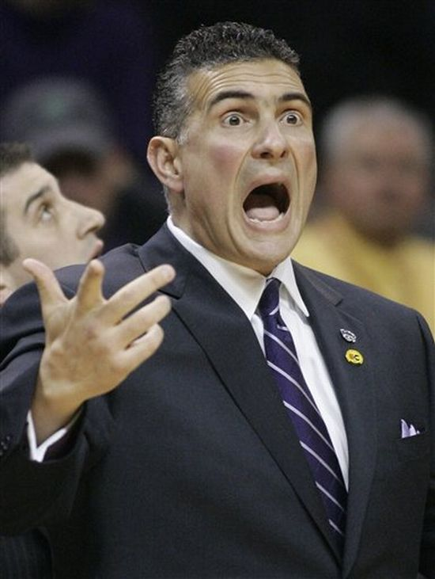
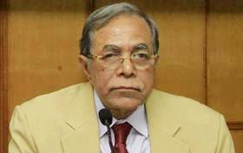
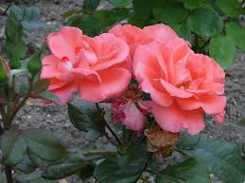
Do not shout.
May long live our president.
How fine the flower is!

Slide 9
What is parts of speech?

Slide 10
Pair Work
How many kinds of parts of speech?
parts of speech
noun
pronoun
adjective
verb
adverb
preposition
conjunction
interjection

Slide 11
Evaluation
◊ What is parts of speech?
◊ How many kinds of parts of speech?
◊ Give the any one example of parts of speech.

Slide 12
Home Work
Every body makes three example every parts of speech.

