Slide 1
Welcome to everyone
Notes:
This is a welcome slide. I have chosen the pearl picture because the topic is related to the subject matter. If you want, you can change, no problem.

Slide 2
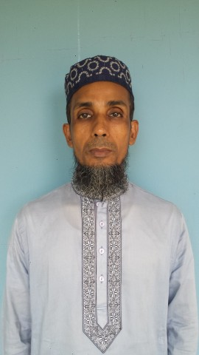
Identification
Mohammod Helal Uddin
Assistant Teacher ( English )
Wahid Siddek High School,Gurarai,
Sadar, Moulvibazar
E-mail: helal.bd.mb@gmail.com
Mobile: 01720630018
Class-eight
Unit :seven
Lesson :one

Slide 3
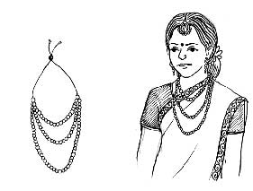
A Look at the pictures then say about them.
Notes:
Students will discuss this pictures in pairs. Teacher may monitor the discussing.

Slide 4
Let’s go enjoy the following and guess which video is this?
Notes:
Last greeting.

Slide 5
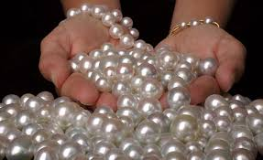
Today our Lesson is…….
Pearls! Pearls! Pearls!
Notes:
Lesson declaration. Teacher may skip to the page 15 directly to avoid page No.7-14 clicking right play button (Word meaning).

Slide 6
Learning outcomes
At the end of the lesson, we will be able to-
ask and answer questions
listen for information
read and understand text through silent reading
Notes:
Speaking, listening, reading and writing skills will be focused.

Slide 7
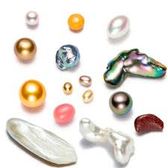
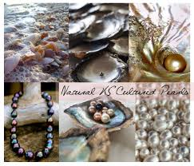
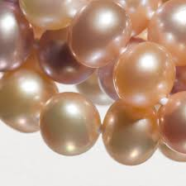
Key Words
Word Meaning
Pearls
Pearls are valuable things in the world
Notes:
Last greeting.

Slide 8
Mythology
Meaning: Folklore, Tradition, Mythos,
Pearls have been mentioned in religious texts mythologies from the earliest times.
Notes:
Teacher may show the word first, then ask the meaning and at last he may show the meaning and sentence making .

Slide 9
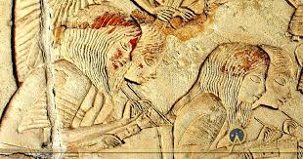
Ancient
Meaning: Olden, Age-old, Earliest
In ancient Rome, pearls were considered the greatest sign of wealth and social status.
Notes:
Teacher may show the word first, then ask the meaning and at last he may show the meaning and sentence making .

Slide 10
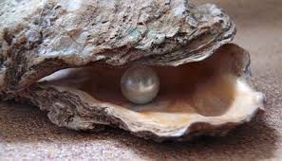
Dissolve
Meaning: Melt, liquefy, thaw
Pearls were dissolved in water in ancient time.
Notes:
Teacher may show the word first, then ask the meaning and at last he may show the meaning and sentence making .

Slide 11
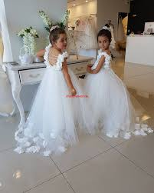
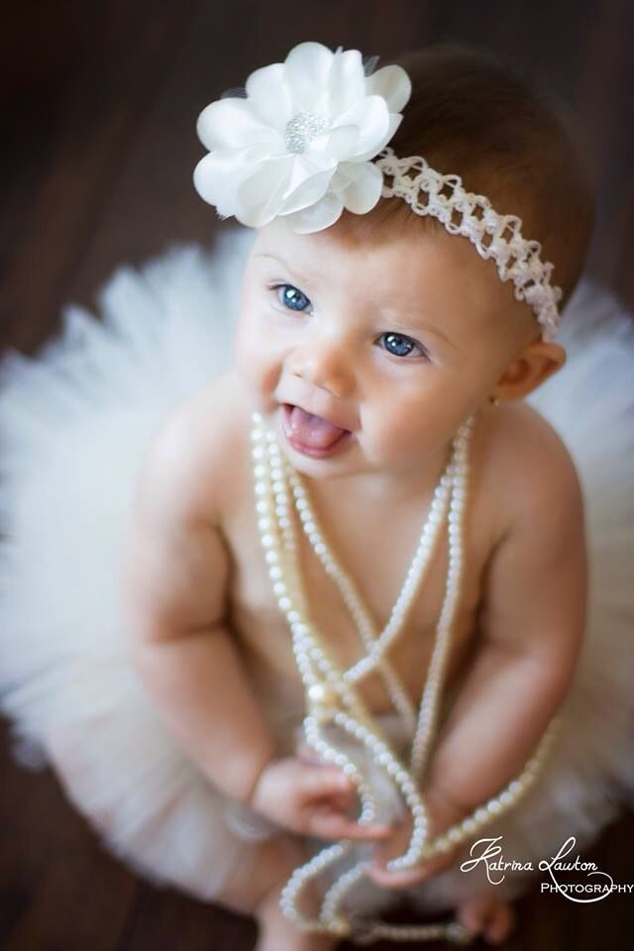
Status
Meaning: Rank, Position,
Pearls were considered as the sign of status in ancient time.
Notes:
Teacher may show the word first, then ask the meaning and at last he may show the meaning and sentence making .

Slide 12
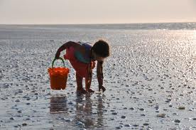
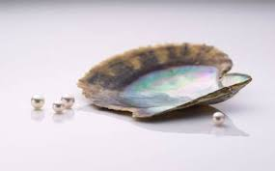
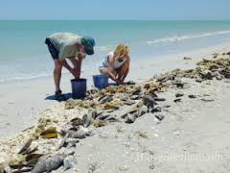
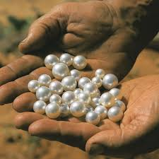
Pair Work
Look at the pictures and answer the questions.
Do you think Pearls were discovered by ancient ? Why ?
Notes:
Teacher may read it loudly as a part of focusing listening skill.

Slide 13
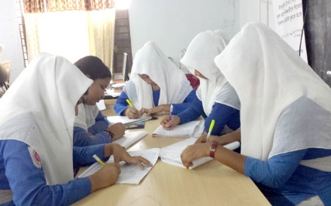
Group Work
Read the passage and answer the following questions
Notes:
Last greeting.

Slide 14
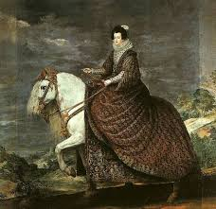
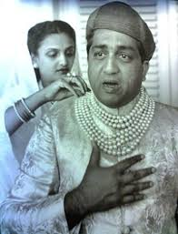
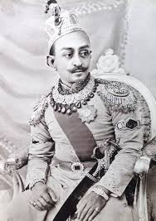
Individual Work
Look at the pictures and answer the questions
Who did use pearls for good Luck ?
The brave knights used to wear pearls in the battles for good luck.
Notes:
Teacher may read it loudly as a part of focusing listening skill.

Slide 15
Pair Work
C Read the text in B again and write the information in the table.
Who | When/Where
The ancient Egyptians | wore | pearls
The Greeks
The ancient Romans
The brave knights
Notes:
Reading and writing skill will be focused by this option.

Slide 16
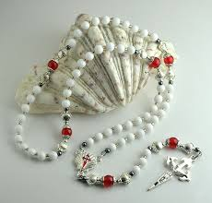
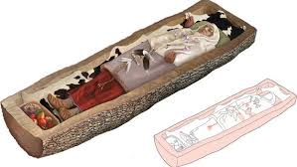
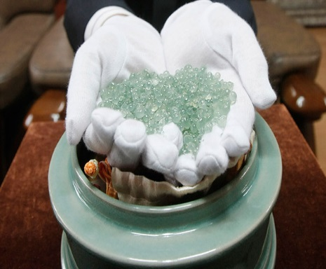
Evaluation
Look at the pictures and answer the following questions
When was the first pearl probably discovered ?
Why were they buried with pearls ?
Why do you think pearls were valued so much in the past ?
Notes:
Last greeting.

Slide 17
Home Work
Write a summary of the passage.
Notes:
Last greeting.

Slide 18
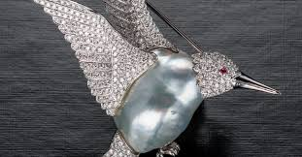
Thank You
Notes:
Last greeting.

