Slide 1
Welcome

Slide 2
Identity
c
c
c
Class-Nine
Subject-English 1st paper.
Writing part.
c
Md.Abul Hossain
Asst Teacher
Banagram Manik Uddin High School.
Sarishabari,Jamalpur.
c
c

Slide 3
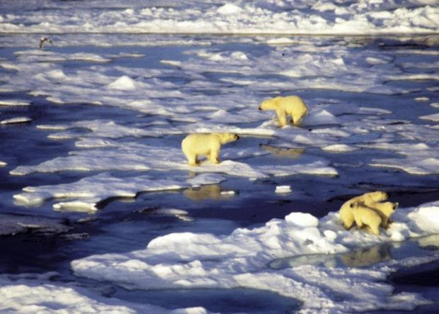

Slide 4
Unit-05
Nature and Environtment

Slide 5
Learning outcomes
After we have studied lesson, we will be able to…………………
Comprehend and summaries texts.
Ask and answer questions.
Take part in role playing and making dialogues

Slide 6
Our today’s lesson -01
The greed of the roaring rivers

Slide 7
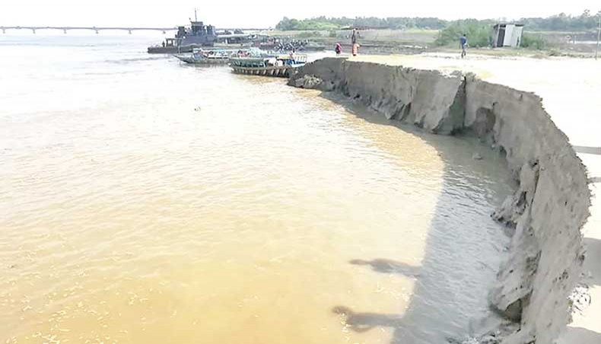
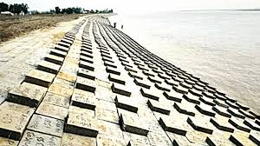
jamuna river

Slide 8
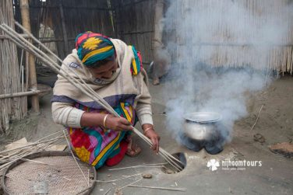
Meherjan try to fire but not fire?

Slide 9
Vocabulary
Embankment - বেড়িবাঁধ।
Trembl - কাঁপা।
Whispering - শো শো শব্দ।
Erosion - ক্ষয়।
Threaten - ভয় দেখানো।
Prompet - চটপটে।

Slide 10
Group work
Complet the summery of meherjan’s life with word from the box
Due to
homeless
Slum dweller
hunger
victims
Close to
Meherjan is a typical (1)-------------- woman who lives in a slum. she lost her shelter and properties (2)----------- the erosion of the river Jamuna. her husband had died of diseases caused by poverty and (3)------------. Now, she is only a (4)-------.Like Meherjan there are many people who have become the (5)------------of the river erosion.

Slide 11
Evalution
What dose meherjan use to make fire for cooking her meals?
What property did Meherjan lose due to river erosion ?
What do you know abut Meherjan’s family ?

Slide 12
Home work
Write a summary of the passage .

Slide 13
Thank you

