Slide 1

Welcome

Slide 2
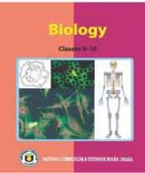
Identity
Presented by
Afroza nasreen sultana
Assistant Teacher
Govt high school .
Class : Nine
Biology
Chapter:5

Slide 3

What can you see in this picture?
Notes:
Teacher may ask about the picture first to take out the lesson name.

Slide 4
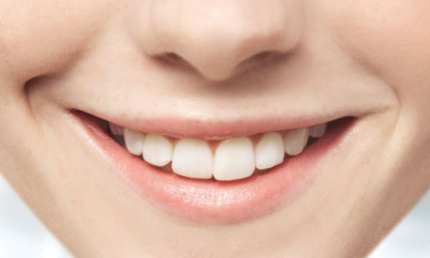
Lesson Declaration
Today we `ll discuss about
Human Teeth

Slide 5
Lesson Objectives:
After viewing this presentation you will be able to-
Explain teeth structure
Identify different kinds of human teeth
Describe human teeth componenets

Slide 6
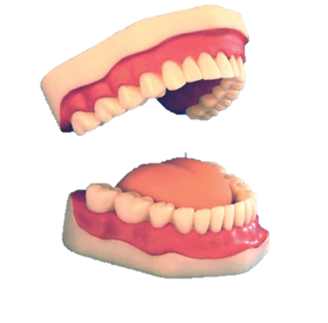
How many times human teeth are appear ?
What can you see in this picture?
We can see human teeth .Teeth are the hardest part of a body . An adt 16 in each half of the jaws.
Milk teeth appear first in childhood and are replaced by the permanent teeth up to the age of 18 years .

Slide 7
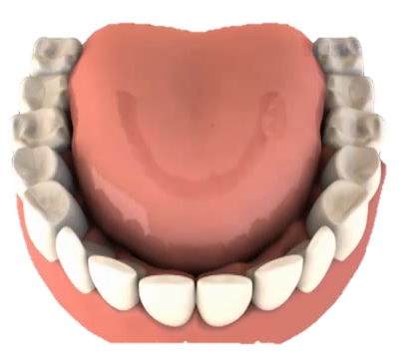
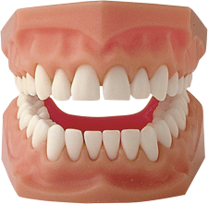
Can you tell how many types of permanent teeth ?
Do you know the name of this teeth?
Do you know how does it work ?
How many types do you see in this picture ?
Molar
Premolar
Canine
Incissor
There are four types of teeth in this picture
Each half of jaw bears 2 Incissors ,1 canine, 2 Premolar, 3 molar

Slide 8
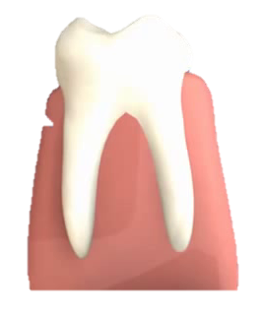
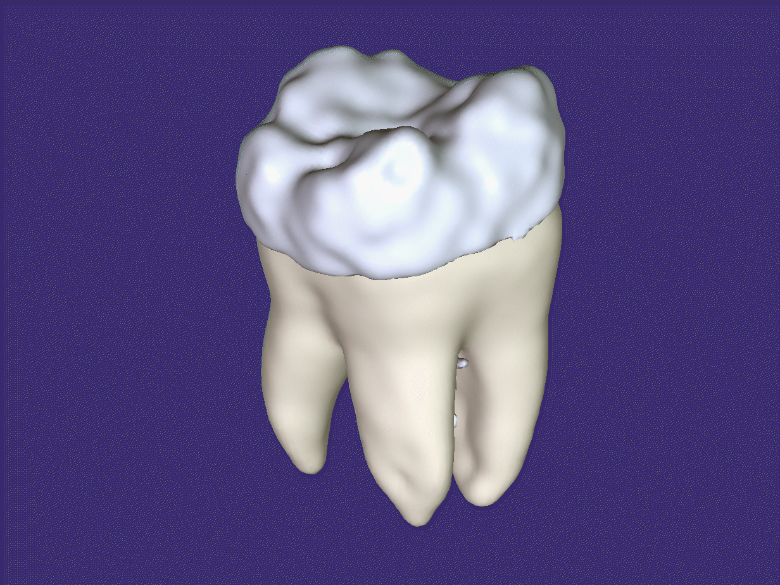
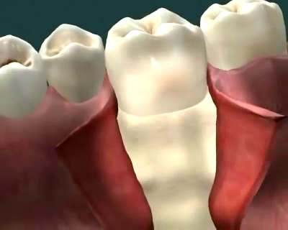
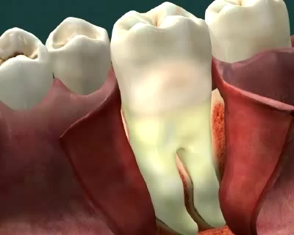
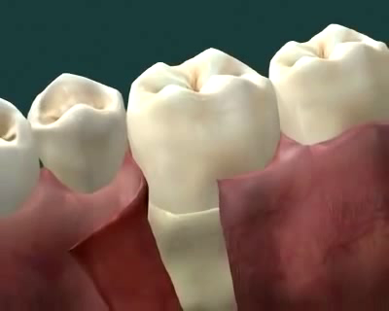
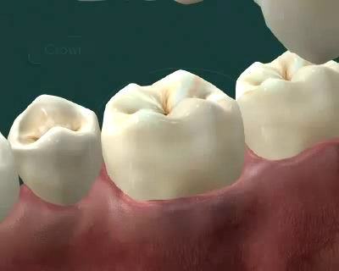
Structure of teeth
What is the name of this parts ?
How many parts are there ?
What can you see in this picture?
What is it called?
What can you see in this picture?
What can you see in this picture?
What is it called?
What is it called?
Crown
Neck
?
Root
The part of above the gum
It is called Crown
It is called Root
It is called Neck
The inner part of below the gum
The tooth between crown and root
There are three parts

Slide 9
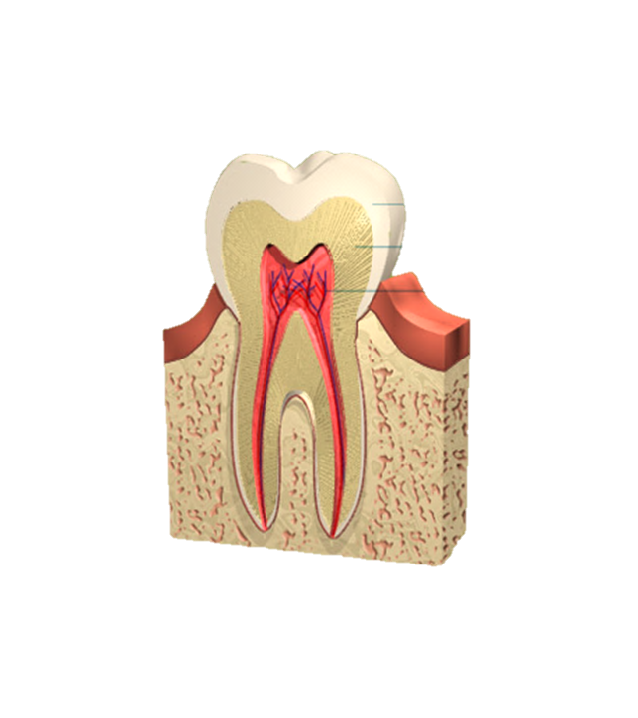
Do you know which components are composed each tooth?
Enamel
Now we watch a video clip
Dentine
Pulp
https://www.youtube.com/watch?v=X2ua1sMqmDI
Cement
Longitudinal section of teeth

Slide 10
Group work:
Time : 10 minute
Make a chart of various types of teeth and write how it works .

Slide 11
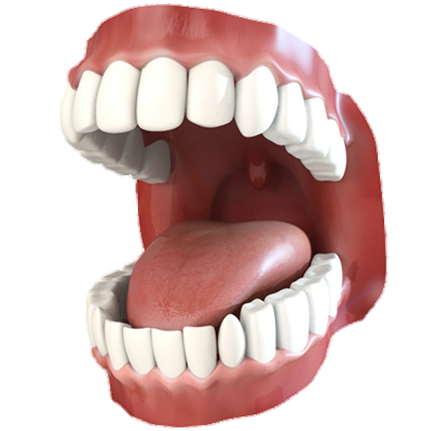

Evaluation :
?
1. What is the name of arrow mark pathway ?
a) Premolar b) Incissor
c) Canine d) Molar
2
. Which tooth cut and bite the food ?
a) Premolar b) Incissor
c) Canine d) Molar

Slide 12

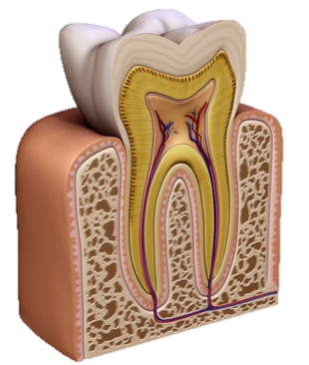
Home work
If it does not work properly , what problem arises – give reasons to support your answer?

Slide 13
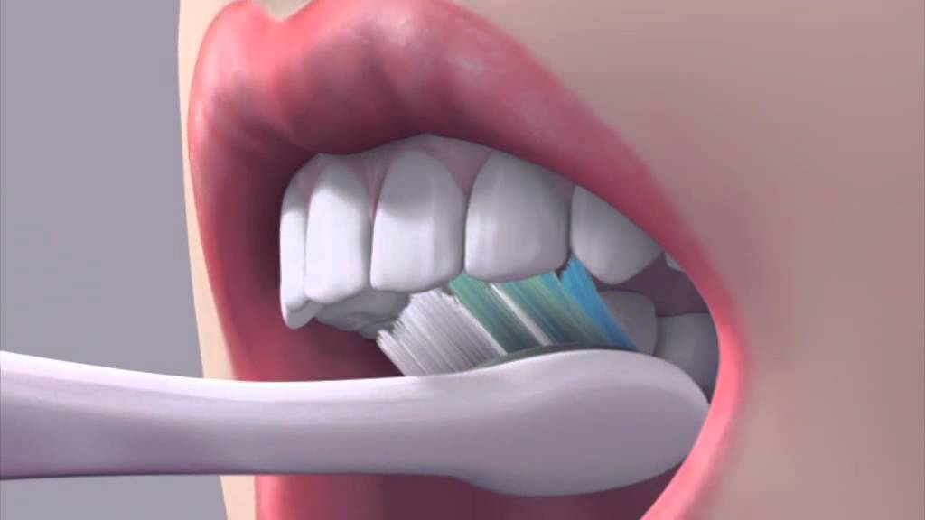
Thank you all

