Slide 2
MD. KOWSER ALI
ASISSTANT TEACHER
DURLOVPUR GOVT. PRIMARY SCHOOL
HORINAKUNDU, JHENIDAH.
kowser.gps@gmail.com
Sub: English
Class: Two
Lesson : The Golden Goose
Parts of the lesson: Activity-B
Page No-59

Slide 3
Safety environment by greetings song.
Hello! Hello! How are you?
I’m well, I’m good.
I’m great, I’m wonderful.
Hello! Hello! How are you?
I’m fine! I’m great today.

Slide 4
Checking homework and justify the previous lesson.
What kind of eggs did the goose lay?
What did the farmer do with the eggs?

Slide 5
Our today’s lesson is too--
Today we will read the 2nd part of the story.

Slide 6
LEARNING OUTCOMES
By end of the lesson students will be able to-------
Listening: 1.1.1 become familiar with English sounds by listening to common
English words.
4.2.1 enjoy simple stories
Speaking: 1.1.1 repeat after the teacher simple words and phrases with
proper sounds and stress.
1.1.2 say simple words and phrases with proper sounds and stress.

Slide 7
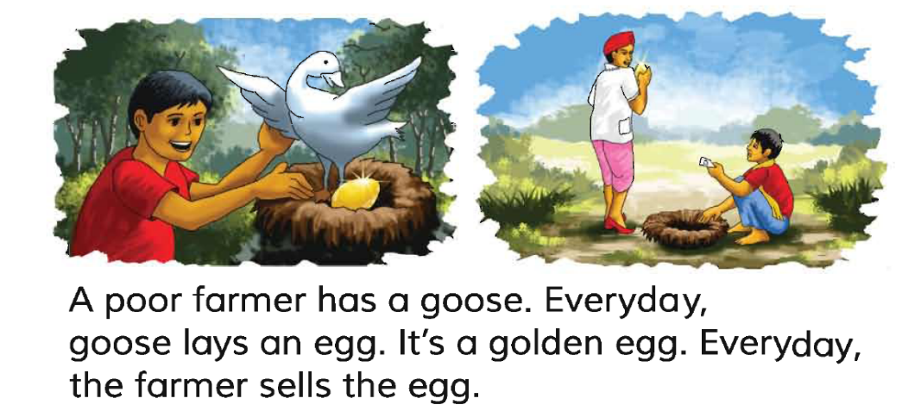
Let’s read the 1st part of the story again.

Slide 8
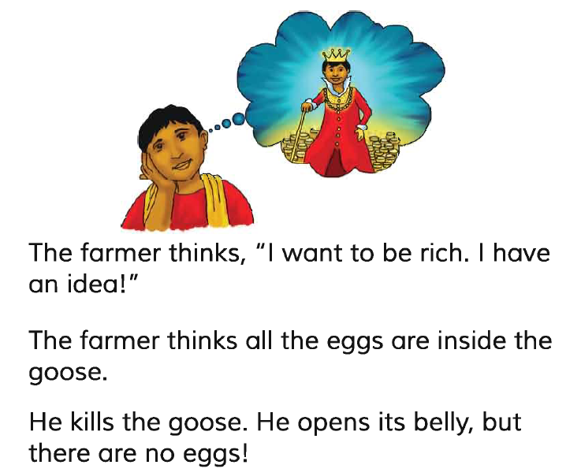
Now we will read the 2nd part of the story.
Repeat after me.
Reading. (SGW)

Slide 9
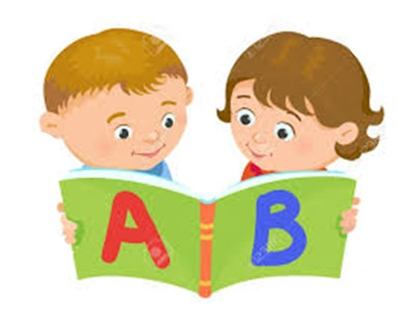
Reading in pair.
I reading.

Slide 10
Read and say.
He kills the goose. He opens its belly. But there was no eggs.
The farmer thinks all the eggs are inside the goose.
The farmer thinks, “ I want to be rich. I have an idea”.
Identifying weak students and taking to cure.

Slide 11
One day one word
Read and say
idea
ধারণা
Spell out the word - SGW

Slide 12
Find out the letters that are made by the word -----.
n
i
z
m
d
x
e
k
c
a
Find out the correct word------.
idia
adia
idea
idae

Slide 13
Say the missing letter.
i-ea
id-a
-dea
ide-
Write the word to your notebook.
তারিখঃ ০০/০০/০০
idea
আইডিয়া
ধারণা

Slide 14
Home work
Page 55 will be well read and written.

Slide 15
That’s all for today. Goodbye. See you tomorrow.

