Slide 2
MD. KOWSER ALI
ASISSTANT TEACHER
DURLOVPUR GOVT. PRIMARY SCHOOL
HORINAKUNDU, JHENIDAH.
kowser.gps@gmail.com
Sub: English
Class: Two
Lesson : The Golden Goose
Parts of the lesson: Activity-C
Page No-60

Slide 3
Safety environment by greetings song.
Hello! Hello! How are you?
I’m well, I’m good.
I’m great, I’m wonderful.
Hello! Hello! How are you?
I’m fine! I’m great today.

Slide 4
Checking homework and justify the previous lesson.
What kind of eggs did the goose lay?
What did the farmer think?
Did the farmer have any goose?
Who was sad?

Slide 5
Our today’s lesson is too--
Activity-C

Slide 6
LEARNING OUTCOMES
By end of the lesson students will be able to-------
Listening: 3.1.2 understand simple questions and statements about familiar objects.
4.2.1 enjoy simple stories
Speaking: 1.1.1 repeat after the teacher simple words and phrases with
proper sounds and stress.
1.1.2 say simple words and phrases with proper sounds and stress.

Slide 7
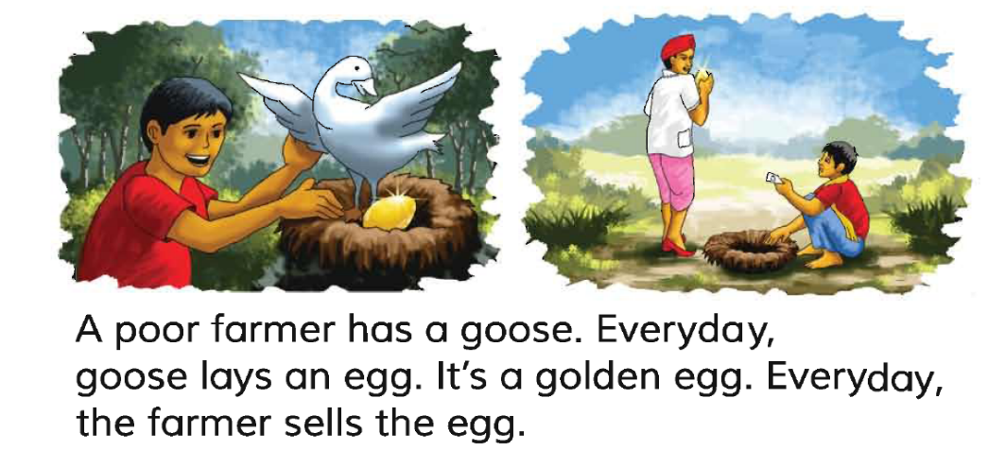
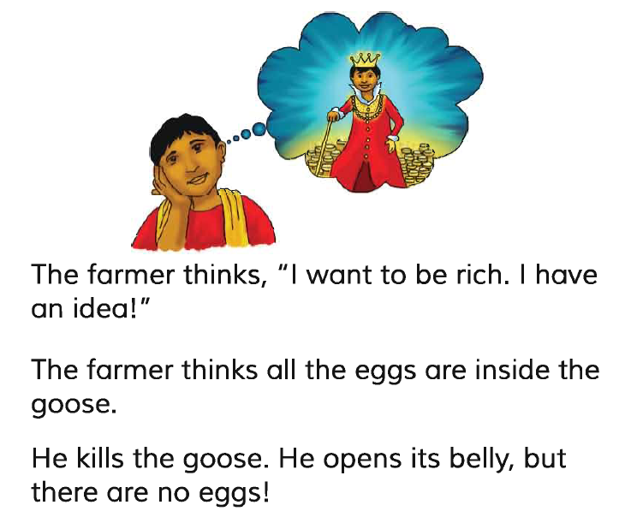
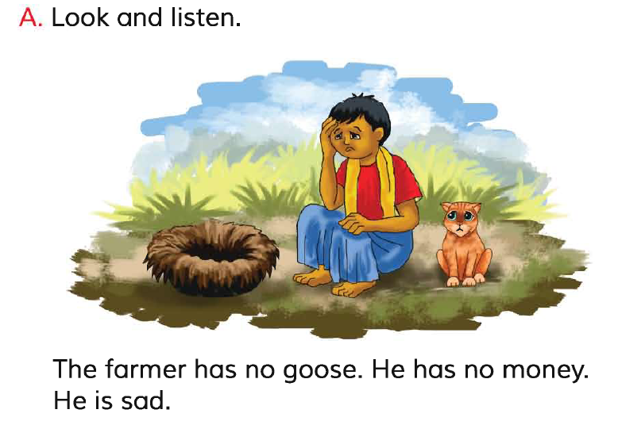
Let’s read the whole story again.
Repeat after me.
Reading -SGW

Slide 8
Pair reading.
I reading.

Slide 9
Open your English book at page-60 and see the Activity-C
The moral of the story is-
“Don’t be greedy.”

Slide 10
One day one word
Read and say.
moral
নীতি বাক্য
Spell out the word - SGW

Slide 11
Find out the letters that are made by the word--------.
m
w
o
r
v
t
a
b
l
x
Find out the correct word-------.
marel
morale
moral
maral

Slide 12
Say the missing letter.
mor-l
m-ral
mora-
mo-al
Write the word to your notebook.
তারিখঃ ০০/০০/০০
moral
মোরাল
নীতি বাক্য

Slide 13
Homework
Page 59 will be well read and written.

Slide 14
That’s all for today. Goodbye. See you tomorrow.

