Slide 1
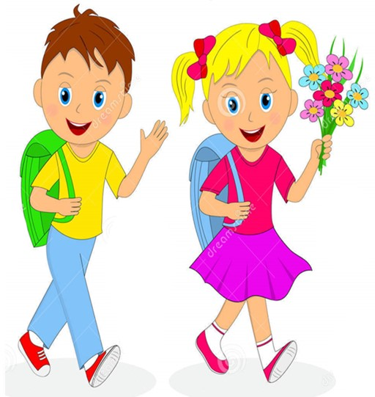

Slide 2
MD. KOWSER ALI
ASISSTANT TEACHER
DURLOVPUR GOVT. PRIMARY SCHOOL
HORINAKUNDU, JHENIDAH.
kowser.gps@gmail.com
Sub: English
Class: Two
Lesson : The Golden Goose
Parts of the lesson: Activity-B
Page No-60

Slide 3
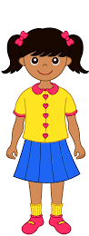
Safety environment by greetings song.
Hello! Hello! How are you?
I’m well, I’m good.
I’m great, I’m wonderful.
Hello! Hello! How are you?
I’m fine! I’m great today.

Slide 4
Checking homework and justify the previous lesson.
Did the farmer have any goose?
Did the farmer have any money?
Who was sad?

Slide 5
Our today’s lesson is--
Activity-B

Slide 6
LEARNING OUTCOMES
By end of the lesson students will be able to-------
Listening: 3.1.2 understand simple questions and statements about familiar objects.
4.2.1 enjoy simple stories
Speaking: 1.1.2 say simple words and phrases with proper sounds and stress.

Slide 7
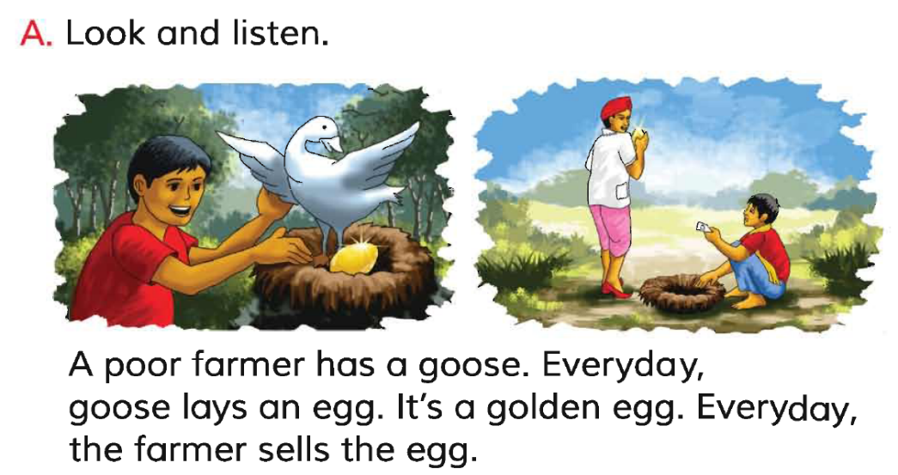
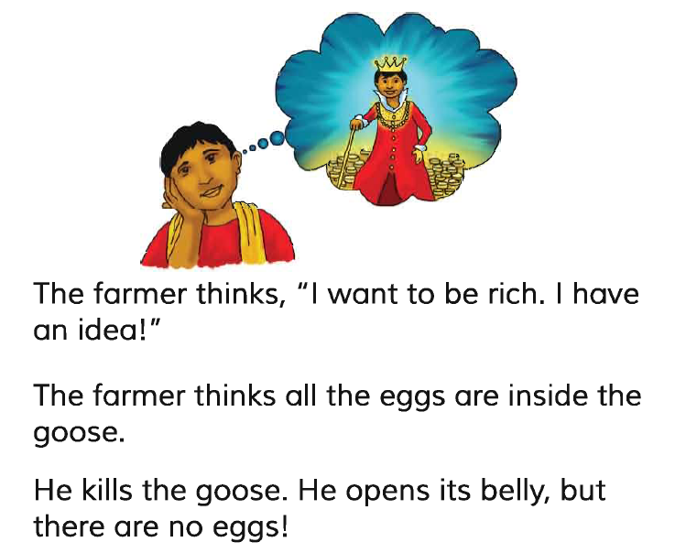
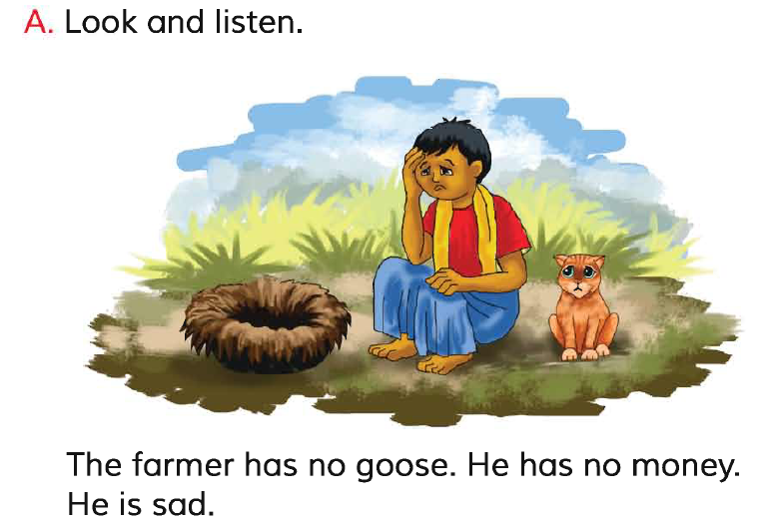
Let’s read the whole story again.
Reading -SGW

Slide 8
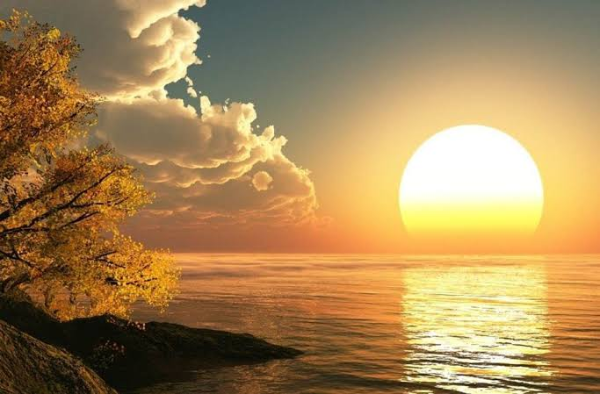
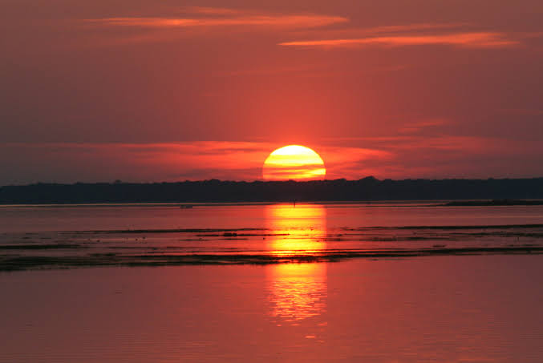
What is this?
What is this?
The sun rises in the est.
The sun sets in the est.
true
false
The sun sets in the west.

Slide 9
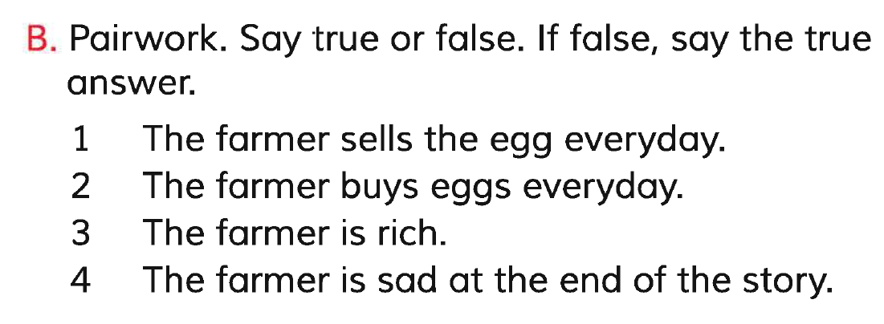
Open your English book at page-60 and see the Activity-B
true
The farmer sells eggs everyday.
false
The farmer is poor.
false
true
See the right answers.

Slide 10
Read and say.

Slide 11
One day one word
Read and say.
false
মিথ্যা
Spell out the word - SGW

Slide 12
Find out the letters that are made by the word--------.
f
n
a
l
z
t
s
b
e
d
Find out the correct word-------.
false
folse
felse
fols

Slide 13
Say the missing letter.
fa-se
f-lse
fal-e
fals-
Write the word to your notebook.
তারিখঃ ০০/০০/০০
false
ফলস
মিথ্যা

Slide 14
Homework
Page 58 will be well read and written.

Slide 15
That’s all for today. Goodbye. See you tomorrow.

