Slide 1
Welcome to my class

Slide 2
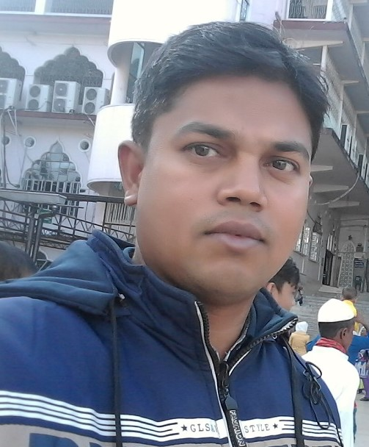
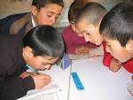
Subject :English
Class: Four
Lessson unit: Reshma…accident
Time:50 munites
Md Shohag Chowdhury
Assistant Teacher
Daudpur Govt Primary School.
Nawabgonj, Dinajpur.

Slide 3
Create emotion
Hands up, Hands down, Head bend right,
Head bend left, Head bend back, Head bend front.

Slide 4
Students will learn from this lesson…
To read the text with correct pronunciations, stress and intonations
2. To write five sentences about a rickshaw pullar.

Slide 6
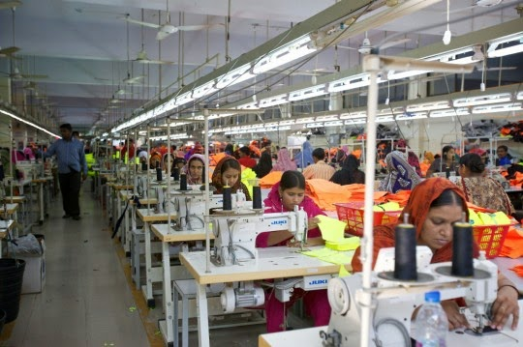
Lesson Declarations
A garment workers of the day

Slide 7
Garment worker
One who work in a garment
Amina Begum is a garment worker

Slide 8
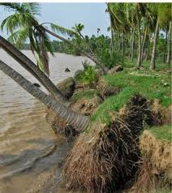
River erosion
The fall of soil in the river
Reshma’s village fall in a river erosion.

Slide 9
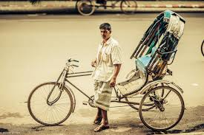
Rickshaw driver
Who pull by leg rickshaw.
He is a rickshaw driver.

Slide 10
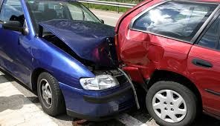
Accident
A sudden occurrence
He died in an accident

Slide 11
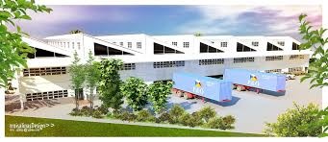
Teachers reading
Students reading
Reshma is a garment worker in Dhaka.

Slide 12
Group work
Question and anwser
What does Reshma do?
Why did Reshma’s family go to Dhaka?
Where does she work?

Slide 13
Small group work
Re arrange the word & sentences
Metnrag.
Was a there her river in village erosion.
Lost home they their.

Slide 14
Individual work work
Fill up the gaps
erosion
garment
driver
destroy
helper
1. Reshma is a………worker in Dhaka.
2.There was a river………..in her village.
3.Rashma’s father was a rickshaw…….

Slide 15
Individual work
Bingo game
Garment,Driver,Erosion,
Village,Dhaka,Worker,Family,Accident.

Slide 16
Thank you so much
“ Always behave good with each other.”

