Slide 1
To this session

Slide 2
TEACHER’S INTRODUCTION
MD. SHAMSUDDAWHA
ASST. TEACHER (ENGLISH)
GANGORE HIGH SCHOOL
NIAMATPUR, NAOGAON
CELL NO. 01717-516353
E-MAIL: shamshzoha@gmail.com

Slide 3
LESSON INTRODUCTION
ENGLISH SECOND PAPER
CLASS: NINE - TEN
DURATION: 50 MIN.
DATE: 25-07-2019

Slide 4
How much do you like flowers?
I like flowers very much.

Slide 5
1.She sang a song.
2. I like flowers very much.
What is the parts of speech of the words in the circles?
Verb

Slide 6
Our today’s topic
Right forms of verbs

Slide 7
Learning Outcomes
After this lesson the students will be able to...
write the sentences using right forms of verbs.
fill the gaps with right forms of verbs (with clues).
correct mistakes and re-write the passage with right forms of verbs.

Slide 8
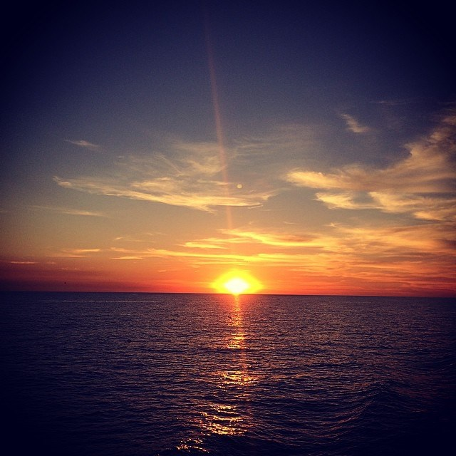
Rules
1. If the sentence is Universal truth or Habitual fact, it will
be Present Indefinite tense.
The sun rises in the east.

Slide 9
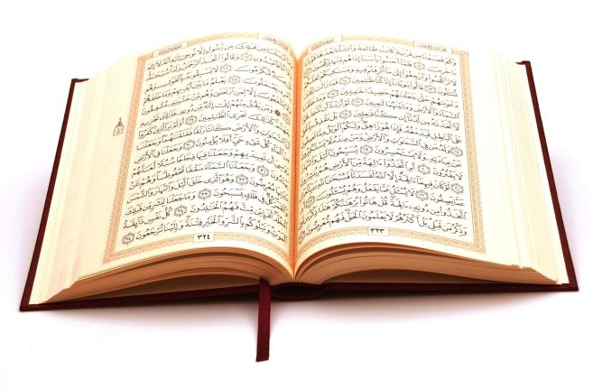
2. If in the sentence there is everyday//always/regularly/
occasionally/usually/often/sometimes/generally, the sentence will be Present Indefinite tense.
He reads the Holy Quran everyday.

Slide 10
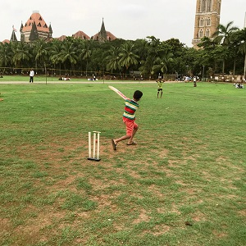
3. If in the sentence there is now/at this moment/at this
time , the sentence will be Present Continuous tense.
Rana is playing cricket now.

Slide 11
4. If in the sentence there is recently/already/just/just
now/lately/ever/yet , the sentence will be Present Perfect tense.
I have recently visited Cox’s Bazar.
After shall/should/can/could/may/might/will/
would/would rather/had better, verb will be in base form.
We should take care of our health.

Slide 12
5. If in the sentence there is for/since+ time the
sentence will be Present Perfect Continuous Tense.
It has been raining for three hours.
If in the sentence there is once/ago/long ago/last night/ last week/last year/yesterday , the sentence will be Past Indefinite tense.
Once there lived a princess.

Slide 13
INDIVIDUAL WORK
05
MINUTE
Fill the gaps using verbs.
He (to go) to school everyday.
I (to watch) television now.
Rahim recently (to receive) a letter.
Mina (to read) for three hours.

Slide 14
6. If in the past tense there is word ‘before’ between
two clauses, the sentence structure will be-
The clause(Past Perfect)+ before +The clause (Past Indefinite).
They had reached the school before the bell rang.
If in the past tense there is word ‘after’ between two clauses, the sentence structure will be-
The clause(Past Indefinite)+after +The clause (Past Perfect).
The children went to their bed after they had finished their study.

Slide 15
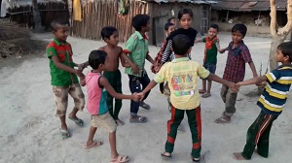
We saw them playing.

Slide 16
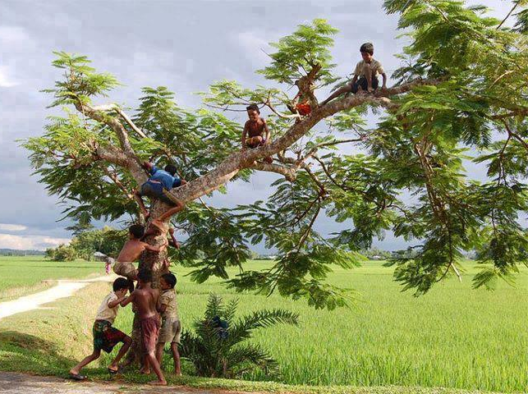
The boys wanted to climb the tree.

Slide 17
7. If in a simple sentence there are two verbs, one verb will
be present participle(verb + ing) or before that verb
there will be ‘to’ + verb(base form)
We saw them playing.
The boys wanted to climb the tree.
If in the sentence there is It is time/It is high time/I fancy/ would rather that, after the subject of these words verb will be in Past Indefinite form.
It is high time farmers planted paddy.

Slide 18
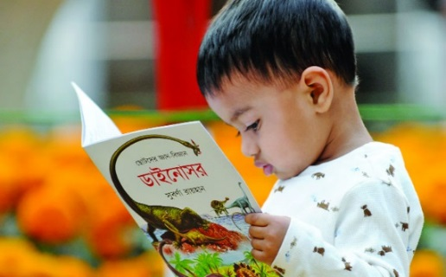
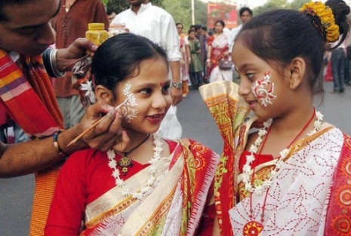
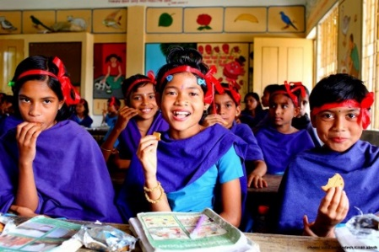
Pair work
07
MINUTE
Write the sentences using right forms of verbs.
is reading
1. She (read) a book now.
enjoyed
2. The girls (enjoy) very much in the last Pahela Boisakh.
took
3. They (take) their tiffin after they (finish) their lesson.
had finished

Slide 19
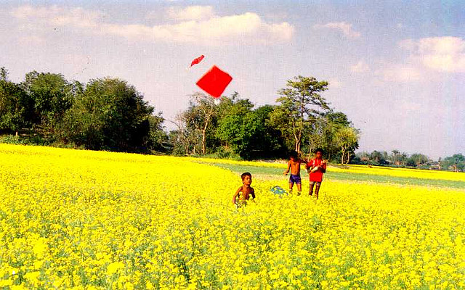
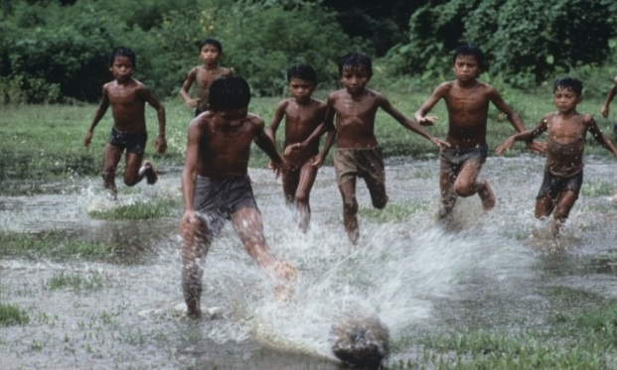
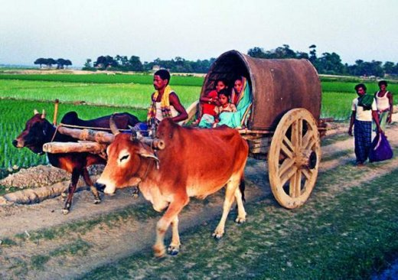
have been flying
4. The boys (fly) kites since morning.
like
5. Children (like) to play.
6.The woman and her children went home (board) on a cart.
boarding

Slide 20
Group work
10
MINUTE
Take verb from the box and fill in the gaps. Use right forms of the verbs.
leave, walk, sleep, take, sit
Mr. Anwar Rahman _____ in the open air every morning. He feels fresh. Today he _________
already a mile. Now he _______ rest _____ on a bench. A dog ____________for one hour near the bench. It is high time he ____ the place.
walks
has already walked
is taking
sitting
has been sleeping
left

Slide 21
Rewrite the passage using right forms of verbs.
Mita and Rita are two friends. Mita meet Rita seven days ago. Rita did not come to school one week. Mita went Rita’s home to saw her. She meet Rita’s mother before she enter into Rita’s room. Rita felt happy look at Mita.

