Slide 1


Slide 2
MD. SHAMSUDDOHA
ASST. TEACHER (ENGLISH)
GANGORE HIGH SCHOOL
NIAMATPUR, NAOGAON
ENGLISH 2ND PAPER
CLASS: EIGHT TO TEN
TRANSFORMATION OF SENTENCES
PART: TWO

Slide 3
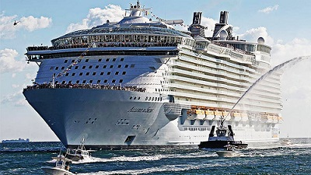
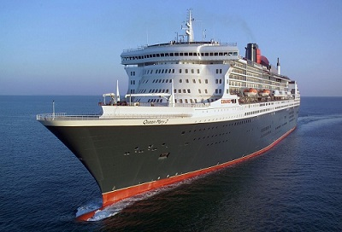
This is a big ship.
This is not a small ship.

Slide 4
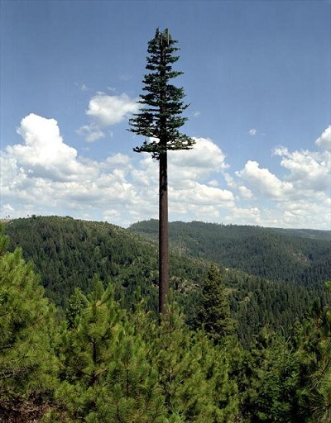
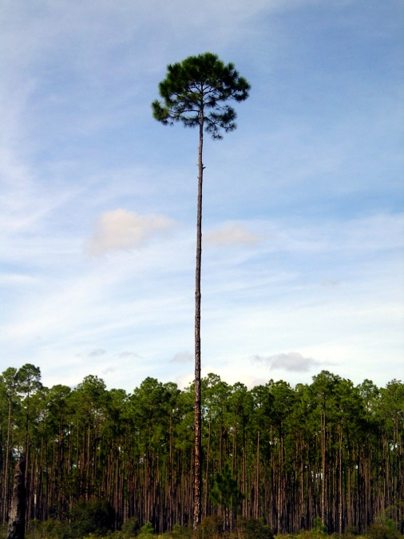
It is a tall tree.
It is not a short tree.

Slide 5

Can you guess what is our today’s topic?
Transformation of Sentences
Affirmative to Negative (Part 2)

Slide 6

After completing this lesson, students will be able to ……
tell the definition of transformation
write opposite meaning of the main word
transform sentences from affirmative to negative

Slide 7

Changing one form into another

Slide 8
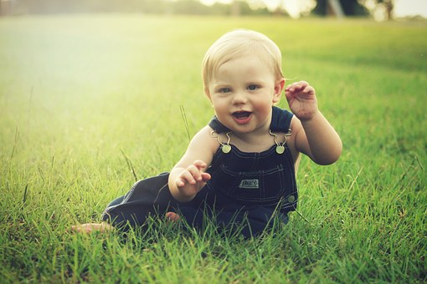
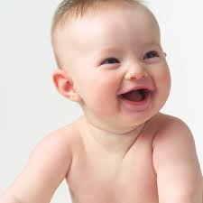
It is a nice face .
It is not an ugly face.
Transform means to change from one form into another.
Transformation of sentences means, changing the type of sentence
into other without changing it’s meaning.

Slide 9

03
minute
Individual Work
Can you tell me, what do you mean by transformation of sentences?

Slide 10
Follow
Rahim is an honest man. (Make it negative)
Rahim is not a dishonest man.
Mim is a good girl. (Make it negative)
Mim is not a bad girl.
Rahim is an honest man. (Make it negative)
Rahim is not a honest man.
Mim is a good girl. (Make it negative)
Mim is not a good girl.
Only formation of the sentence is changed
here. Meaning of the sentence is not changed.
Both the formation and meaning of the
sentence is changed here.

Slide 11
Ron is always punctual. (Make it negative)
Ron is never late.
I always tell truth. (Make it negative)
I never tell truth.
Ron is always punctual. (Make it negative)
Ron is not always punctual.
I always tell truth. (Make it negative)
I do not tell truth always.
Only formation of the sentence is changed.
Meaning of the sentence is not changed.
It is called transformation of sentence.
Both the formation and meaning of the
sentence is changed.
It is called conversion of sentence.

Slide 12
Examples of some opposite words.
Main word | Opposite word | Main word | Opposite word
honest | dishonest | friend | Foe/enemy
good | bad | wise | unwise
clever | fool | happy | unhappy
moral | immoral | real | unreal
mortal | immortal | hard | easy
regular | irregular | present | absent
active | inactive | always | never

Slide 13
Main word | Opposite word | Main word | Opposite word
pleasant | unpleasant | love | hate
responsible | irresponsible | rich | poor
doubtful | undoubtful | honour | dishonour
pleased | displeased | healthy | unhealthy
honesty | dishonesty | ordinary | extraordinary
literate | illiterate | willing | unwilling
possible | impossible | obey | disobey

Slide 14
Main word | Opposite word | Main word | Opposite word
obedient | disobedient | comfortable | uncomfortable
solvent | insolvent | polite | impolite
right | wrong | clean | dirty
sincere | insincere | kind | unkind
conscious | unconscious | correctly | incorrectly
remember | forget | worst | best
punctual | late | favorable | unfavorable

Slide 15
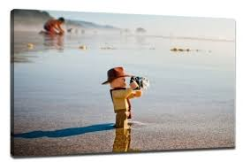



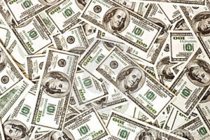



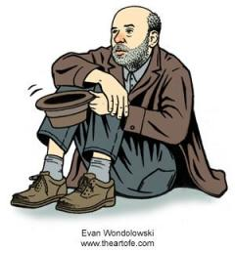
Pair Work
05
minute
Write the opposite of the following words.
 | strong | ? | clean |  | ?
 | late | ? | active |  | ?
 | foe | ? | mortal |  | ?
 | ordinary | ? | insolvent |  | ?
 | right | ? | rich |  | ?

Slide 16
Rules
1. As soon as → replaced by → No sooner had ----- than.
As soon as the thief saw the police, he ran away.. (Negative)
No sooner had the thief saw the police than he ran away.
2. Absolute Superlative degree → replaced by → No other + attached word +
so + positive form + as + subject.
Dhaka is the biggest city in Bangladesh. (Negative)
No other city is as big as Dhaka in Bangladesh.

Slide 17
3. Sometimes affirmative sentences are changed into negative by using
opposite words. Before the word, off course ‘not’ is used.
I shall remember you. (Negative)
I shall not forget you.
4. Always → replaced by → Never.
Raven always attends the class. (Negative)
Raven never misses the class.

Slide 18
5. Too …… to → replaced by → so … that+ can not/could not (in past).
He is too weak to walk. (Negative)
He is so weak that he cannot walk.
6. Sometimes → replaced by → not + always.
Robi sometimes visits me. (Negative)
Robi doesn’t always visit me.

Slide 19
7. Many → replaced by → not a few.
I have many friends. (Negative)
I do not have a few friends.
8. A few → replaced by → not many.
Bangladesh has a few scholars. (Negative)
Bangladesh does not have many scholars.

Slide 20
9. Much → Replaced by → A little.
He belongs much money. (Negative)
He doesn’t belong a little money.
10. A little → replaced by → not much.
Dolon has a little money. (Negative)
Dolon doesn’t have much money.

Slide 21
10
minute
Group Work
Change the following sentences into negative.
As soon as I got the job, I informed my friends.
I have a few friends.
He is too dishonest to speak the truth.
Akbar was the greatest Moghul emperors.
I will always remember this.
The poor are sometimes happy.
I have many dolls.
I missed the train.
The tea is too hot for me to drink.
Rocky is the best boy in the class.

Slide 22


