Slide 1
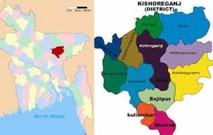
You are welcome
Email:dhalder785@gmail.com

Slide 2
Presented by-
Dulal Halder
Assistant Teacher
Kumna Govt.primary School
Chhatak,Sunamgonj
Email:dhalder785@gmail.com
Class:Four
Subject:English ForToday
Unit:10
Lesson:1--2
Heading:My home district
Email:dhalder785@gmail.com

Slide 3
How are you?Do you like song?Lets sing a song.
Email:dhalder785@gmail.com

Slide 4
At the end of the lesson students will be able to---
Listening:3.3.1-understand questions about objects around them.
Speaking:1.1.2-say speaking with proper intonation.
1.7.1-read paragraph, dialogues stories, letters and other texts.
Email:dhalder785@gmail.com

Slide 5
Attention please
When do we use capital letters in a sentence?
Where do you use full stop in a sentence?
Where do you use questions marks in a sentence?
Home district
Email:dhalder785@gmail.com

Slide 6
Take your book and open at page 38.Our new lesson is
‘My home district’
Email:dhalder785@gmail.com

Slide 7
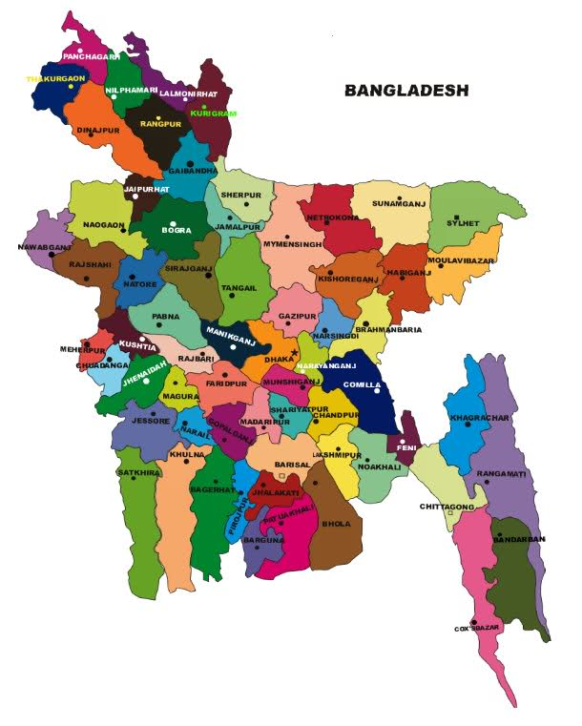
Email:dhalder785@gmail.com

Slide 8
I,W-What can you see in the picture?
# Which place are star marked (Dhaka)?
# What other place map are showing inside the Bangladesh map (Kishoregonj)?
Email:dhalder785@gmail.com

Slide 9
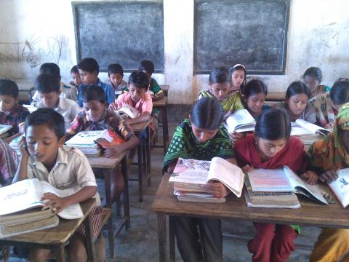
W.C.W- Read this passage with me.
Do you understand about this passage.
Email:dhalder785@gmail.com

Slide 10
Find out the new words
Headquarters,
municipalities
Upazillas
villages
Headquarters- the head office of an organization.
Municipalities- a local government of a town or city.
Upazillas- an area of a country
Villages- rural area.
Email:dhalder785@gmail.com

Slide 11
Evaluation ?
Email:dhalder785@gmail.com

Slide 12
Answer the questions.
Whose home district are we reading about?
How many municipalities and upazillas are there in Kishoregonj?
Email:dhalder785@gmail.com

Slide 13
8 / 13 / 108 / 10 / 145 / 1745
What has the indicated of the following numbers?
Email:dhalder785@gmail.com

Slide 14
See You again
Email:dhalder785@gmail.com

