Slide 2
Md. Mominul Islam
Assistant teacher
Dattagati Girls High School,
Abhaynagar, Jashore.

Slide 3
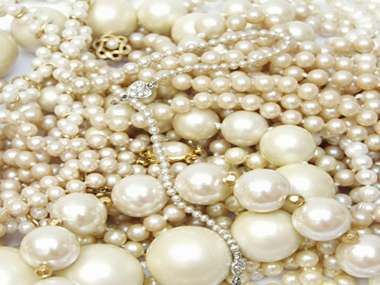
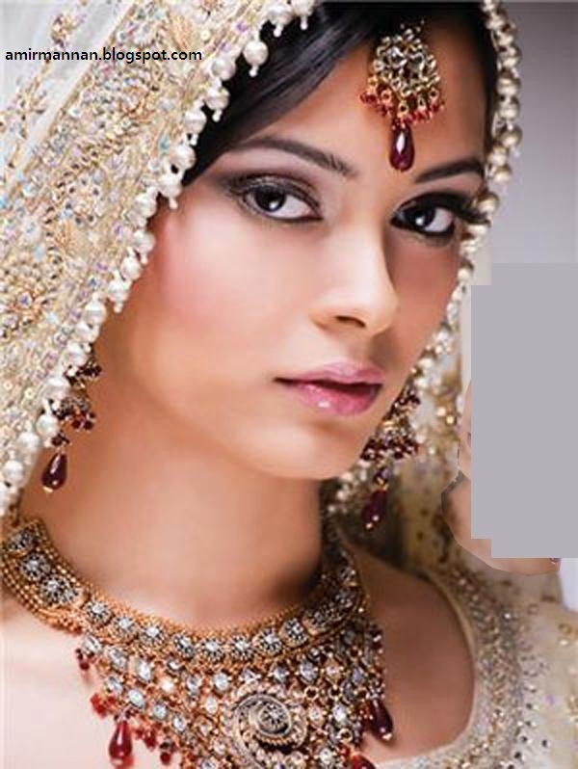
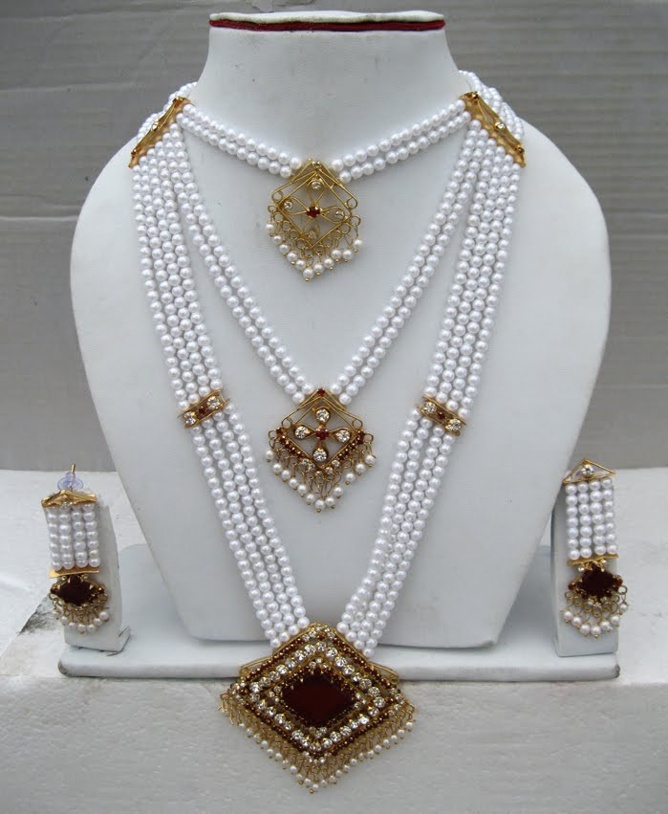
What do you see in the picture ?
What are the uses of these?
What are these made of ?

Slide 4
Lesson Declaration .
Today we will learn about
Pearls ! Pearls! Pearls !
English For Today .
Class -8
Lesson -1
Unit -7

Slide 5
Learning outcomes -----
By the end of the lesson learners will be able to-
Describe the picture (Listening &speaking skill)
Read the text
Write the answers of the questions& information in the table .

Slide 6
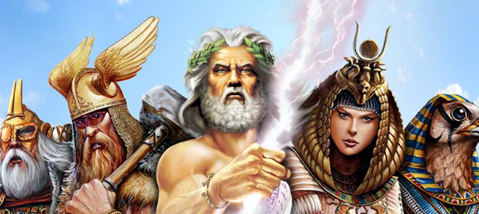
Word meaning .
Mythology
(Noun)
Ideas or facts that many people believe but that are not true .
There are many stories on Greek mythology .

Slide 7
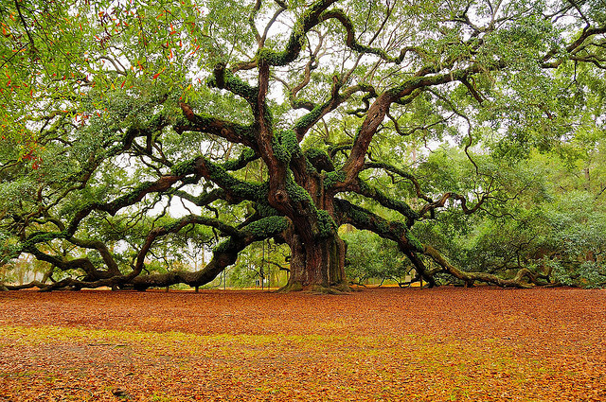
Ancient (Adjective)
Very old
We can see the ancient tree in our village

Slide 8
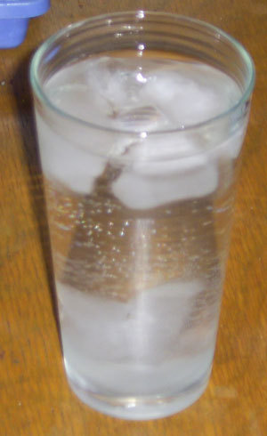
Dissolve (Verb)
Absorb or vanish
Ice is dissolving in water .

Slide 9
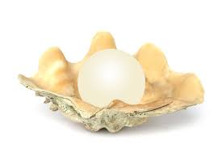
Unparalleled (Adj)
unique
The pearl is unparalleled to look at

Slide 10
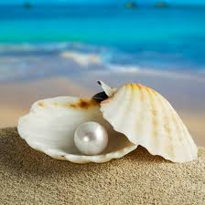
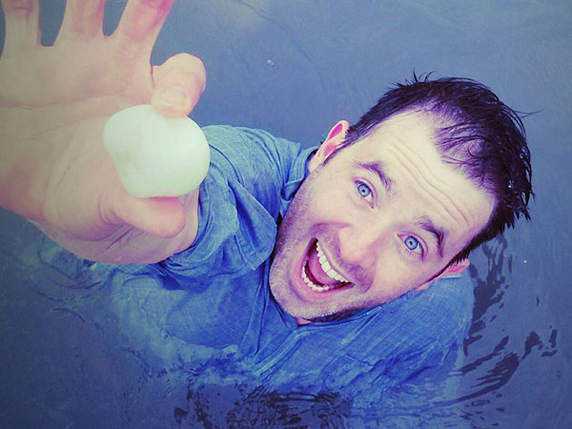
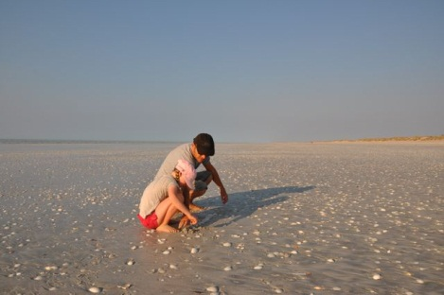
Look at the picture and Can you say when the first pearl was discovered by human being ?

Slide 11
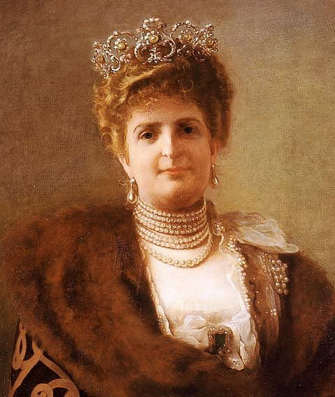
Who thought pearls as a sign of love and respect for the entire nation ?And what did she do for that ?

Slide 12
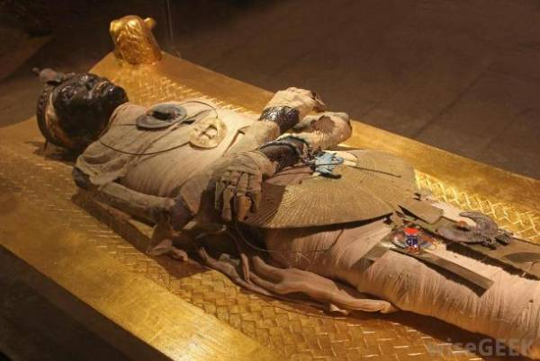
What did ancient Egyptian think about the pearls ?

Slide 13
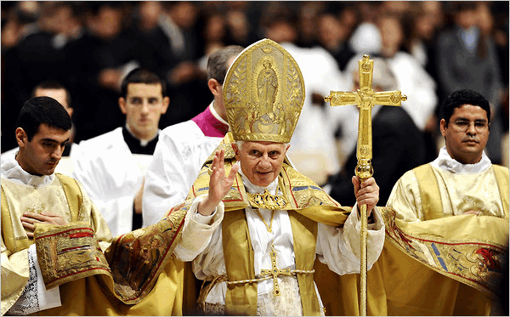
What did the Greek think about the pearls ?

Slide 14
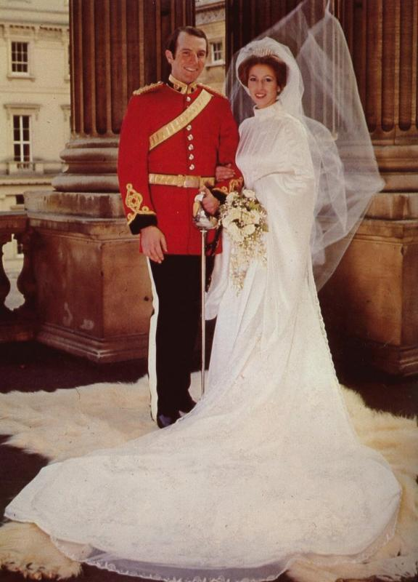
What do you see here ?

Slide 15
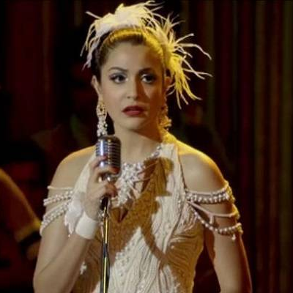
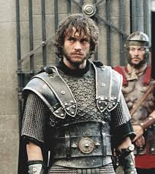
What did the ancient Roman think about the pearls ?

Slide 16
Make groups with 4 ss & write the answer of the questions in section B . You have 7 minutes time . Then check with me .
Yes , because people used to search for food at different places like forest ,river , sea shore etc .
2.It was valued so much for it’s shine .
3. The knight thought pearls would bring victory for them .

Slide 17
Make pairs for section C. Read the text B again and write the information in the table. You have 10 minutes . Then check with me.
Who |  |  | When/where
The ancient Egyptians |  |  | when they were buried .
The Greek | wore | pearls | at the time of love and marriage .
The ancient Romans |  |  | in noble families .
The brave knight |  |  | in the battles .

Slide 18
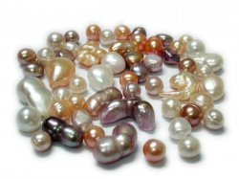
Home work
Write a paragraph on Pearls explaining it’s uses of ancient and present times ..

