Slide 1
Welcome to my MMC

Slide 2
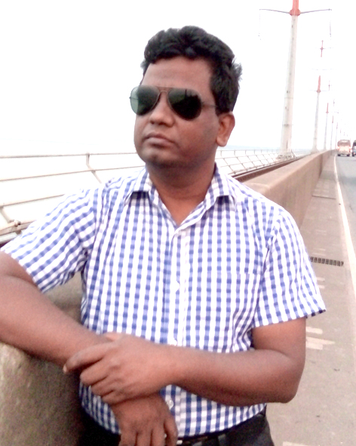
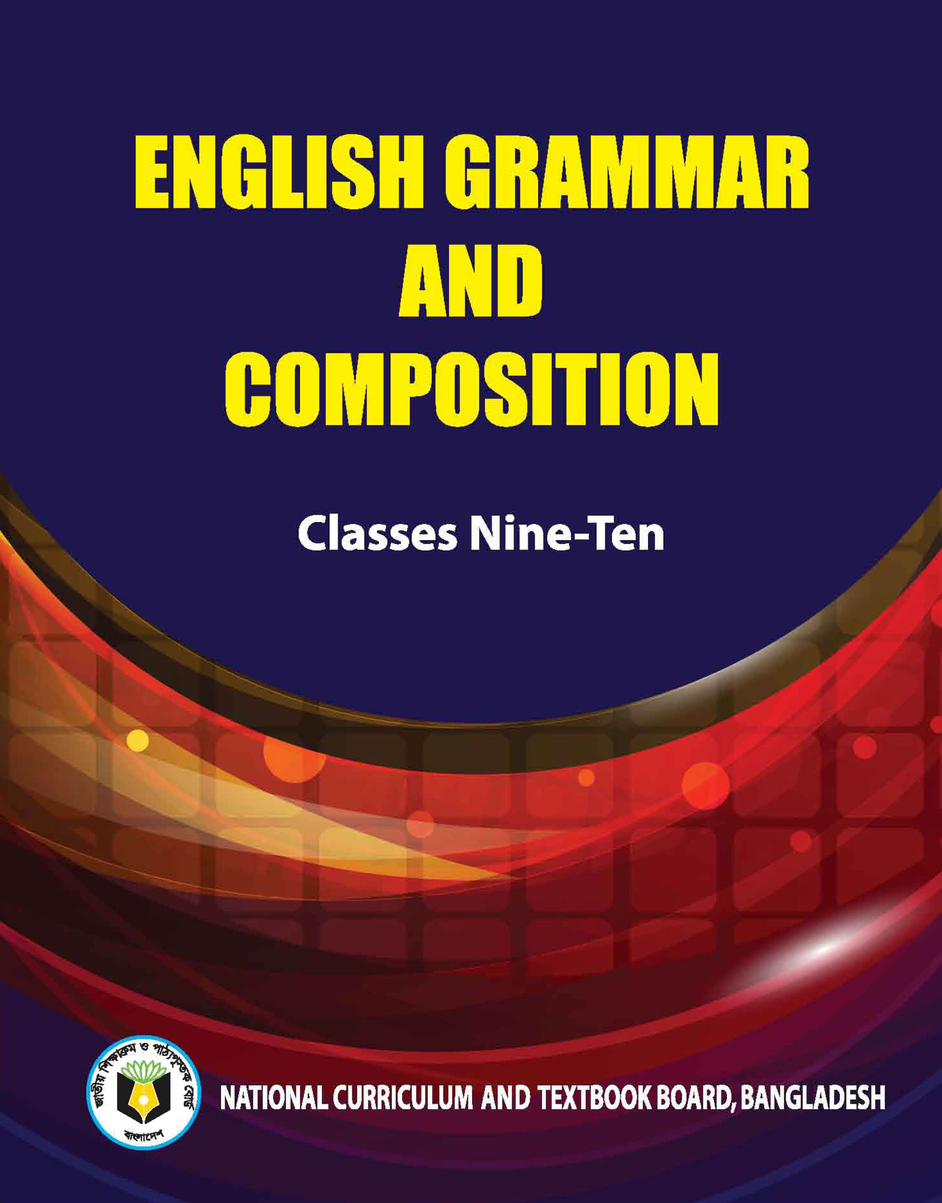
Identity
Teacher’s Identity
Lesson Introduction
Jahangir Alam
Assistant Headmaster
Dighulia Shahid Mizanur Rahman High School, Tangail.
E-mail: Jahangir.icttang@gmail.com
Cell : 01710500769.
Class : IX-X
Section : A
Sub : English Second Paper
Topic : Completing Sentence

Slide 3
because of his illness.
He could not go to college____________________
What kind of sentence is this?
Completing sentence
Let us discuss about completing sentence.

Slide 4
Be continued after part – 2.

Slide 5
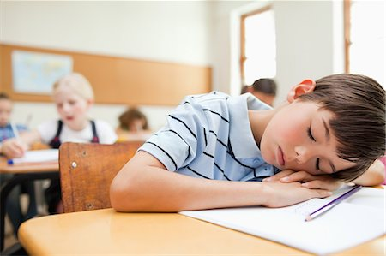
Completing item - 13
Use of ‘because of, on account of, owing to, and due to.’
on account of his illness.
He cannot do hard work ______________________
Notes:
So………… that (এত... যে)

Slide 6
Activities
Everybody love him due to ............
On account of rain ............
I could not enjoy the day because of ............
We were held up for two hours owing to ............
The game was delayed On account of ............

Slide 7
Completing item - 14
Use of ‘would rather ...... than’
coffee.
I would rather drink tea than ______
Activities
I would rather die than ............
I would rather go ............
............ than fail.
I would rather stay than ........
The mother would rather die than ....

Slide 8
Completing item - 15
Use of ‘had better’
had better is unreal past. It does not mean past tense rather it denotes present and future. No infinitive is used after it.
go.
You had better ____
Activities
You had better .....
They had better .....

Slide 9
Completing item - 16
Use of ‘No sooner had ... than’
the train left.
No sooner had he reached the station than ____________
Formation : No sooner had + subject + V3 + extension (if any) + than + subject + V2

Slide 10
Activities
No sooner had the police come ____
No sooner had the bell rung ____
____ we started for home.
No sooner had the magic started ____
____ than the play began.

Slide 11
Completing item - 17
Use of ‘It is time (proper time)’
Formation - 1 : It is time + to + V1 + extension.
start the mission.
It is time to ________________
Formation – 2 : It is time for + object + V1 + extension.
board the plane.
It is time for me to _______________

Slide 12
Completing item - 18
Use of ‘It is time (time is over)’
Formation : It is time + subject + V2 + extension.
we went home.
It is time ________________
we should go home.
It is time __________________
I stopped working and went home.
It is time ________________________________
we started our train journey.
It is time __________________________

Slide 13
Completing item - 19
Use of ‘It is high time (time is over)’
Formation : It is high time + subject + V2 + extension.
It is high time ______________
we went home.
we should go home.
It is high time __________________
I stopped working and went home.
It is high time ________________________________
we started our train journey.
It is high time __________________________

Slide 14
Completing item - 20
Use of ‘as if / as though’ (যেন)
Formation - 1 : Subject + V1 + ext. + as if/as though + Subject + V2 + extension.
He speaks as if / as though ___________________
he knew everything.
Formation - 2 : Subject + V2 + ext. + as if/as though + Subject + had + V3 + extension.
He spoke as if / as though ________________________
he had known everything.

Slide 15
Completing item - 21
Use of ‘let alone’ (Undesirable thinking)
Formation : Negative sentence + let alone + relevant part of the sentence.
He cannot live in a hut let alone ___________________
an aristocratic house.

Slide 16
Activities
He cannot eat a mango let alone ____
____ ten kilometers.
They cannot play so bad let alone ___
____ GPA 5.
Shimla cannot cook rice let alone ____

Slide 17
Continue to next content

