Slide 1
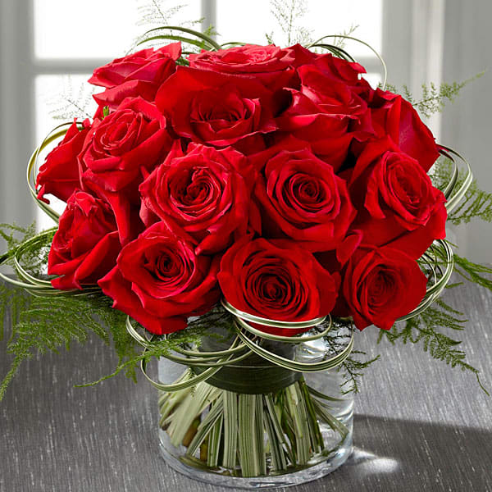
ww
Welcome

Slide 2
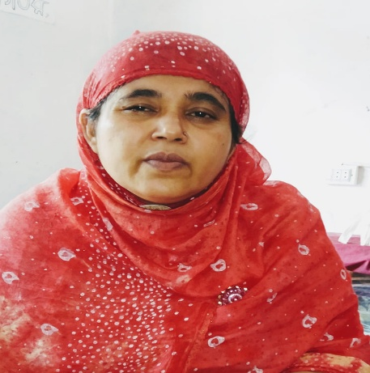
Introduction of Teacher
MST :Momotaz Khatun(Assistant Teacher)
Baniargati Mohila Model Dakhil Madrasah
Sadar, Jashore
Mobile No-01936284934

Slide 3
Lesson
Lesson Introduction
Class: Four
Sub: English
Unit:34
Lesson-1
Time:45 minuets

Slide 4
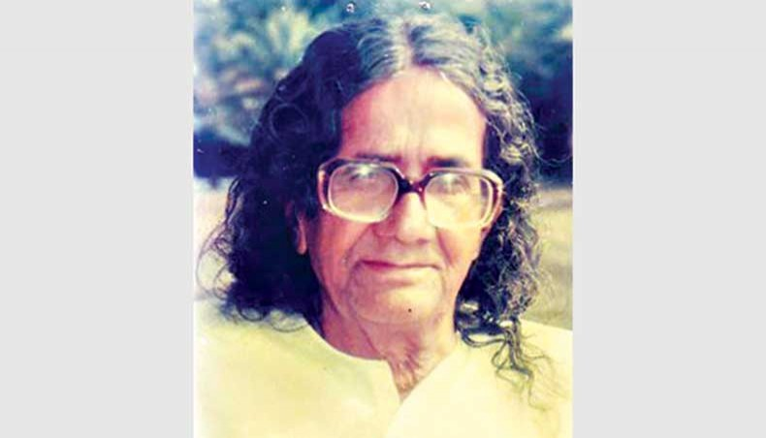
Lets See The Picture
SM Sultan

Slide 5
Learning outcomes
End of the lesson, students will be able to--------------
the context of words.
Tell the time (hours only and mention a. m or p. m).
read words phrases and sentences in proper sound stress and intonation.

Slide 6
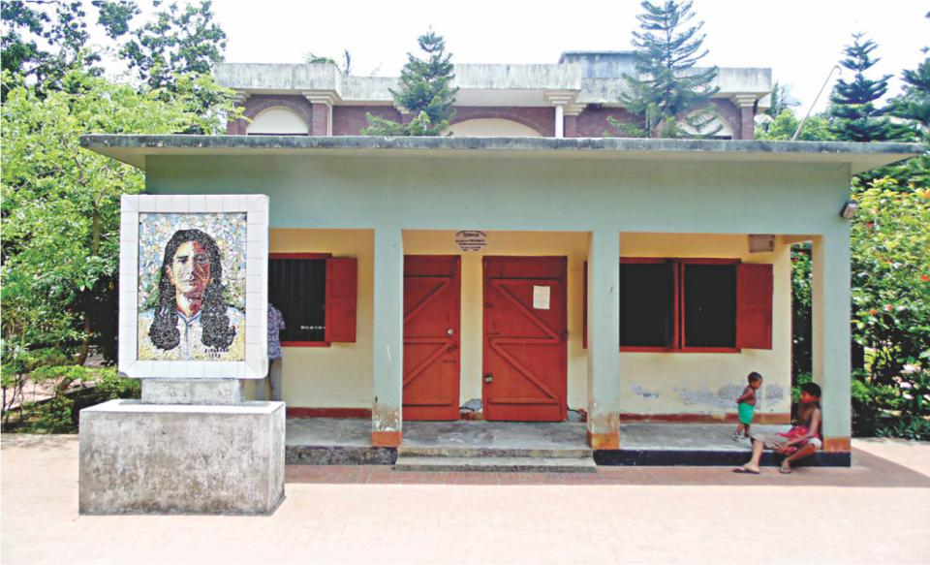
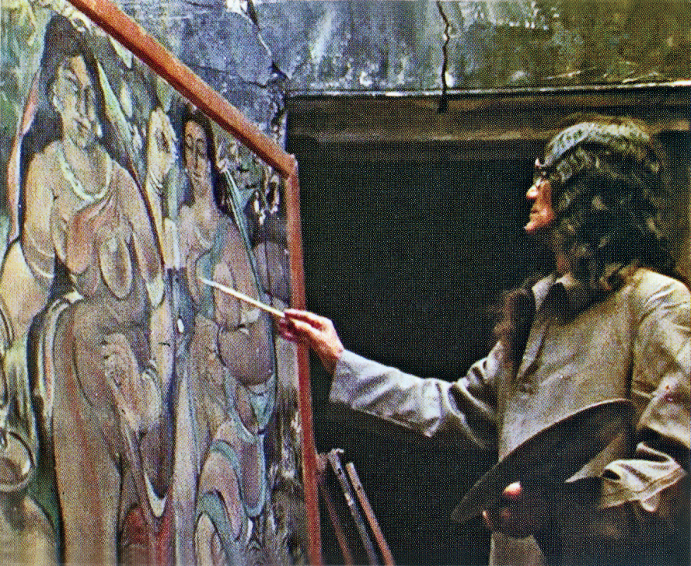
urean
Picture-1
Picture-2
SM Sultans House
Artist SM Sultan

Slide 7
Teacher Model Reading
SM Sultan is a famous painter of our country.He was born in Narail
In 1923.His family did not have a lot money.Sultan went to school
For five years.But then went to work with his father.

Slide 8
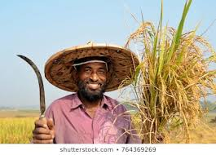
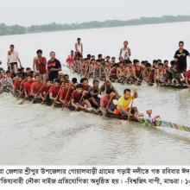
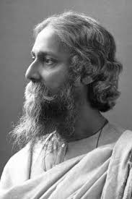
Farmer
Cultivator
Picture
Photo
Famous
Well known

Slide 9
Choose the best answer-
When was sultan born?
a. In 1919 b.in 1929 c. in 1938 d.in 1994
Ans: b.in 1929
(ii) Sultan was from----
a.Jashore b.Rajshahi c.Narail d.Khulna
Ans:Narail
c.(iii) He came of a ----- family
a.Rich b. solvent c. well-to-do d. poor
Ans: d.poor

Slide 10
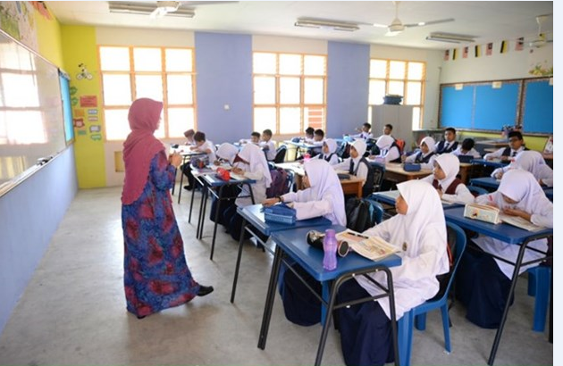
Student Silent Reading

Slide 11
Group Work
Find out the new word

Slide 12
swer
Evaluation
1.Who is SM Sultan?
Answer: SM Sultan is an artist.
2.When was Sultan born?
Answer: Sultan was born in Narail in 1923.

Slide 13
Home Work
Now write a short composition in only five
Sentence about “SM Sultan.’’

Slide 14
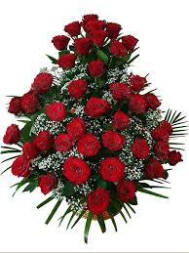
Thank you Every body

