Slide 1
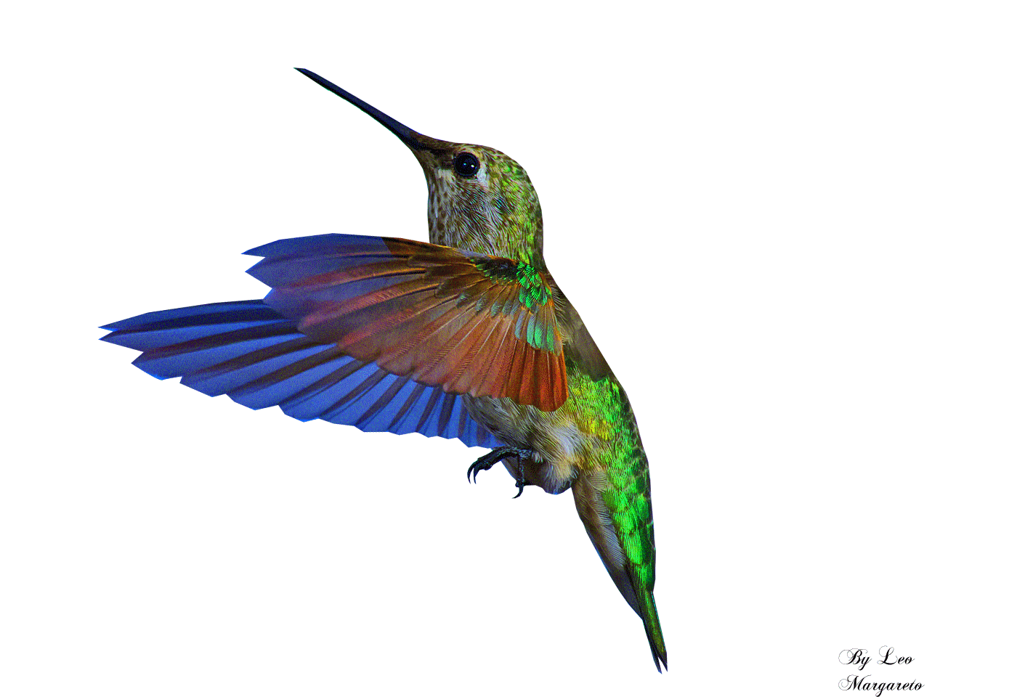
Welcome to You

Slide 2
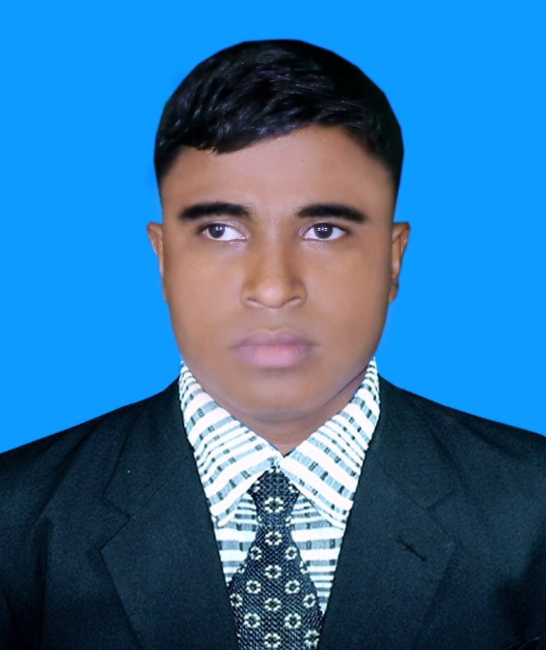
A.Sukur Ali Khan Asistant Teacher (English) Naldha secondary School Fakirhat, Bagerhat Email : sukur360720@gmail.com Mobile no-01922360720
Introduction
Class: Nine Subject :English 1st Paper Unit:7 ,Lesson :1 Time :50 minutes

Slide 3
Let us see some pictures and try to answer:

Slide 4
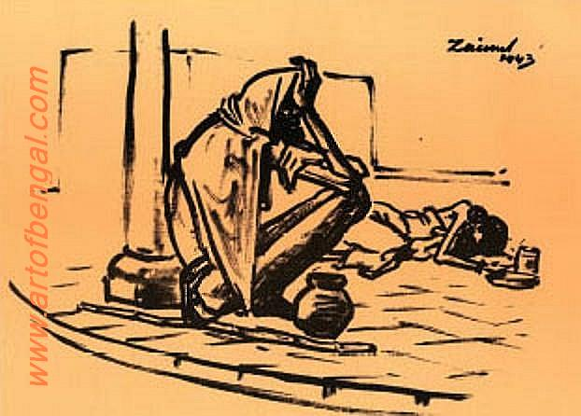
What do you see in the picture?

Slide 5
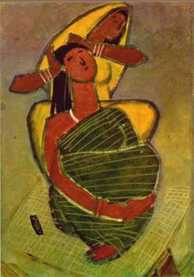
Do you know who has drawn this picture?

Slide 6
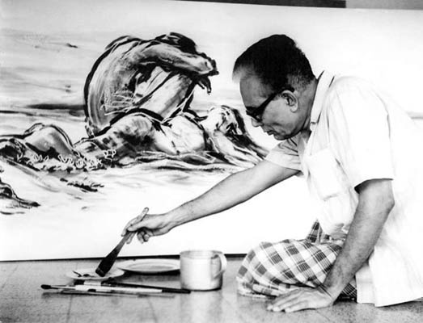
Do you know the person?

Slide 7
Can you guess what are we going to learn today?
We are going to learn about
Zainul Abedin, the great artist

Slide 8
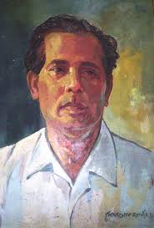
Zainul Abedin

Slide 9
Learning Outcomes
By the end of the lesson the students will be able to…
use some new words
tell about the biography of Zainul Abedin
describe the remarkable works of Zainul Abedin
read and understand texts through silent reading
ask and answer questions

Slide 10
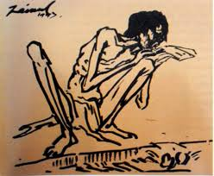
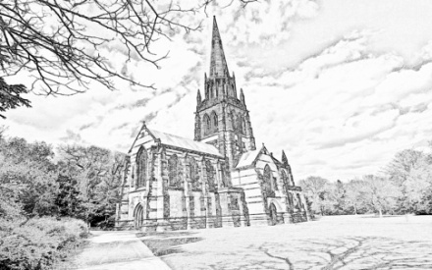
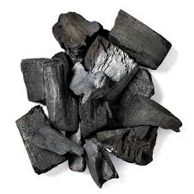
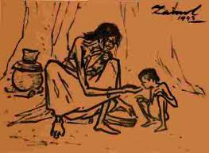
A time when there is little food in a region.
Famine
A drawing made very quickly.
Sketch
A black substance made by burning wood.
Charcoal
Suffering or death caused by lack of food
Starvation

Slide 11
Biography of Zainul Abedin at a glance
Zainul Abedin
The first principal of the first art school in Dhaka
His famous painting is Manpura
Gratuated from Calcutta Art School
Born on 29th December,1914
Got Governor’s gold medal
Died on 28th May,1976

Slide 12
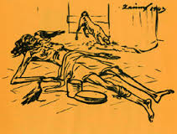
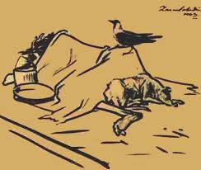
Remarkable Paintings of Zainul Abedin
Famine In 1940

Slide 13
He organized the ‘NABANNA’ exhibition in 1969.In it a 65- foot long scroll painting exhibited the artistic protect against the Pakistan regime.

Slide 14
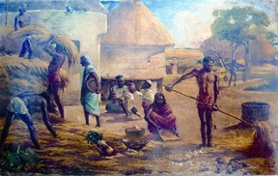
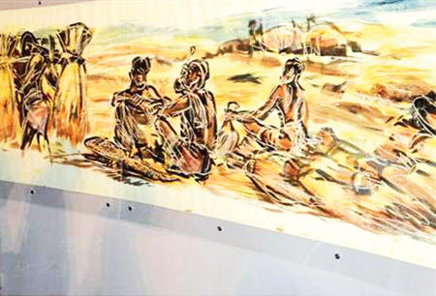
Nabanno Utshob

Slide 15
Manpura

Slide 16
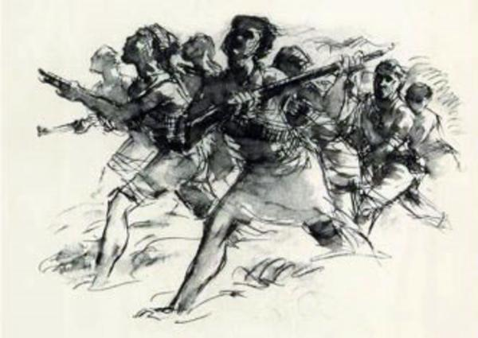
Non- cooperation movement in Zainul’s art against the Pakistan

Slide 17
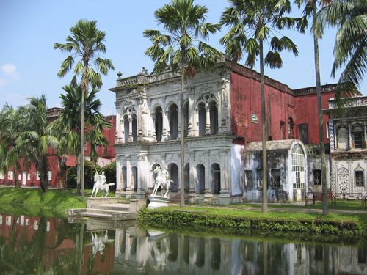
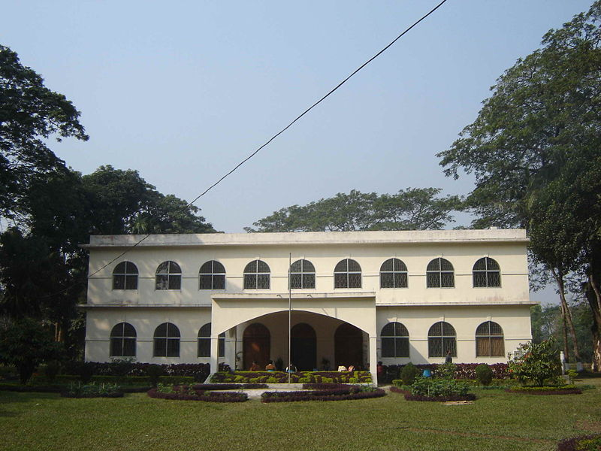
Institutions Founded By Zainul Abedin
Folk Art Museum at Sonargaon
Zainul Abedin Shangrahasala in Mymensingh

Slide 18
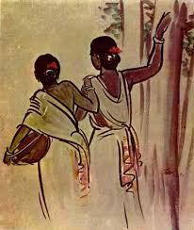
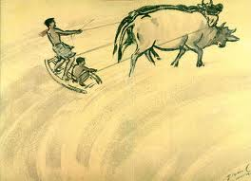
Pair Work
Describe the pictures in pairs

Slide 19
Group Work
The following sentences are in wrong order. Write them in correct order.
He designed the pages of the constitution of Bangladesh. The river Brahmaputra played a predominant role in his paintings. Zainul Abedin is an internationally renowned artist. He hails from Kishorganj. He is the founding father of Bangladeshi art.

Slide 20
Evaluation
Who is considered the founding father of Bangladeshi art?
Name some famous paintings of Zainul Abedin.
Where did he found the Folk Art Museum?
When did Zainul Abedin get the Governor’s gold medal?

Slide 21
Homework
Write a paragraph about Shilpacharya Zainul Abedin within 70 words using the following clues.
born -- drawing -- school -- father -- artistic - beauty
Notes:
Time : 2 M

