Slide 1
Welcome
To
Our Today’s English Class

Slide 2
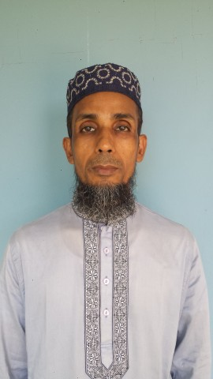
Identification
Mohammod Helal Uddin
Assistant Teacher (English)
Wahid Siddek High School,
Gurarai, Sadar. Moulvibazar
E-mail : helal.bd.mb@gmail.com
Class- Eight
Subject : English For Today
Unit : 06
Lesson : 01

Slide 3
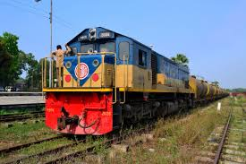
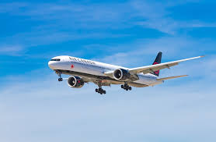
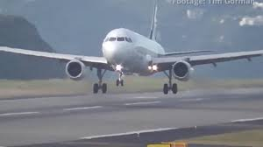
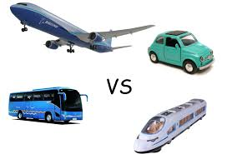
Look at the following pictures and answer the questions
What can you see in the pictures. Tell .

Slide 4
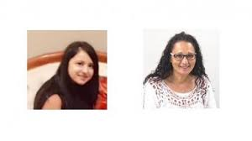
Let’s go enjoy a video

Slide 5
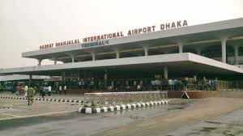
Today our Topics is……….
At the airport

Slide 6
Learning Outcomes
End of this unit, The students will be able to…………..
Listen for information
Read and understand texts
Ask and answer questions
Write a short paragraph.

Slide 7
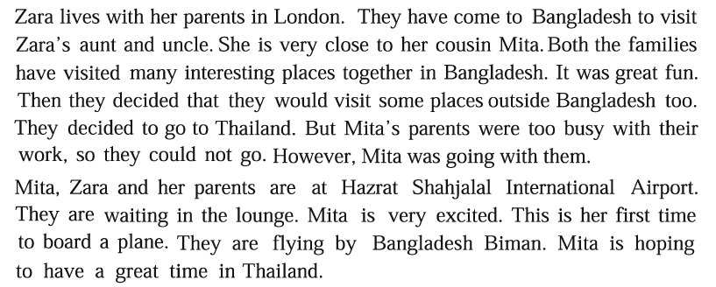
Read the passage then answer the questions In group
Why is Mitta excited ?
02. Why aren’t Mitta's parents going with her ?
03. What does an immigration officer do at the airport ?

Slide 8
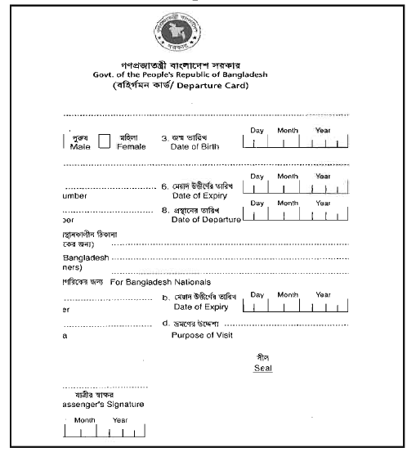
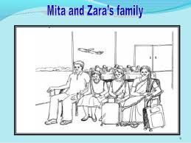
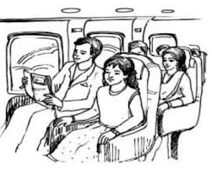
Read the card and discussed in pairs then fill up the form

Slide 9
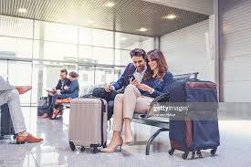
Let’s go practice vocabulary.
Lounge- meaning : A room for waiting in at airport
They are waiting for a plane

Slide 10
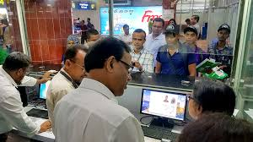
Immigration-means: The place of an air port or country border where government official check documents of people entering that country.
A immigration officer is checking passport

Slide 11
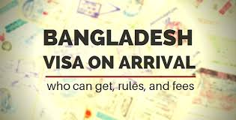
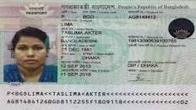
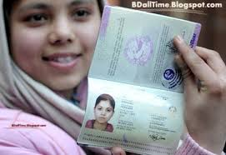
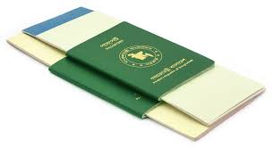
Look at the pictures then answer the questions individually
What things do we need for travelling foreign country ?

Slide 12
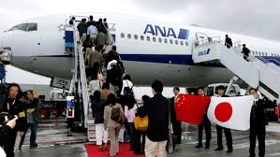
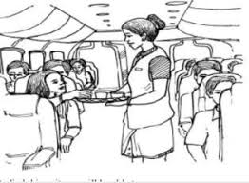
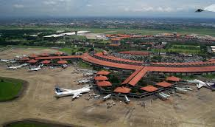
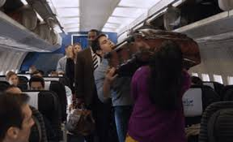
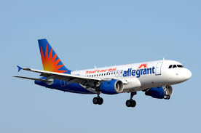
On the way by plane while they were traveling
Barman Bella servicing snakes
Getting into the plane
Airport
Taking seat
Flying the plane

Slide 13
Evaluation
Look at the pictures again then answer the following questions.
01.Who are the people in the pictures ?
02. What could be their relationship ?

Slide 14
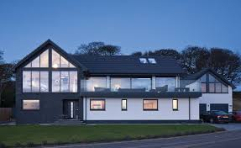
Home Work
Write a paragraph about journey by train.

Slide 15
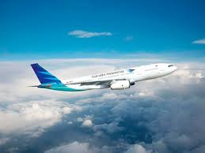
Thank You

