Slide 1
Welcome to my
class dear students

Slide 2
Presentation conducted by
MD. MILAN SHIKDER
Assistant teacher (English)
Hazi Abdul Malek Girls’ High School
Shipyard, Khulna.
Subject :English 1st paper
Class-9, Unit-3, Lesson-2

Slide 3
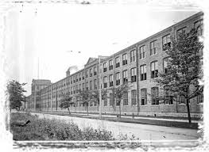
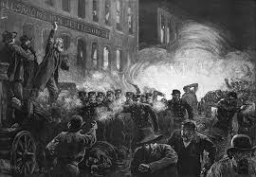
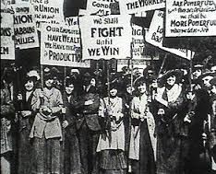
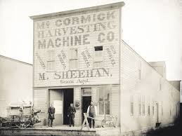
Look at the picture
Which event does it remind us?

Slide 4
Our Today’s Lesson is -
May Day

Slide 5
Learning outcomes
After we have studied this lesson, we will be
able to-
Talk about the history of May Day.
Ask and answer questions.
Use write form of verb.
Read text and answer the questions.

Slide 6
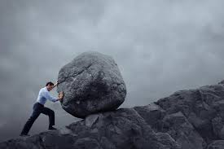
New words
Struggle
Meaning :
To contend with an opposing force
We struggled against Pakistani army on 1971.

Slide 7
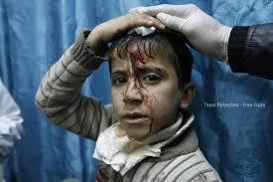
wounded
Meaning : suffering injury
The boy was seriously wounded

Slide 8
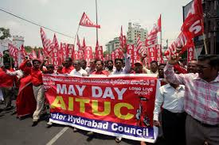
Rally
Meaning : to draw or call parsons together for a common action or report.
The rally was addressed by the labour leaders.

Slide 9
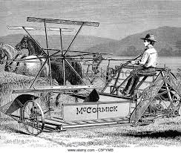
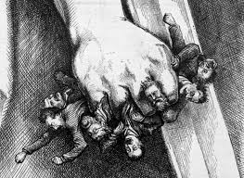
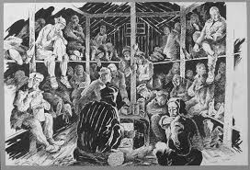
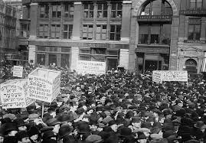
One striker was killed, five or six seriously wounded and many of them were badly injured.
Before 1886, people worked 14 or even more hours a day
They were oppressed by their master
They met a meeting to straggle against their master
Police fired into the strikers
They made a rally beside McCormick Harvester Company

Slide 10
Read the text B and answer the questions.
Questions :
What does May Day refer to?
How long did the workers have to work a day before the May 1 strike?
Why did the workers in Chicago go on a strike?
What do you learn from the events of May 1, 1886?

Slide 11
Answer :
1. May Day refers to International workers Day.
2. The worker had to work a long shift fourteen or even more hour a day before May 1 strike.
3. The workers in Chicago went on a strike demanding eight-hour workday.
4. The events of May 1 teaches us about workers’ right- better working conditions, better pay and better lives.

Slide 12
C. Fill in the blanks with the verbs given in the box. Put them into their correct forms.
add
arrive
begin
do
hear
live
send
support
tread
work
Tania is a poor garment worker. She ______ in a big garment factory in Gazipur. She _____ in a slum with a few fellow workers. She works eight hours a day on a monthly salary of Tk. 3000/-. She does overtime to ______ some more money to her income. If she can save something, she ____ it to her father to ______ the family.
One day Tania was busy _______ her work in the factory. Suddenly she _____ someone shouting “Fire! Fire!” The workers were panic-stricken and everyone ______ to rush to the stairs. There were no enough staircases in the factory building. So some workers were _____ under the foot and some other were injured in some other ways. However, the fire brigade ______ there in minutes and nothing untoward happened.
works
lives
add
sends
support
doing
heard
began
treaded
arrived
add arrive begin do hear live send support tread work

Slide 13
D. Now read the completed passage in C silently and answer the following questions.
1. Do you think Tania’s monthly salary is enough for her work?
2. Does Tania live in a hygienic place? Is it good for her health? What may happen if she continues living there?
3. Is the factory safe enough for workers to work in? Why do you think so?
4. Do you have any suggestions for factory workers’ general health, happiness and safety? If so, what?

Slide 14
Home Work
Write a paragraph on ‘The life of a day worker

Slide 15
Thank you all

