Slide 1
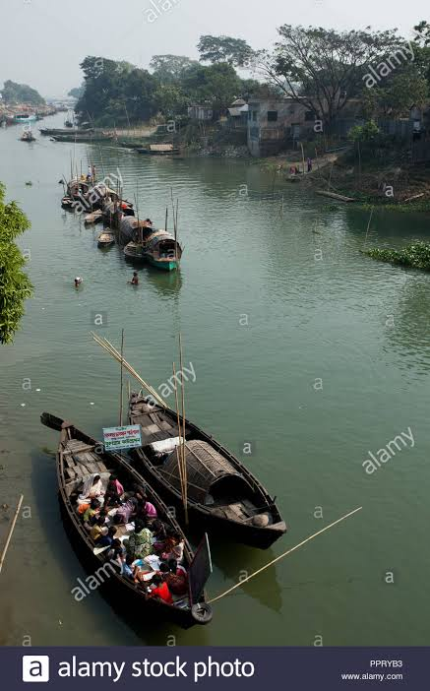
স্বাগতম

Slide 2
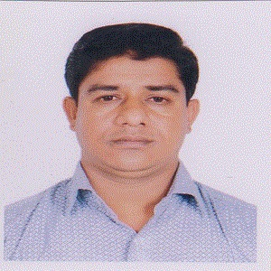
Introduction
Md. Forhad Alam
Assistant Teacher(Computer)
Kurarbazar DBI High School
Beanibazar, Sylhet.
Email:forhadalam79@gmail.com
Unit-7, Lesson-4
Time: 45 Minute

Slide 3
Let us watch a video.
What have you watched in the video?
River Gypsy

Slide 4
Our Today’s Lesson is-
River Gypsies in Bangladesh-2
Unit-7, Lesson-4

Slide 5
After we have studied this lesson. we will be able to…
ask and answer questions…
read and understand the text…
participate them in a short composition.

Slide 6
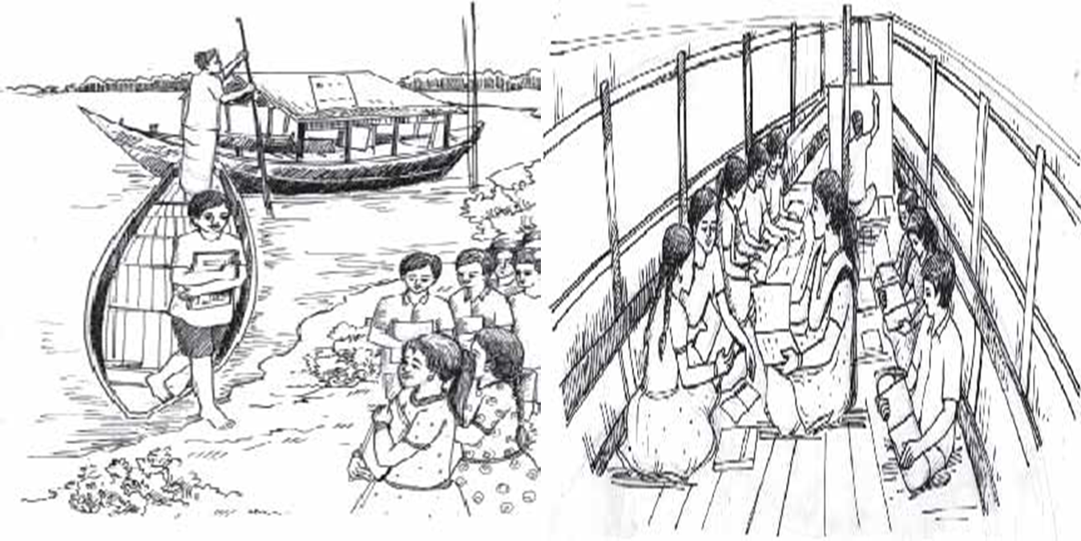
A Look at the pictures. Discuss with your partner and say who they are, where they are, what they are doing, etc.
Notes:
Teacher may ask the students to talk about the pictures with their partners.

Slide 7
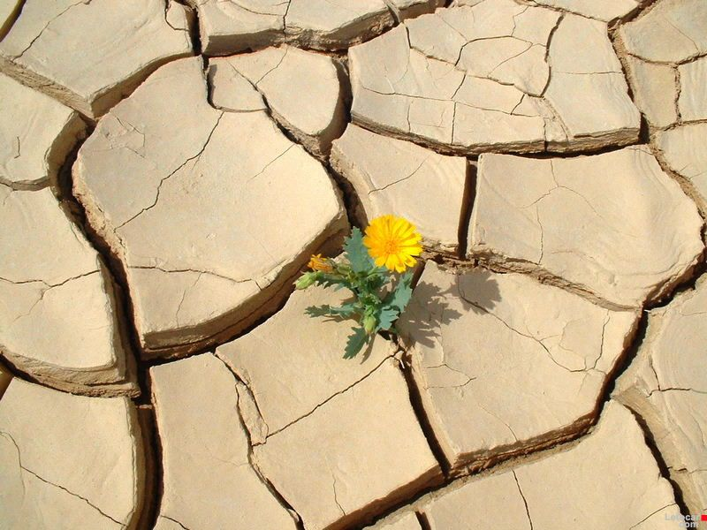
Survive
Meaning : Continue, stay alive, last
How beautifully the flower plant survives in such a rough soil!
Notes:
Teacher may show the word first, then ask the meaning, then he can show the details accordingly.

Slide 8
Used to
Meaning : in the habit of/ habit
I used to play football in my childhood.
Notes:
Teacher may show the word first, then ask the meaning, then he can show the details accordingly.

Slide 9
Inherit
Meaning : Heir, take over, get
She inherited a house from her mother.

Slide 10
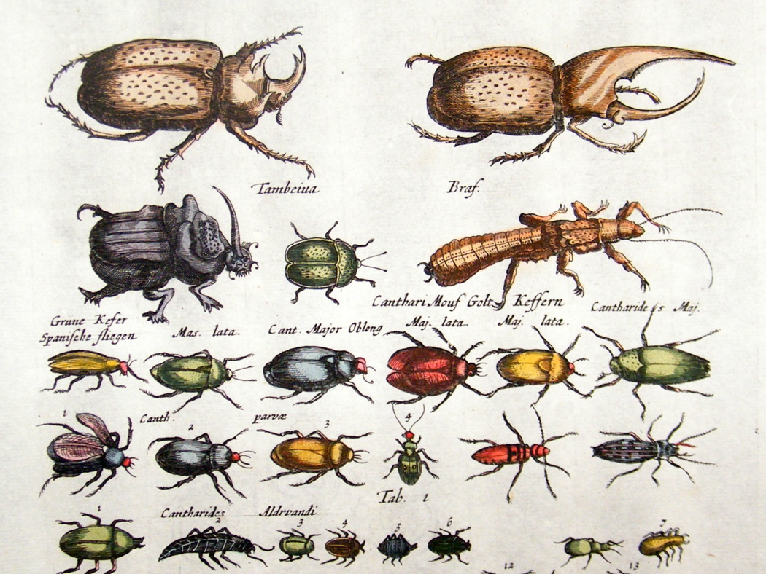
Petty
Meaning : small, miniature, little
All these are petty creatures.

Slide 11
Trick
Meaning : Fake, false, bogus
I have understood your tricks.

Slide 12
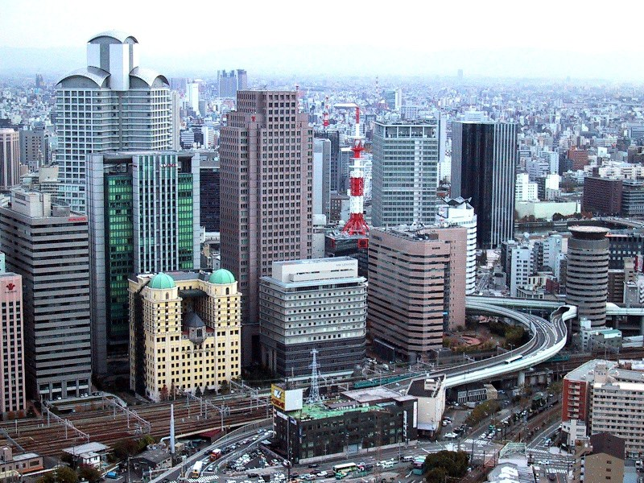
Urban
Meaning : City, town, corporation
We live in an urban area.

Slide 13
B Read the text and answer the following questions.
River gypsies in Bangladesh are having various problems.
Let us see……

Slide 14
Firstly:
Urbanisation

Slide 15
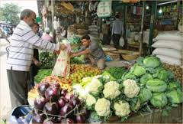
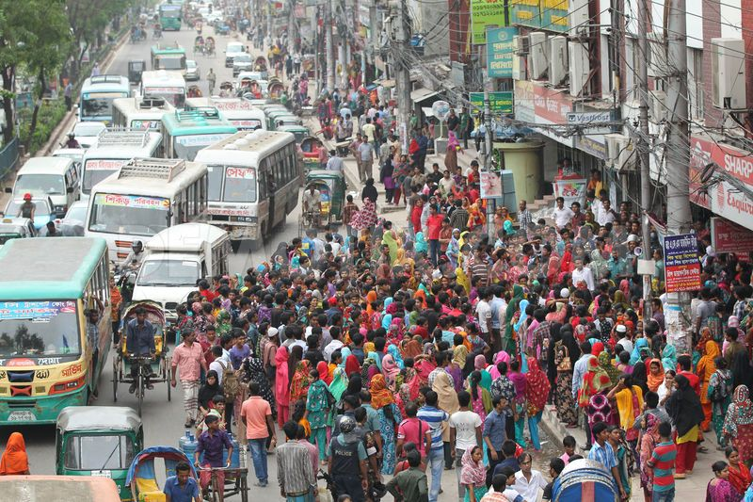
Losing
customer
for urban people.

Slide 16
Individual work
Global climate change---
Has a great effect on gypsy people
Many river gypsies are changing there lifestyle because---
They have accepted the changed reality---
The word “Affect” means---
Damage.
The government is offering them---
Suffrage.

Slide 17
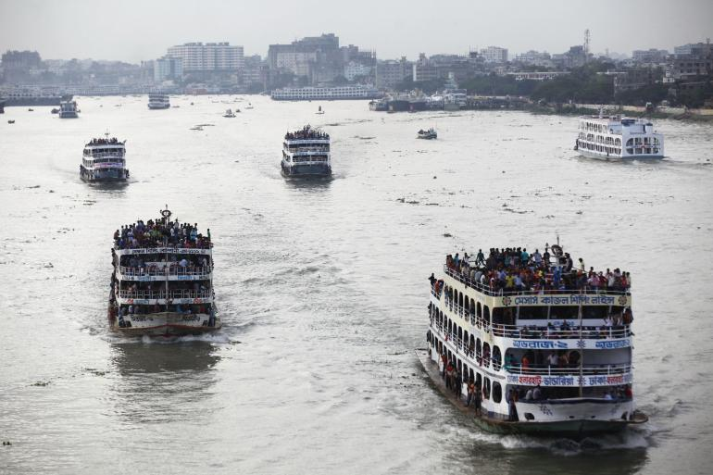
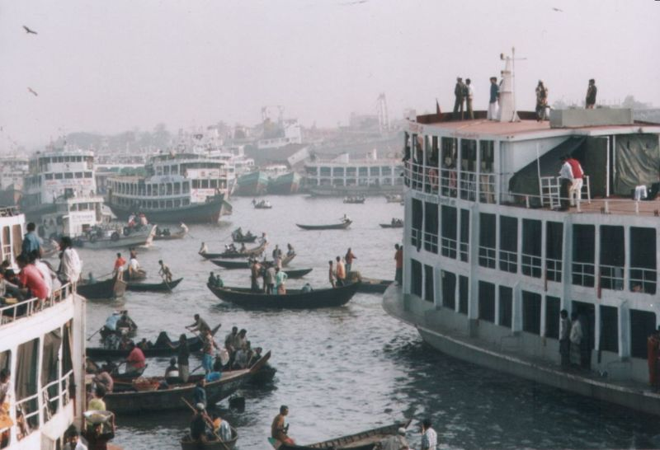
Secondly
Previous waterways
24,000 km
Present waterways
6,000 km
in dry season
Thus waterways are decreasing rapidly which is not favorable to the gypsies.

Slide 18
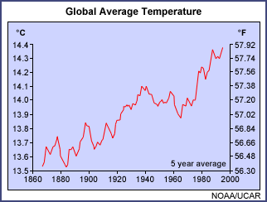
Scientists believe that Bangladesh will be worst affected by global climate change.

Slide 19
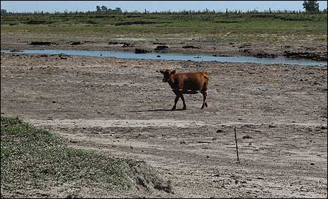
The unpredictable rain and drying out of rivers have made boat movement heavily restricted.

Slide 20
Pair work
1 What are the main problems that river gypsies are facing?
2 What is the effect of global climate change in Bangladesh?
3 Why are many river gypsies thinking of changing their lifestyle?
4 Why can’t river gypsy children go to conventional schools?
5 Who are running special schools for river gypsy children? Why?

Slide 21
Evaluation
How does global climate change affect Bangladesh?
Where are gypsy children born and brought up?
What is mobile boat-school?
Why can’t the gypsy people come to the mainstream of population?

Slide 22
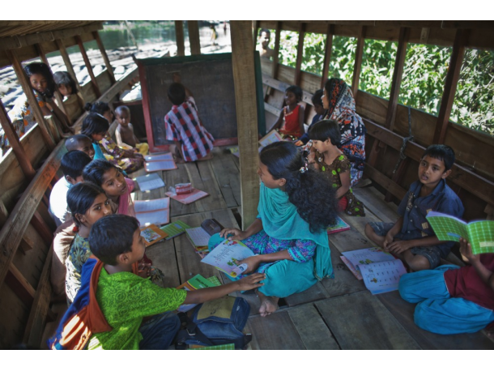
Home Work
Imagine there is a boat-school in your area to teach river gypsy children.
Write a composition about how you can help the gypsy children with learning.

Slide 23
Thank you all.

