Slide 1

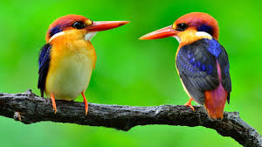

Slide 2



Welcome to all

Slide 3

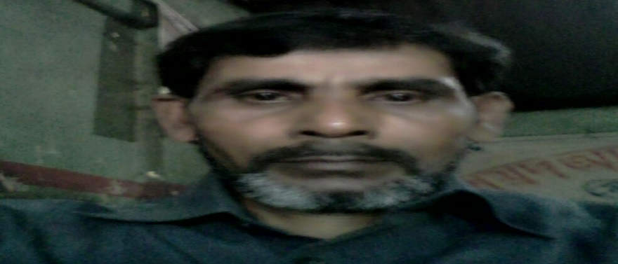
INTRODUCTION
MD ABUL KASHEM
ASSISTANT TEACHER
LAKESHWOR DAKHIL MADRASA
CHATAK SUNAMGNJ
MOBILE 01786498922

Slide 4

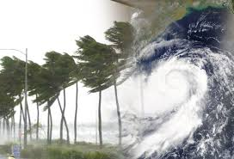
LESSON INTRODUCTION
LESSON:2-3: CYCLONE AILA
UNIT:24
CLASS: FIVE
TIMES: 50 MINITES
DATE:28/11/2019

Slide 5

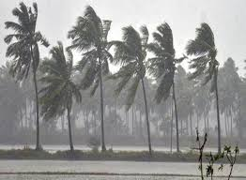
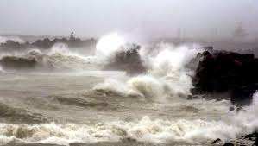
LOOK, LISTEN AND SAY
THE WIND IS BLOWING
THE SEA IS RISING

Slide 6

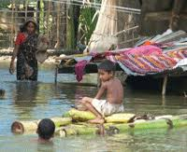
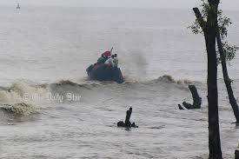
The river is rising
The sea is rising

Slide 7
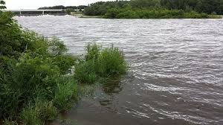
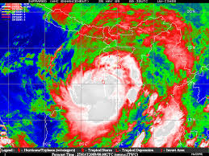
The river is flooded the field
The Cyclone Aila

Slide 8

Learning outcome
To describe about the Cyclone Aila
To compare cyclone and storm
To explain how does damage houses and trees

Slide 9
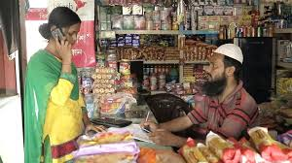
Ideal Lesson-Read loudly
Babul’s father had a grocery shop and his mother worked in a fish farm.They hsd a small house that they shared with Baabui’s grandparents. Babul was just a baby, but his sister Nipa was six years old.

Slide 10
Look at the picture and say .What is it?

Slide 11
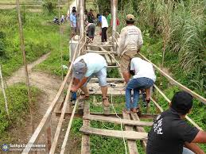
What are they doing ?

Slide 12
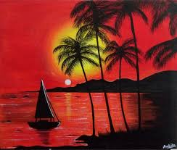
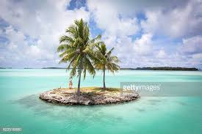
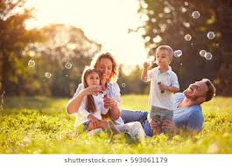
Cyclone
ঘুর্নিঝড়
মুদির দোকান
Grocery shop
সন্ধ্যাবেলা
Evening
দ্ধীপ
Island
পরিবার
Family

Slide 13
Correct pronounciation the words
Cyclone Aila , Ialand, Afternoon, Grocery shop, Plastic

Slide 14
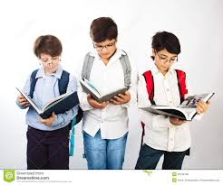
GROUP WORK
1.Where babul’s family live on?
2.What did babul’s father ?
3.How old is Nipa ?
4.What did babul’s mother ?

Slide 15

Evaluation
Matching Column A with Column B
Column A
Column B
Wind is blowing
Repairing the bridge
The river is rising

Slide 16
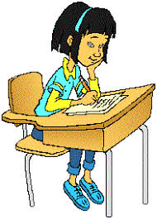
HOME WORK
Write a paragraph more than 50 words about Cyclone Aila .

