Slide 1
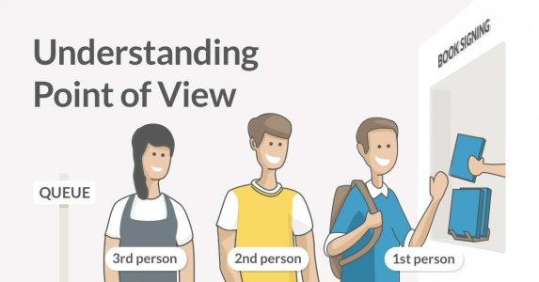
WELCOME

Slide 2
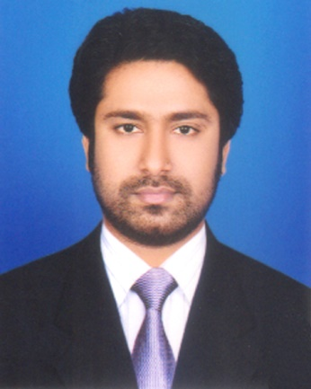
Presented by
M Humayun Kabir
English Teacher
Bhayeta Abdul Quddus Dakhil Madrasah, Tangail Sadar
Cell : 01727-425565 ; 01924-320532
E-mail : hkabir082009@gmail.com

Slide 3
Lesson Identity
A. Tense - Present Simple-2 (Part-A)
Class Six
Unit Six
31 October 2019

Slide 4
Learning outcomes
After we have studied this lesson, we will be able to
know about the use of ‘s or es’ with verbs.
clear the Number and Persons and
use the Third Person Singular Number.

Slide 6
Let’s Start our Today’s Topic

Slide 7
TOPIC
Present Simple with
Third Person Singular Number
Subject : English 2nd Paper
Lesson : 6.2 (Part-A)
Period : 3rd
Time : 40 minutes
Date : 31 October 2019

Slide 8
Let’s Try to Learn from the Video

Slide 9
Person
1st Person
2nd Person
3rd Person
I, We
You, You
He, She, It
(Sami, Meena, Cat)

Slide 10
3rd Person
Singular Numbers
He, She, It and their names. Such as-
He = Sami, Father, Brother but not Brothers etc.
She = Meena, Mother, Sister but not Sisters etc.
It = Cat, Mobile phone, Pen but not Pens etc.

Slide 11
The Use of “s / es”
N.B: I, We, You, You, They = Not s/es with verb.
He, She, It, Sami, Meena, Cat = But s/es with verb.
(s/es only for Present Simple Tense.)

Slide 12
Where “s / es” ?
Verb + o, ss, sh, ch (চ), x, y, z = es (otherwise ‘s’)
Go – goes ; Do – does; Miss – misses; Brush – brushes; Search – searches; Mix – mixes; Buzz – buzzes.
Consonant + y = -ies : Try – tries ; Cry – cries
(But, Play – plays; Pray – prays)

Slide 13
Practical Use with Present Simple
1. He recites a poem. =
সে একটি কবিতা আবৃত্তি করি।
2. He
doesn’t
recite a poem. =
সে একটি কবিতা আবৃত্তি করে না ।
3.
Does
he recite a poem ? =
সে কি একটি কবিতা আবৃত্তি করে ?
4.
Doesn’t
he recite a poem ? =
সে কি একটি কবিতা আবৃত্তি করে না ?
5.
What
does he recite ? =
সে কী আবৃত্তি করে ?
6.
What
doesn’t he recite ? =
সে কী আবৃত্তি করে না ?

Slide 14
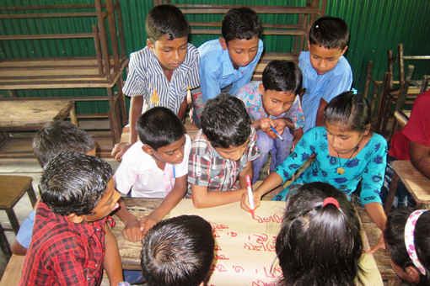
Group Work
Let’s Try to Find out
s / es
with Present Simple
from this Video
and write down.

Slide 15
Let’s Watch a Video

Slide 16
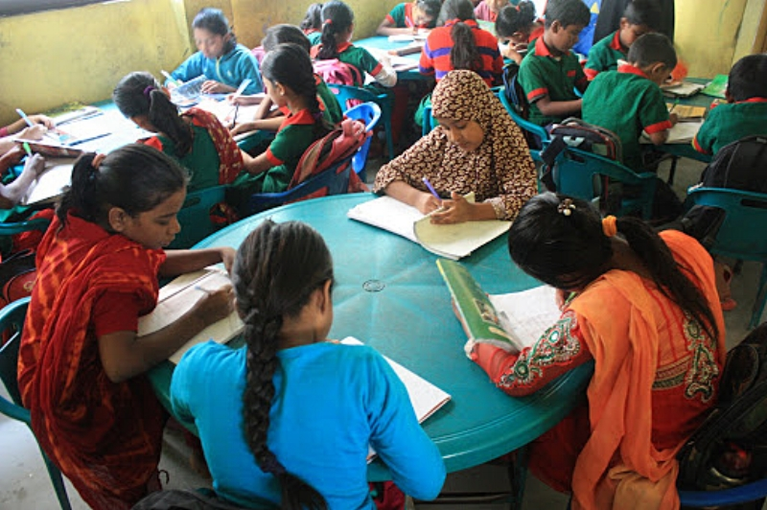
Individual Work
Make sentence using the Present Simple Tense with following persons
She …
Mother …
Sami …
Our teacher …
The internet …

Slide 17
Assessment
Open your Text Book and find out the
‘s / es’
with Verbs / Present Simple.

Slide 18
Home Task

Slide 19
Assignment
Make a note on
Present Simple with following
Persons and Verbs-
He / want …
She / give …
It / do …
Ayesha / drink …
Al-amin / eat …

Slide 20
Thank You All
May Allaah swt learn and expert in the Use of Persons.

